Slide 1
Qualifying work experience
Benedict Fisher, SRA
Richard Williams, SRA

Slide 2
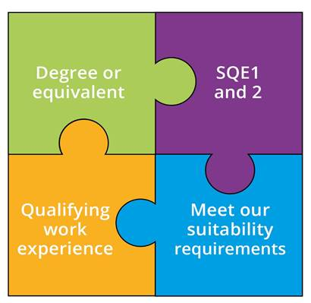
The new way of qualifying
Notes:
If you attended earlier sessions, you will recall the 4 piece jigsaw slide – QWE fundamental part of qualification as a solicitor.
But before I do that – I just wanted to quickly remind you constitutes a QWE placement it is……
We don’t prescribe what full time or part time is
There is no minimum or maximum prescribed length for each individual placement
Just to remind people that QWE can be confirmed by signed off a solicitor within the organisation where QWE placement is taking place or a solicitor outside of the organisation who has direct experience of individuals work.,

Slide 3
QWE – the key facts
Qualifying work experience must:
be providing legal services for two years (full time or equivalent)
enable you to develop some or all of our the competences (in Statement of Solicitor Competence)
be confirmed by a solicitor or Compliance Office for Legal Practice (COLP) – they are not ‘signing off’ whether someone is competent.
You can do it in:
up to four different organisations
in a range of organisations such as law firms, law clinics, or in-house. Can be outside a regulated firm and can be done overseas
Notes:
If you attended earlier sessions, you will recall the 4 piece jigsaw slide – QWE fundamental part of qualification as a solicitor.
But before I do that – I just wanted to quickly remind you constitutes a QWE placement it is……
We don’t prescribe what full time or part time is
There is no minimum or maximum prescribed length for each individual placement
Just to remind people that QWE can be confirmed by signed off a solicitor within the organisation where QWE placement is taking place or a solicitor outside of the organisation who has direct experience of individuals work.,

