Slide 1
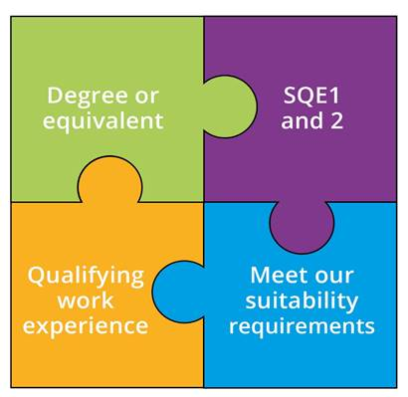
What is the SQE?
A single, robust, examination all aspiring solicitors will have to take
To be introduced 1 September 2021
Everyone will meet the same high standards in a consistent way
We will no longer specify routes to admission as a solicitor

Slide 2
Qualifying work experience
At least 2 years’ experience of legal services, confirmed by a solicitor
Working in law clinics and law firms, as a paralegal and a trainee
No more than 4 different organisations – can be abroad
Delivering legal services; developing some or all of required competences
No requirement for 3 practice areas

Slide 3
SQE1
Functioning Legal Knowledge Assessments
Two 180-question examinations - 10 hours in total
FLK - test ability to identify legal principles and apply them to client problems and transactions
Unflagged ethics questions throughout

Slide 4
SQE1
Functioning Legal Knowledge Assessments
FLK1
FLK2
Business Law and Practice
Dispute Resolution
Contract
Tort
Legal System of England and Wales
Public Law
Legal Services
Property Law and Practice
Wills and Admin of Estates
Solicitors Accounts
Land Law
Trust
Criminal Law and Practice

Slide 5
SQE2
Practical legal skills assessments
+
16 written and oral tests - 14 hours in total
Simulating tasks carried out by a solicitor in practice
Tests practical legal skills and functioning legal knowledge equally
Unflagged ethics questions throughout

Slide 6
SQE2
Practical legal skills assessments
Six skills assessed
Client interviewing and attendance note
Advocacy
Case and matter analysis
Legal research
Legal writing
Legal drafting
Across five contexts
Criminal Litigation
Dispute Resolution
Property Practice
Wills and Intestacy, Probate Administration and Practice
Business organisation rules and procedures

Slide 7
SQE website
Launched 11 May - sqe.sra.org.uk
Source of all SQE assessment related information for all stakeholders
Designed with the focus on the candidate but with input from and information for all stakeholders

Slide 8
SQE website – what is covers
What the SQE is
Preparation –
Assessment Specifications
sample questions
dates of assessments
what to expect on the day of assessments
Notes:
Yiannis

Slide 9
SQE website – what is covers
Steps needed to take the SQE
registration and booking
payment methods
policies such as reasonable adjustments
After the assessment – results, booking next assessment
Help and support – candidate services team, policies
Notes:
Yiannis

Slide 10
Registration and booking
Registration will open in early/mid July
Individual candidate must create an SQE account
Pre-booking steps
diversity survey
registering exemptions
requesting reasonable adjustments
Notes:
Yiannis

Slide 11
Registration and booking
Nov SQE1 bookings to open later in July
We will alert the market when registration and booking will be open via the website and social media
Notes:
Yiannis

Slide 12
Bookings for candidates
Select a test centre
Payment method to complete booking
Payment by card
Use of a pre-paid voucher
Booking by employer or training provider

Slide 13
What to expect on the day

Slide 14
Assessment dates update
SQE1 dates for 2021
8 November (FLK1)
11 November (FLK2)
First SQE2 will be in April 2022
Written part: 11-13 April
Oral part, first sitting: 19-20 April
Oral part, second sitting: 21-22 April
Notes:
Zoe

Slide 15
Assessment dates update – SQE1
Regular pattern of SQE1 dates from 2023
Two sittings in 2023 - January and July
Continue to monitor demand for introducing additional SQE1 sittings
Add sittings when appropriate, for example, in April and October
Notes:
Zoe

Slide 16
Assessment dates update – SQE2
Regular pattern of SQE2 dates from 2023
Two sittings in 2023 - in April and July
Rising to three SQE2 sittings in 2024 (January, April and July)
Ultimately four SQE2 sittings (January, April, July, and October) when appropriate
Notes:
Zoe

Slide 17
SQE assessment dates update
Candidate journey: allows candidates that pass SQE1 to book the next available sitting of SQE2
Advance notice
Assessment dates: 12 months in advance
New assessment window: 18 months in advance
Notes:
Zoe

Slide 18
Results timings
SQE1
6-10 weeks
SQE2
14-18 weeks
Notes:
Zoe

Slide 19
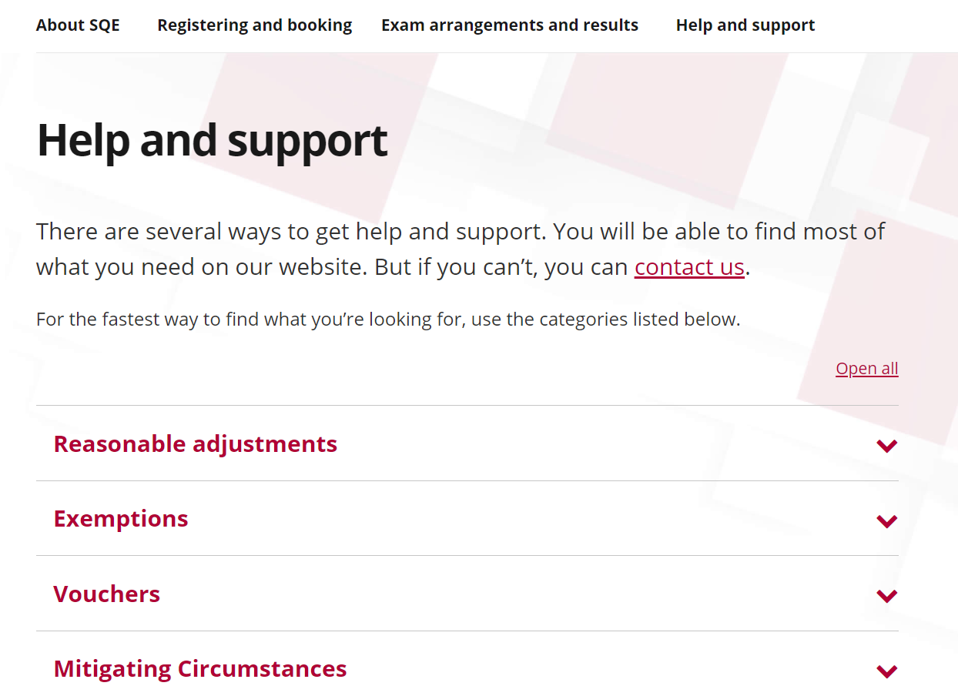
Help and support
sqe.sra.org.uk/help
Notes:
Yiannis

Slide 20
Further resources
For info on SQE assessment:
sqe.sra.org.uk
or contact
Candidate Services
Follow us on Career in Law
For info about wider qualification: sra.org.uk/sqe
or contact
sqe@sra.org.uk

