Slide 1
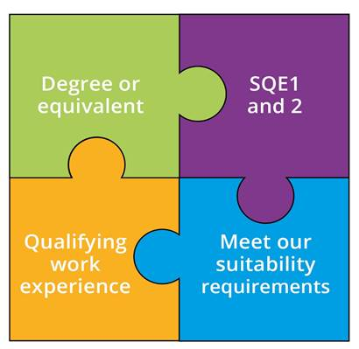
What is the SQE?
A single, robust, examination all aspiring solicitors will have to take
To be introduced 1 September 2021
Everyone will meet the same high standards in a consistent way
We will no longer specify routes to admission as a solicitor
Notes:
SQE 2 only after passing SQE 1

Slide 2
Qualifying work experience
At least 2 years’ experience of legal services, confirmed by a solicitor
Working in law clinics and law firms, as a paralegal and a trainee
No more than 4 different organisations – can be abroad
Delivering legal services; developing some or all of required competences
No requirement for 3 practice areas
Notes:
Sign off to confirm completion of QWE, not to assess that standard has been met
Focus on developing the competences in the Statement of Solicitor Competence

Slide 3
SQE website
Launched 11 May - sqe.sra.org.uk
Source of all SQE assessment related information for all stakeholders
Designed with candidate and other stakeholder input
Notes:
Yiannis

Slide 4
SQE website – what is covers
What the SQE is
Preparation –
Assessment Specifications
sample questions
dates of assessments
what to expect on the day of assessments
Notes:
Yiannis

Slide 5
SQE website – what is covers
Steps needed to take the SQE
registration and booking
payment methods
policies such as reasonable adjustments
After the assessment – results, booking next assessment
Help and support – candidate services team, policies
Notes:
Yiannis

Slide 6
Registration and booking
Registration will open in early/mid July
Individual candidate must create an SQE account
Pre-booking steps
diversity survey
registering exemptions
requesting reasonable adjustments
Notes:
Yiannis

Slide 7
Registration and booking
Nov SQE1 bookings to open later in July
We will alert the market when registration and booking will be open via the website and social media
Notes:
Yiannis

Slide 8
Employer / training provider booking and payment
Bulk purchase vouchers and issue to candidates
Using card payment, no credit check
via CS team, credit check and invoiced
Bulk bookings via CS team, credit checked and invoiced
Employers and training providers can request credit checks and processed when registration opens
Notes:
Zoe

Slide 9
Assessment dates update
SQE1 dates for 2021
8 November (FLK1)
11 November (FLK2)
First SQE2 will be in April 2022
Written part: 11-13 April
Oral part, first sitting: 19-20 April
Oral part, second sitting: 21-22 April
Notes:
Zoe

Slide 10
Assessment dates update – SQE1
Regular pattern of SQE1 dates from 2023
Two sittings in 2023 - January and July
Continue to monitor demand for introducing additional SQE1 sittings
Add sittings when appropriate, for example, in April and October
Notes:
Zoe

Slide 11
Assessment dates update – SQE2
Regular pattern of SQE2 dates from 2023
Two sittings in 2023 - in April and July
Rising to three SQE2 sittings in 2024 (January, April and July)
Ultimately four SQE2 sittings (January, April, July, and October) when appropriate
Notes:
Zoe

Slide 12
SQE assessment dates update
Candidate journey: allows candidates that pass SQE1 to book the next available sitting of SQE2
Certainty: as far as possible aiming to start assessments for each relevant assessment window as follows:
SQE1: third week of the month
SQE2: final week of the month
Notes:
Zoe

Slide 13
SQE assessment dates update
Advance notice:
Assessment dates: 12 months in advance
New assessment window: 18 months in advance
Notes:
Zoe

Slide 14
Results timings
SQE1
6-10 weeks
SQE2
14-18 weeks
Notes:
Zoe

Slide 15
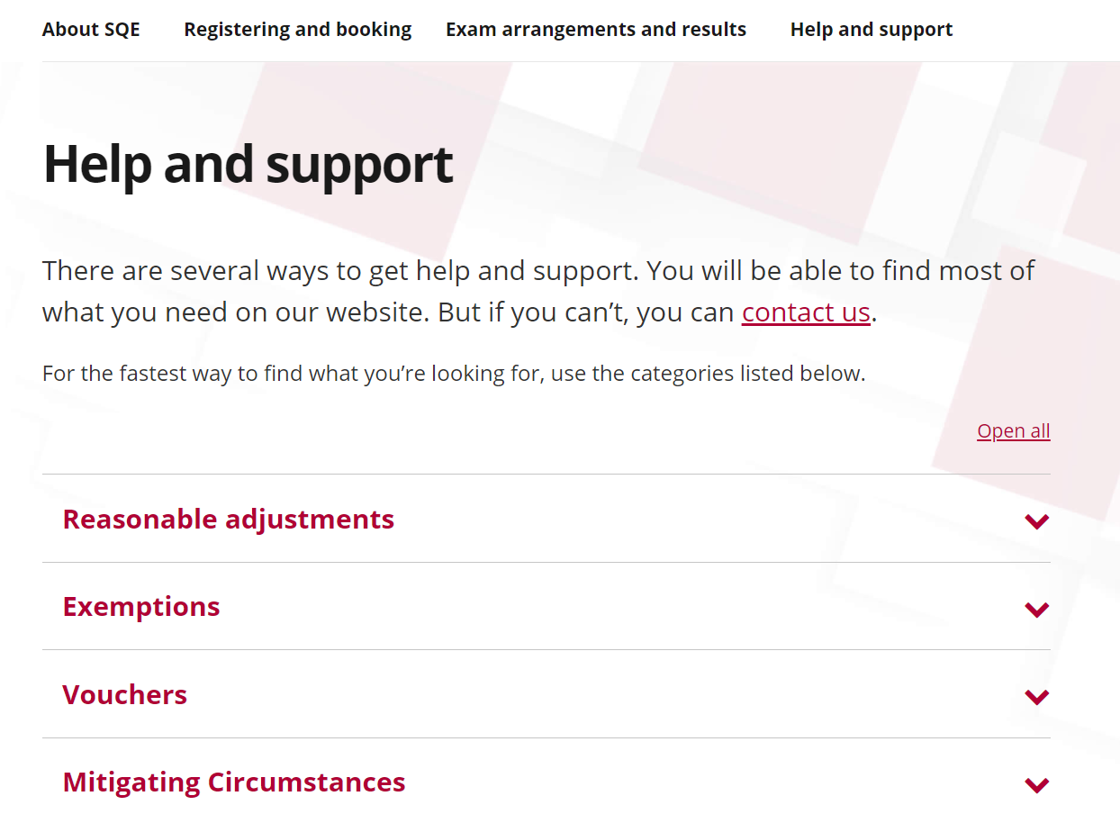
Help and support
sqe.sra.org.uk/help
Notes:
Yiannis

Slide 16
Keep in touch
For info or queries on SQE assessment:
sqe.sra.org.uk
Join our SQE LinkedIn group
Monthly SQE
Update bulletin sra.org.uk/sqeupdate
For info about wider qualification
sra.org.uk/sqe

