Slide 1
Complying with sanctions and financial crime regulations
Clive Myrie, Journalist and broadcaster (Chair)
Colette Best, Director of Anti-money Laundering, SRA
Suzie Ogilvie, Global Head of Financial Crime and Sanctions, Freshfields Bruckhaus Deringer LLP
Giles Thomson, Director, Office for Financial Sanctions Implementation and Economic Crime, HM Treasury

Slide 2
Why it matters
More than £12 billion criminal cash generated annually in the UK
Increased threats of bribery, child sexual abuse and drugs
550,000 – 850,000 individuals posing a risk to children
£19 billion cost to the UK from illegal drugs
Notes:
The onslaught of anti-money laundering and financial crime legislation and regulations can feel relentless. We’ve seen new MLRs every year, plus frequent changes to corporate transparency requirements, criticisims of poor quality SAR reporting and of course financial sanctions
So it’s helpful to step back and remember why we’re doing this
Would recommend you look at the NCA assessment of strategic and organized crime
https://www.nationalcrimeagency.gov.uk/who-we-are/publications/533-national-strategic-assessment-of-serious-and-organised-crime-2021/file

Slide 3
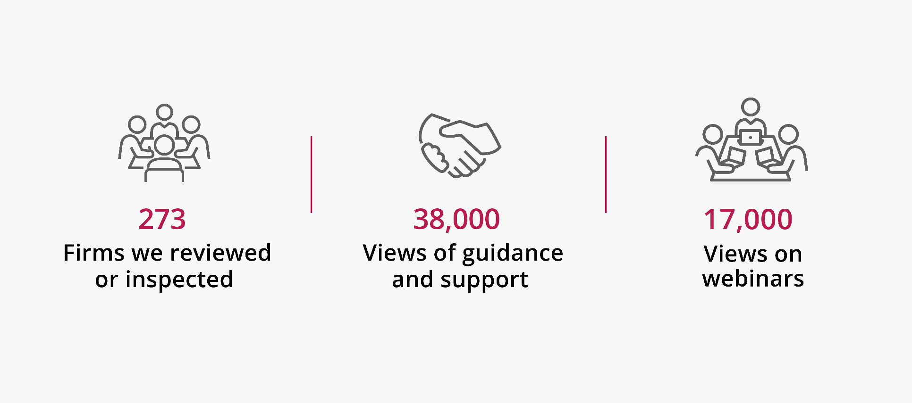
What did we do?
Notes:
All this covered in annual report – more detail on themes and areas for improvement
thank you to all the firms involved in our inspections and desk-based reviews over the last reporting year. While we have a responsibility to undertake this work, and firms have a duty to co-operate, we do appreciate the disruption this can cause, and flexibility required. I’m pleased to report that the majority of firms continue to find these exercises useful and in particular, the feedback they receive and assistance in improving their controls if necessary.
126 rolling inspections
13 FI
25 thematic
109 DBRs
LSAG guidance been updated, waiting for HMT approval. Includes guidance on PF
In the last year have published guidance for MLROs/MLCOs
Guidance on who the regs apply to
Lots of webinars online
Lots of good practice but some areas where firms are still struggling
Assessing risk
Controls

Slide 4
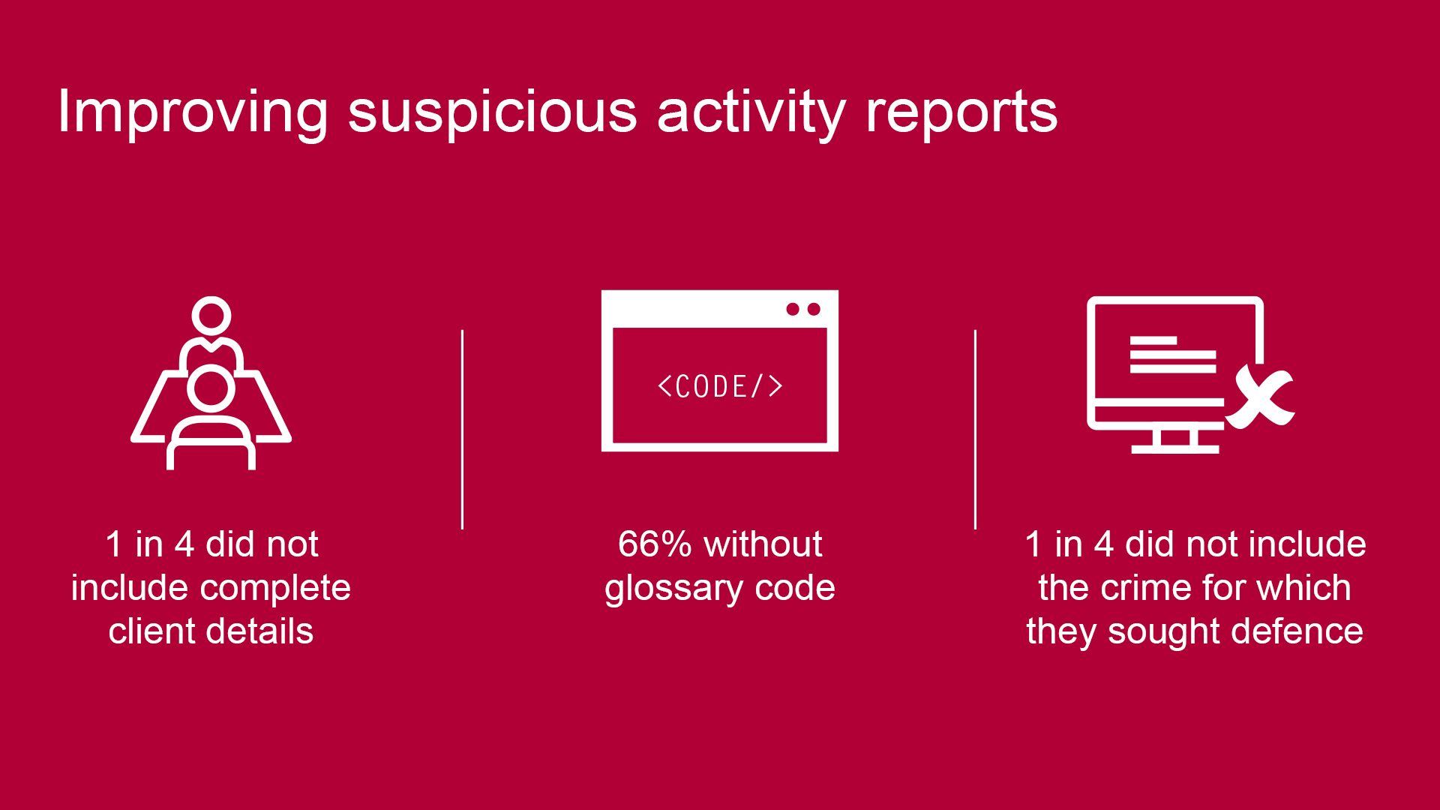
Suspicious activity reports (SARs)
Notes:
12 months of data from onsite inspections
Over two-year period, firms had submitted 2 DAMLs and one information SAR
Problems with quality?
Glossary codes
Client contact details
The act for which you’re seeking a defense

Slide 5
Sanctions
Applies to all
Strict liability
Guidance published setting out how to comply
Make sure you identify your clients and seeking licences
Does your firm have the right controls in place?
Do staff know what they are?

Slide 6
Sanctions – challenges and
‘bear traps’
Suzie Ogilvie
2022

Slide 7
Some of the challenges presented
Speed of change
Level of due diligence required into ownership and control
Circumvention and facilitation risks, and the lack of clarity in circumstances where divestments of shareholdings have been made by designated persons.
Where sectoral sanctions apply, thorough and ongoing analysis of sanctions is necessary.
Not just about sanctions list searches – (a) need to look at ownership and control and (b) consider the sectorial and trade measures
US secondary (or extra-territorial sanctions)

Slide 8
Some considerations
Can you identify any designated persons (DPs) within the shareholding or board structure of any of the parties to the matter?
Has any DP recently reduced any shareholding in a party to the matter as a result of the actual or threatened imposition of sanctions?
Any ‘secrecy countries’ in the ownership structure?
Consider how your new business intake works? How do you capture client and counterparty risks (including OFAC designations)? How can you build in alerts to capture sectoral sanctions?
If so, what is their percentage interest and/or position? Are there any possible relationships with others in the shareholding structure?
Sign up to the email alerts

Slide 9
Some considerations
Have you been given assurance by a party that might have once been owned or controlled by a DP that they are no longer so owned or controlled? If so, were there any assumptions or limitations?
In respect of the proposals themselves are there any other links to any DPs e.g. share pledges, interest payments, bank accounts?
Is there a transfer of, or change in any financial obligations, in favour of a Russian, or Russian-linked, person?
Are you dealing with a newly incorporated entity or unknown person where source of wealth and funds in unclear?
Could there be sanctions or POCA reporting issues?

