Slide 1
Continuing competence – creating the best approach for your firm
Jane Malcolm, Executive Director, SRA (Chair)
Karen Bailey, Owner, Bailey Wright & Co
Sarah Hardy-Pickering, Head of Learning and Development, Weightmans LLP
Karen Minns, Policy Manager, Regulatory Policy, SRA
Julie Swan, Director of Education and Training, SRA

Slide 2
Jane Malcolm, Executive Director,
External and Corporate SRA (Chair)

Slide 3
Karen Minns, Policy Manager, Regulatory Policy, SRA

Slide 4
1. Reflect
Think about your practice to identify learning and development needs
When to reflect
Questions to help you reflect
Use the competence statement and other resources on the website

Slide 5
2. Identify
Reflection helps you identify your learning and development needs and how to address them.
Use the competence statement to help with reflection and help identify any gaps
Your needs are personal to you
Use this process to build strengths and meet goals as well as addressing weaknesses

Slide 6
3. Plan and address
Formal training
In-house training
Shared learning
Feedback
‘Informal’ training
Research, reading, discussion
File review

Slide 7
4 and 5. Record and evaluate
Record activity undertaken to address your learning and development needs
Demonstrate to us and your employer that you are addressing your development needs
Evaluating helps identify any key points where further learning and development is required

Slide 8
Role of firms
All SRA firms must ensure that managers and employees are competent and keep up to date
We can investigate where there are serious or repeated or persistent complaints about competence about a firm
Firms need systems and processes in place to ensure competence of solicitors and employees

Slide 9
Julie Swan, Director of Education and Training, SRA

Slide 10
Ongoing work
Legal Services Board review
How do we maximise our current approach:
  Thematic reviews
  Training record reviews
  Clearer standards and resources
  Better use of available data
Notes:
Ongoing work and LSB work – JS
I am going to give a quick overview of our work in this area and share some of our thinking with you about our strategic direction in relation to continuing competence.
Professional learning and development is a dynamic area- roles and area of practice require new skills, there are new ways of accumulating knowledge and higher demands from consumers that solicitors are competent - so it’s only right we continue to refine and enhance our approach to competence.
We know firms value the flexibility to align training to business needs and models and to take advantage of the freedom in approaches to learning and development – there isn’t a clamour for more prescriptive rules in this area.
But there is a lot of interest in this area at the moment, particularly due to a review that has been undertaken by our oversight regulator, the LSB.
The LSB has set a series of outcomes legal regulators that it expects us and other legal services regulators to meet over the next 18 months to ensure that we are assured that those we regulate remain competent throughout their careers with a view to seeking to minimise harm from incompetence for consumers.
At this stage we do not think that the LSB’s work will lead to a significant change to our overarching framework for ongoing competence – so we don’t intend to change our competence statement in response to the LSB work or, for example, revert back to the old hours-based/CPD approach.
The key question for us is what more we can do within our existing framework for ensuring competence to get greater assurances from solicitors and firms that they are meeting our requirements. Within the existing framework -
We already undertake checks of firms and the systems they have in place to ensure the competence of solicitors and staff in high risk areas or areas where we think we need to know more through our ongoing thematic review work – we have recently looked at immigration firms and are looking at how solicitors working in-house meet their competence obligations.
And we have called in training records in those practice areas where evidence suggests there are issues with competence – we looked at those working in the Youth Courts last year and we are currently looking at the training records of solicitors practising in magistrates and higher courts
We also articulate the standards we expect of solicitors in common or high-risk practice areas- we have already done this for solicitors practising in the coroners court and will shortly consult on behaviours we expect of those working in the youth courts. This will help solicitors working in these areas focus their learning and development and help clients recognise what to expect.
We have updated the resources on our website, for example, by creating the new learning and development template Karen mentioned, and by more clearly setting out our expectations for firms. We will also be adding new case studies to support understanding of how to meet our requirements.
We are looking at making better use of the data us and other organisations such as LeO hold to see how this could indicate issues with a firms’ training and development.
A focus throughout our work in this area is ensuring that we are targeted, proportionate and risk based in our approach and that we are supporting you in meeting the requirements. So we will not be acting in this area without evidence that shows there is a need for us to do so.
We are planning to respond to the LSB early next year to set out how and where we meet its objectives and our proposals for how we intend to address any areas where we think there could be more for us to do.

Slide 11
Karen Bailey, Owner, Bailey Wright & Co

Slide 12
Continuing Competence
Sarah Hardy-Pickering
Head of Learning and Development
0151 242 6980
Sarah.Hardy-Pickering@Weightmans.com
Notes:
When my Dad became a vicar later in his life, he asked the Archdeacon (or Archdemon as they were known in our house) for advice on his first sermon. After a lengthy pause, the Archdeacon replied, “about God and about ten minutes”. I am using this as a benchmark and will attempt to speak about continuing competence and for about ten minutes

Slide 13
To be continuingly competent, you need to
Take responsibility for your own learning and development
Reflect and learn from yourself and others
Accurately evaluate your strengths and limitations re demands of work (not at home re who does the bins and laundry…)
Maintain an adequate and up to date understanding of relevant law, policy and practice
Adapt your practice to address developments in the delivery of legal services
Notes:
These come from the SRA competence statement and in my view very clearly places the responsibility on the Solicitor…

Slide 14
So how do we do this?
Obviously we do it carefully……!
Notes:
We use the steps suggested to process map… soooooo Steps… (pause before next slide)

Slide 15




Steps…
Notes:
Errr - Not this Steps

Slide 16
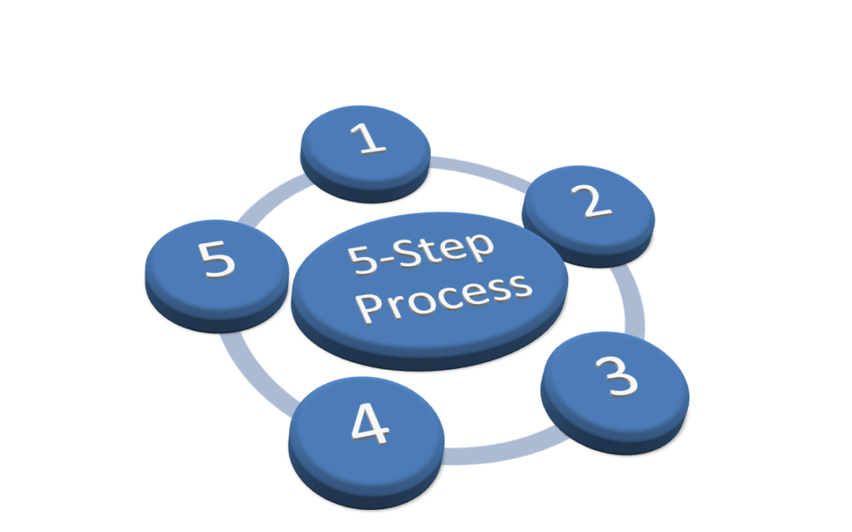

Steps…
Notes:
Or even these steps

Slide 17
Steps…
Notes:
But this…a five step process

Slide 18
These steps…
Reflect
Identify
Evaluate
Plan & address
Record

Slide 19
…And the competence statement
There are 91 competencies…..but you all know that…
I was not planning on “testing” you on them
Notes:
There are four broad themes:
Ethics, professionalism and judgement (5 subheadings)
Technical legal practice (7 subheadings)
Working with other people (3 subheadings)
Managing themselves and their own work (3 subheadings)

Slide 20

Notes:
And then we design our training plan, development offerings and support around the steps and the statement
Easy Peasy Lemon Squeezy
or
Difficult Difficult Lemon Difficult?

Slide 21
If you get the first two steps right…
… the rest is “just” logistics
Notes:
I am going to concentrate on “Reflect” and “Identify” as these are often seen as the hardest to define and measure

Slide 22



“Reflect”
Notes:
The easiest way to do this is to normalise reflective and development conversations in your “one to ones” and discuss:
What has gone well and why?
What could have been “better” and why?
What will you do differently next time?
So what is going well – thumbs up
What is not going so well – something out of date and fishy in the fridge that needs dealing with
What will you do differently next time and what support do you need – your shopping list of development areas

Slide 23
“Identify”
What do I need and where can I find it?
Learning Management System/Intranet
Training schedule
Learning and Development team
Management and talent programmes
Technical training
Business Skills training
External training and events
Find and read some stuff
Notes:
You have your shopping list of dev needs
Next step – who “stocks” this stuff???
Try… (see list above)

Slide 24

Address it…
Notes:
You can be as self reflective as you like, and identify what needs finessing… you then need to actually do something about it!
You know what you need and where to get it so time to address it i.e. buy it”
Our resources vary depending on the size of our firm and our corporate structures – but there is nothing more a L and D person loves than talking to others about how fabulous L and D is and what they do so find a friendly one and have a chat.
There is free stuff out there

Slide 25
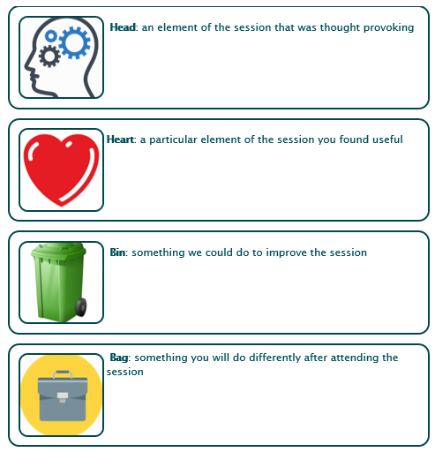
A gift…
Notes:
We use this as a self reflective feedback sheet after we have delivered training or had a development “intervention”

Slide 26

Notes:
PS Don't forget to record it!
If it is not recorded it is as if it never happened
We are lawyers – record it, write it down, save it, save it again…
And yes – this is hard to monitor as it relies on the individual (we have to nag at least every three months re this)

Slide 27


Be more Auntie Lillie
Notes:
You may be able to have LLB (Hons) and MA and Solicitor and and and after your name but you can never have FYE after your name..
Sat what FYE is

Slide 28

Phew…

