Slide 1
Cybercrime – protecting your firm
Robert Loughlin, Executive Director, SRA
William Wright, Paragon Insurance
James Moss, ICO
Rachel Clements, SRA
NCSC Senior Representative

Slide 2
Today’s session
Current risks
Information security and data protection
Cyber insurance
Current trends in reports
Resources from the NCSC
Summary and close
Notes:
ROBERT: Introductions
Welcome to our Compliance Conference session on cybercrime.
Just to remind you – please do not film or photograph the session – slides and a recording of the session will be available on our website.
We have a packed session for you today which will cover all the key issues you need to know around
cybersecurity risks,
information security,
cyber insurance,
Reporting and trends in reports
And guidance and resources for your firms
And then its over to you for questions for our panel.
But first lets take a quick look at the current picture in terms of risks:-

Slide 3

Current risks
An improving picture
Data protection
Report, report, report!
Notes:
ROBERT-
If we reflect back on the year since our last conference we can see that it’s still another time of high uncertainty.
With headlines full of economic crises, high inflation, energy costs and political upheaval, there are still some constants in life - which includes cybercrime.
One of our key messages today is that reports haven't really changed – however high risks remain.
There are two pieces of good news: The first is that we haven't seen any rise in reports coming in to us. The second is that we are seeing more evidence that firms are successfully defending themselves – which is good to see.
The bad news is that we don’t know if reporting rates are lower because cyber attacks are decreasing and there is plenty of evidence that phishing emails and ransomware attacks are a key risk for firms and clients.
However, on the whole despite earlier concerns about Russian cyber attacks following the war in Ukraine - the current picture is stable.
Overall keep doing what you are doing. We know cyberattacks can happen to anyone, and do – firms are increasingly reducing the damage, or even fending off attacks altogether. However this relies on your systems and procedures.
So our message for today really is don't have nightmares – but do continue to be vigilant and report risks to us.

Slide 4
Cybercrime: panel session
James Moss, Legal Director, Information Commission’s Office
William Wright, Partner and Director, Paragon Insurance
Rachel Clements, Regulatory Manager, SRA
Senior representative, NCSC
Notes:
Robert:
And so now its time to move on to our panel discussion.
We are delighted to welcome our panel with speakers from the insurance industry, the Information Commissioner's Office, the SRA and finally to wrap up our session - the NCSC with sources of advice and support.
Introduce James Moss, from the ICO

Slide 5
Information Commissioner’s Office

Slide 6
ICO position on ransomware
Law enforcement do not encourage, endorse, nor condone the payment of ransom demands. The ICO supports this position.
You should also consider the terminology within the UK GDPR. It requires you to implement “appropriate measures” to restore the data in the event of a disaster.
The ICO does not consider the payment of a ransom as an “appropriate measure” to restore personal data.
Appropriate measures include threat assessments, risk assessments and controls such as offline and segregated backups.
If you can demonstrate appropriate measures (in accordance with the state of the art, cost and risk of processing), then you will be complying with those aspects of the UK GDPR.

Slide 7
Ransomware
If attackers have exfiltrated the personal data, then you have effectively lost control over that data.
This means individuals have lost the protections and rights provided by the UK GDPR. For example, transparency of processing or subject access rights.
For this reason, we do not view the payment of the ransom as an effective mitigation measure.

Slide 8
Ransomware
If you do decide to pay the ransom to avoid the data being published, you should still presume that the data is compromised and take actions accordingly.
For example, the attacker may still decide to publish the data, share the data offline with other attack groups or further exploit it for their own gains.
You still need to consider how you will mitigate the risks to individuals even though you have paid the ransom fee.

Slide 9
When am I ‘aware’ of a breach?
Article 29 WP Group Guidelines on Personal Data Breach Notifications
After first being informed of a potential breach, or when it has itself detected a security incident, the controller may undertake a short period of investigation.
This is to establish whether or not a breach has in fact occurred.
During this period of investigation the controller may not be regarded as being “aware”.
However, it is expected that the initial investigation should begin as soon as possible.
And establish with a reasonable degree of certainty whether a breach has taken place; a more detailed investigation can then follow.

Slide 10
Resources
ICO and NCSC stand together against ransomware payments being made – Joint statement on ransomware
Ransomware and data protection compliance – Updated ICO Guidance
UKGDPR - A.4(12) ‘personal data breach’ means a breach of security leading to the accidental or unlawful destruction, loss, alteration, unauthorised disclosure of, or access to, personal data transmitted, stored or otherwise processed

Slide 11
Cyber Insurance

Slide 12
Today’s Talking Points
What does cyber insurance cover and what doesn’t it cover?
What controls do cyber insurers look for?
How are claims handled?
How can you best manage your cyber risk?

Slide 13
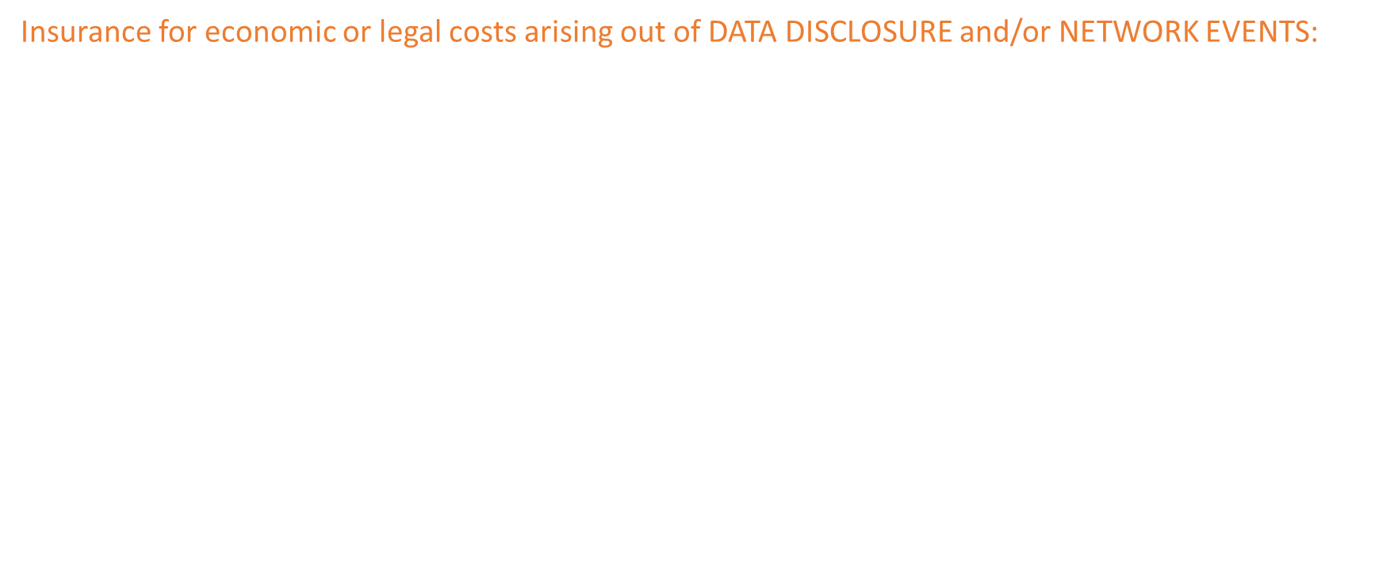
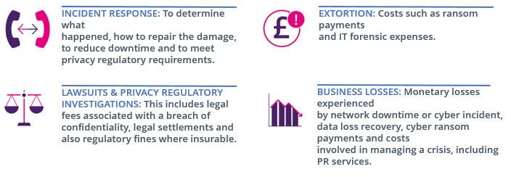
What is Cyber Insurance?
But it is also a crisis management policy not dissimilar to kidnap ransom insurance, in that it offers
services as well as financial risk transfer.

Slide 14
What’s covered?
Standard parameters of cyber insurance
Covers liability arising out of a data breach or network security breach or an unintentional act which result in a breach of privacy regulation
Covers 1st party loss on a named perils basis

Slide 15
What’s covered?
The asset insured is “data” eg personal records and software etc.
Money & securities are not “data” - may also exclude theft of money or securities (refer to Crime policy)
The network insured (typically) = communications and management information networks

Slide 16
Incident Response & Insurance
Key Cyber risk controls
Encryption
Multi Factor Authentication
Training
Awareness
Email scanning
Filtering
Endpoint Detection
Intrusion Detection
Segregated Backups
Access Control
Patch Management
Vulnerability Assessments

Slide 17
How are Cyber Claims Handled?
DISCOVER INCIDENT
Activate Internal Response Plan
TYPE OF
INCIDENT
Regulated Data
Cyber Extortion
Network Interruption
Notify insurers and Paragon International Insurance Brokers
Insurers to appoint specialists vendor on your behalf
You may contract / appoint pre-approved breach response specialists directly
You must seek consent to appoint any non-panel breach response specialists
You must seek consent to make payments

Slide 18
How are Cyber Claims Handled?
WHO TO
CALL
Data Breach Lawyer
[To preserve legal privilege]
Crisis Management Negotiator / IT Specialist
Forensics
Every incident is different, once the initial breach specialist is engaged they will guide you, through the process of incident response

Slide 19
Remember…
You can still benefit from the services of the breach response panel, even if you doubt your cyber insurance policy will provide cover for the event
If the cyber event is covered by your cyber insurance policy, you must notify insurers. If not, you will be required to retrospectively obtain consent by insurers to hire the breach response experts
This consent will not be guaranteed

Slide 20
If you want to work with a firm who isn’t approved?
Your insurer may consider adding your choice of vendor to the panel at your request. Prior approval can ensure fair pricing for vendor services, as opposed to emergency rates
Provide biographies, showing the requisite skill and experience, as well as the rates they charge showing they are reasonable.

Slide 21




Risk Management Partners
How can you best manage your cyber risk?
Paragon choses 4 partners to evaluate our clients’ security profile and provide risk management services.
KYND – Perimeter scanning and external facing security audit, and phishing training tool
CyberCube – Limit and threat modelling analytics
BitSight – Third party vendor security monitoring tool
S-RM – IT Consultancy

Slide 22
Current trends: Client losses 2021/22
Notes:
RACHEL:
Thank you -as Robert mentioned earlier - overall we are seeing an improving picture - so lets look at some of the current trends in reports we have received from you this year
Firstly in terms of client money - as you can see from our graph– over the last 5 to 6 years estimated client losses have generally decreased each year from a significant high of over 10m in 2017 to just 700k so far this year up to October 2022
– however crucially this year’s figure was a result of just nine cyber attacks all using email modification fraud and of course this figure does not include any associated losses for firms themselves
And while trends in reports are following a similar pattern and are down again this year – we cant say for sure unfortunately that this is because less attacks are happening in firms.
You will have noticed that losses last year in 2021 appears to buck the trend at 2.3m –
but just over half of that sum was stolen in just one conveyancing transaction. – such a large single sum demonstrates why it really pays for criminals to target property transactions

Slide 23



Current trends: Client losses 2021/22
78% via conveyancing
98% via email modification fraud
9 reports client losses up to Q3 2022
Notes:
RACHEL:
In fact the vast majority of attacks in 2021 (78%) targeted conveyancing transactions –
And a huge 98% of that figure was stolen using modified emails with bogus bank account details
Therefore as usual the biggest cyber threat to firms and clients continues to be found in your inboxes. And phishing emails provided the gateway to your systems in most attacks.
With increasing property prices and the rise of off the shelf phishing kits even amateur opportunists can target vulnerable users – and that includes your clients.
And it’s usually clients that tend to be targeted when firms are attacked
So lets look at an example of one such report received by our investigation and supervision department this year -

Slide 24
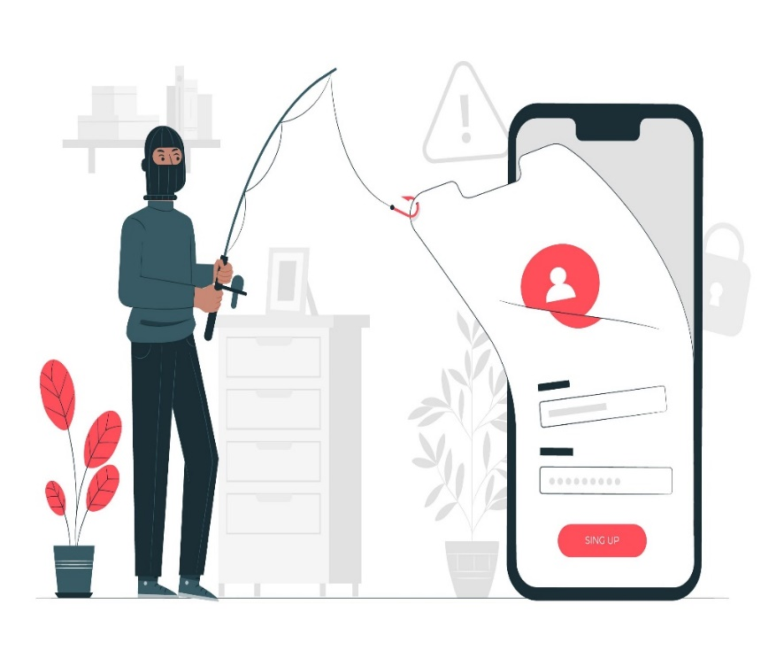
Reporting an email modification fraud
report@sra.co.uk
Warning – do not skip this bit
image: Freepik.com
Notes:
a firm emailed our report line this year to tell us that when they asked their client for deposit monies for their property purchase - the client said it had already been paid.
The firm enclosed a copy of the email sent to the client which showed the firm’s name in their email address and logo had been altered almost undetectably by changing just one letter - from an m to an n.
Timing seemed to be key in this case as the real fee earner was on holiday.
The client was asked to pay the deposit of 50k to new account details and interestingly each time they tried it bounced back–three more account numbers all with different company names were provided – none of which alerted the client – until finally and unfortunately the transfer was successful.
An investigation by the firm’s insurers identified that the attack had originated from a phishing email opened by the fee earner
The firm were resolving this with the client - and their comprehensive report included a copy of their client care letter with the warning to always check bank details before transferring payments based on emails - all headed in capitals and underlined with the words – Warning DO NOT SKIP THIS BIT – …..salient advice
Now the Investigation Officer’s report took into consideration the steps they had taken to respond to the attack, their security measures and their warning notice and took no further action.
But another salient warning is that even with warnings - people often forget about cyber security – so make it a priority to regularly remind your clients about the risks and remind staff to double check email addresses.
Just like the email address on this slide – your emails may not always….

Slide 25

Reporting an email modification fraud
report@sra.org.uk
Warning – do not skip this bit
image: Freepik.com
Notes:
…Be as they seem
Did you spot our modified email address? – I’m sure you did but its very easy to skip the obvious bit…….
But client money isn’t the only thing at risk when a criminal intercepts your systems

Slide 26
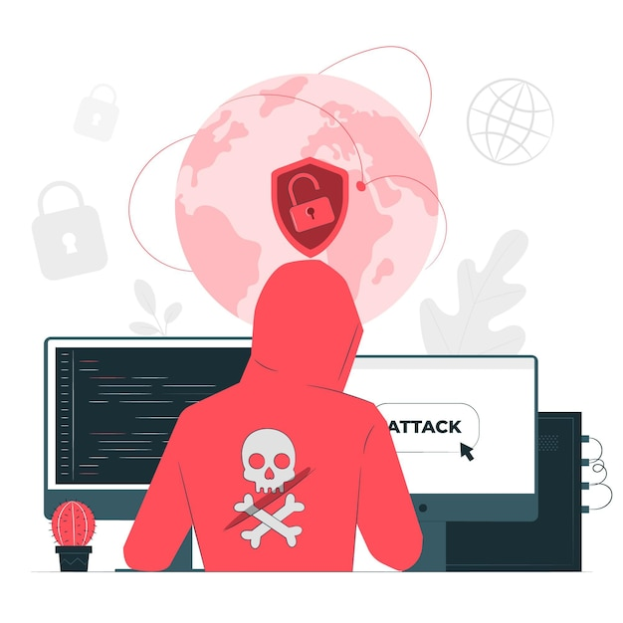
Current trends: data breaches
Examples of sophisticated attacks: hive and M&A’s
ICO fine: measures ‘rendered firm vulnerable’
Prepare: people, systems and controls
Notes:
Your information is valuable and data breaches are increasing – a taste of some of the real life reports we received this year include:
An attack by a well known ransomware gang known as Hive who publicise their professional services on google. They encouraged their victims to log into a portal to negotiate a ransom payment in exchange for their data.
Another example of a sophisticated attack was reported by a large firm whose network had been accessed using a unique form of intrusion - key email accounts belonging to the senior partners were then infiltrated but their focus was not money but corporate data The criminals with a Russian connection target firms dealing with mergers and acquisitions for the purpose of corporate espionage.
However such sophisticated attacks are rare in reports. Crucially the latest research suggests that 82% of data breaches are a result of human error and that’s why phishing emails are so effective - so in terms of basic cyber defences – always think holistically about your ‘people, systems and controls.’
In terms of systems - I’m sure you all heard about the substantial fine imposed by the ICO this year because a firm didn’t have basic security measures in place such as patching systems or multi factor authentication – so if you have limited resources target the areas where you might be most vulnerable.

Slide 27
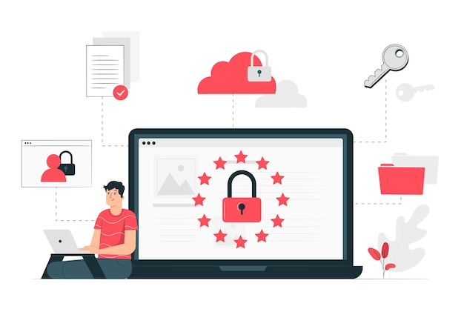
Current trends: managing ransomware risks
Paying ransoms creates risks
80% who paid ransoms were targeted again – could you face increased risks?
Don’t be a target ... focus on prevention
Notes:
And finally focusing on some wider risks highlighted this year – we know that recovering from ransomware attacks can take a considerable amount of time and money – but in conjunction with the ICO and NCSC’s warning letter to the profession - we also recommend that you do not pay ransoms.
Not only are you essentially employing criminals for their services - quite simply, in practical terms - doing so could expose you and your clients to further risk.
In fact recent research shows that it doesn’t pay to pay – (or as a colleague beautifully put it to me - ‘you might as well set your money on fire’)
- according to research 80% of businesses that choose to pay ransoms experienced a further attack and around half thought this was probably by the same attacker - and there is also no guarantee your data wont be released anyway.
So don’t be a target - Focus on low cost strategies to make payments unnecessary instead –regular robust backups, and awareness training particularly about phishing emails where many of these attacks originate.

Slide 28
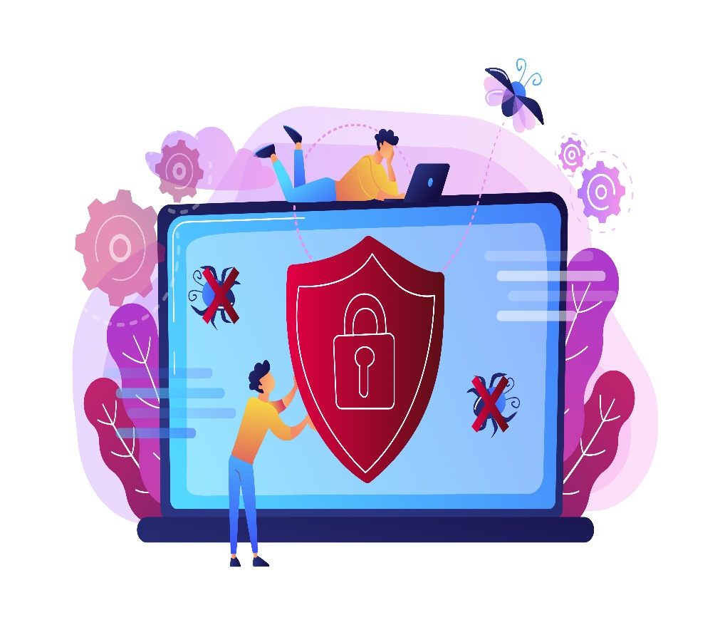




Managing regulatory risks
Disclose material information to clients
Don’t be a target ..
focus on prevention
Don’t be a target ...
focus on prevention
Don’t be a target ..
focus on prevention
Maintain their confidence
Promptly report a serious breach
Promptly report a serious breach
Promptly report a serious breach
Promptly report a serious breach
Notes:
This year we also investigated a small number of third party complaints that indicated clients had not been informed about cyber attacks at firms or reports had not been made to us.
This included firms telling staff not to tell clients about a ransomware attack because client data had only been encrypted - not extracted.
Its always better that clients hear about incidents from you rather than someone else - particularly if its from the press. But more importantly this could be a breach of your duty to disclose all material information to clients –
It’s also really important that you tell us – both as a regulatory obligation but also so that we can warn others, and we issued 50 such warnings to firms and consumers this last quarter as a result of your reports.
Ultimately - a positive cyber security culture relies on your team feeling confident that they can report risks to you as early as possible - and that you will do the right thing with this information.
And this is something we will also always take into account when you report incidents to us.
Thank you.

Slide 29
NCSC brief to SRA Compliance Conference
Mark K1

Slide 30

National Cyber Security Centre
The National Cyber Security Centre (NCSC), a part of GCHQ, is the UK’s technical authority for cyber threats.
Vision – Making the UK the safest place to live and work online.
Support the most critical organisations in the UK, the wider public sector, industry, SMEs as well as the general public.
NCSC is not a regulator!

Slide 31
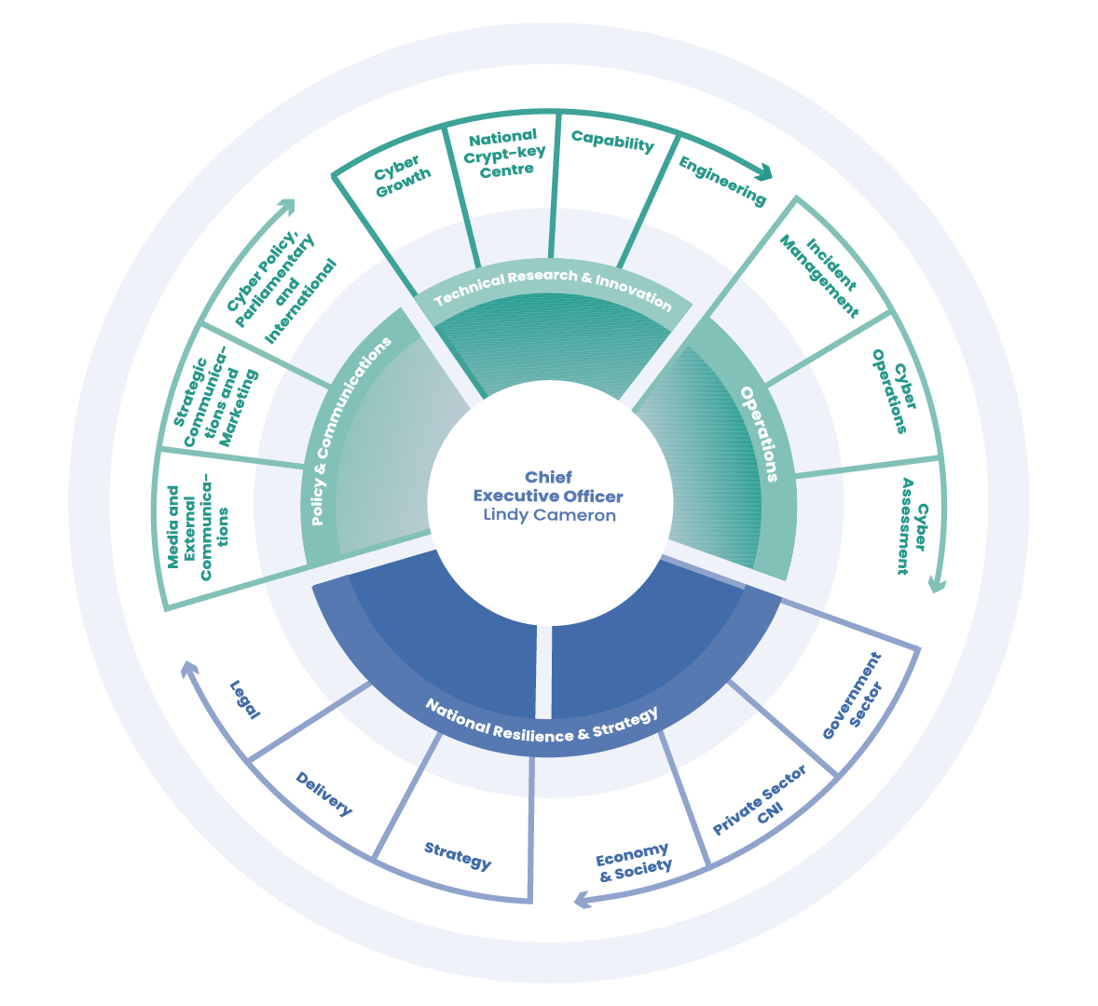
Our structure

Slide 32
Current cyber threats & trends
-Ransomware
-Supply Chain
-NCSC updates
-Cyber threat to the UK Legal sector

Slide 33
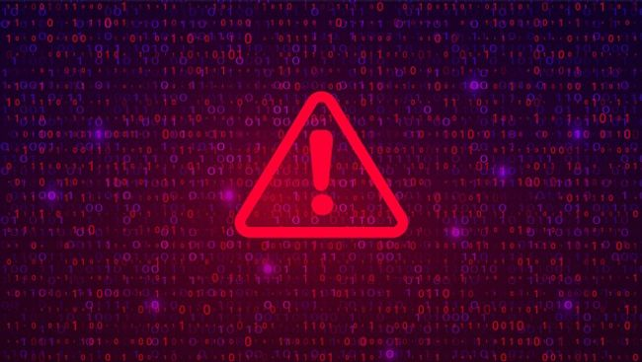
Ransomware Action
Focus on infection vectors…and back up your data:
    Remote Desktop Protocol (RDP): RDP account compromise is the source of 50% of the ransomware attacks we see. We suggest turning off RDP or mitigate by using MFA.
    Patch known vulnerabilities in all remote access and external facing devices and follow vendor remediation guidance including the installation of new patches as soon as they become available.

Slide 34
Ransomware Action
    Prevent malware spreading across your organisation by following NCSC guidance on preventing lateral movement.
    Back up your data effectively. Follow NCSC guidance on mitigating ransomware attacks.

Slide 35





Supply Chain Security : Understanding the problem
Threat actors target supply chain seeking easier access
More sophisticated cyber threat actors, exploit at scale
?
Increased outsourcing of complex IT services make it difficult to evaluate the risks
Visualisation of supply chain beyond tier one may not be possible

Slide 36

NCSC Updates
Cyber Essentials changes:
  Scoping
  Bring your own device (BYOD)
  Legacy software
  Security updates
  Statistics
Early warning – new feature
Cyber threat to UK legal sector report

Slide 37
Cybercrime: panel session
Robert Loughlin, Executive Director, SRA (Chair)
Rachel Clements, Regulatory Manager, SRA
James Moss, Legal Director, Information Commission’s Office
William Wright, Partner and Director, Paragon Insurance
Senior representative, National Cyber Security Centre

Slide 38
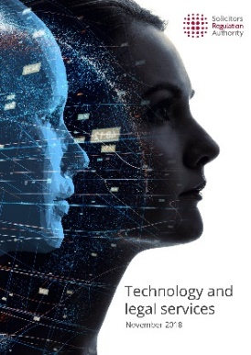

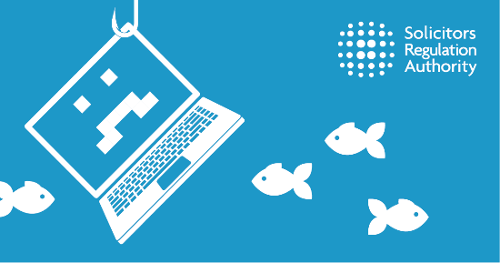
Help and guidance
lis
NCSC
ncsc.gov.uk
Cybercrime
guidance and tips
sra.org.uk/cybercrime
Check our scam alerts page regularly
sra.org.uk/alerts
Notes:
ROBERT: That brings this session to a close. If there’s any one takeaway from all this, it’s that when you do report a breach to us, we won’t take action against those who did the right things. This means you need to make sure you have the training, culture and practices in place to protect you firm and your clients.
And remember there is lots of free information and guidance out there to help you do this too – check our scam alert page for up to date information on the latest scams and there is further cyber guidance in our Risk Outlook updates.
Thank speakers
I’d like to thank our speakers, James, William, Rachel and our representative from the NCSC for their time to talk to everyone today. And I’d like to thank you all for listening
If you didn't get a chance to ask a question today – don’t worry there will also be an opportunity to ask our panel further questions at our virtual Q&A session on 16th November and a chance to see a recording of the session again!

