Slide 1
SQE: What it means for law firms
Julie Swan, Director of Education and Training

Slide 2
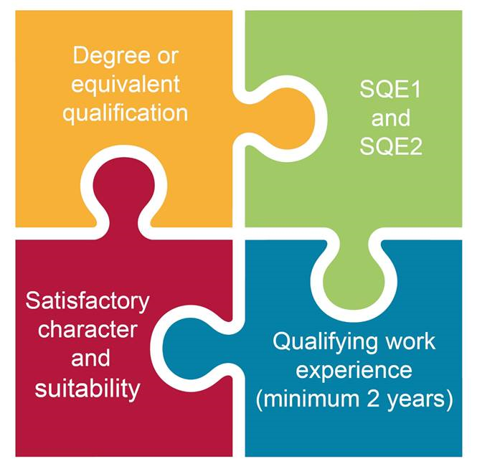
Solicitors Qualifying Examination
A single, national licensing examination
Everyone assessed to the same high standards in a consistent way
We no longer specify training or routes to qualification
First sitting November 2021

Slide 3



Why did we change?
Concerns about inconsistent standards
Lack of flexibility and unnecessary regulatory barriers
High costs of qualification

Slide 4




Benefits
Better guarantee of standards for consumers
Fair for all candidates – everyone assessed on a level playing field
More competitive training market and more cost-effective training options
Flexibility – removal of regulatory barriers, easier to get required work experience and to tailor training

Slide 5





How’s it going?
4 SQE sittings
6,500 first time
candidates
Almost 450
solicitors admitted through the SQE
66
countries
Education and
training market
Troubling
attainment gap

Slide 6





What is QWE?
Any experience of providing legal services where someone can develop at least two or more competences - outlined in the Statement of Solicitor Competence
Can be done in England or Wales or overseas – does not have to be in organisation we regulate
Must be at least two years’ working full time or equivalent part time
Can be done in up to four separate organisations providing legal services - no minimum or maximum length for each individual period
Can be current and previous roles

Slide 7


Confirming QWE
A solicitor or COLP (who we regulate) within the organisation where the placement took place. Does not need to hold a practising certificate
A solicitor working outside the organisation where the placement took place who has direct experience of the work. So long as they:
        Reviewed their work during the relevant period of work experience
        Received feedback from the person or persons supervising their work

Slide 8




What is confirmed
Exposure to some or all of the competences but solicitor not confirming whether individual is competent
The length of work experience/placement carried out
Whether or not there are character and suitability issues
Should be confirmed if it meets our criteria

Slide 9





Things to consider
How will you confirm QWE if you are approached by a candidate?
  Who will it be? How they check?
How will you manage retrospective claims?
  Are you keeping records? For example, temporary employees and the work they did?
What will recording QWE look like in your firm?
How will you manage employee expectations around QWE and qualification?
Can you take advantage of the flexibility to support your recruitment?

Slide 10




What does good QWE look like
Diverse and varied work that provides exposure to a wide range of competences
Opportunities for reflection on performance to identify both strengths and areas of development
Exposure to professionalism and to ethical issues
Effective supervision throughout the placement

Slide 11



Keep in touch
Send your queries to contactcentre@sra.org.uk
Join our SQE LinkedIn group
SQE assessment sqe.sra.org.uk / SQE route sra.org.uk/sqe
SQE Update bulletin sra.org.uk/sqeupdate

