Slide 1

Thematic review
Purpose of a thematic review
What we did
Why we looked at immigration services
www.sra.org.uk/immigration-thematic

Slide 2



Focus of our review and findings
The quality of services provided
Supervision and training
Complaints
www.sra.org.uk/immigration-thematic

Slide 3

Further information and resources
Thematic report including checklists and case study
Guidance
  Immigration work
  Effective supervision
www.sra.org.uk/immigration-thematic

Slide 4
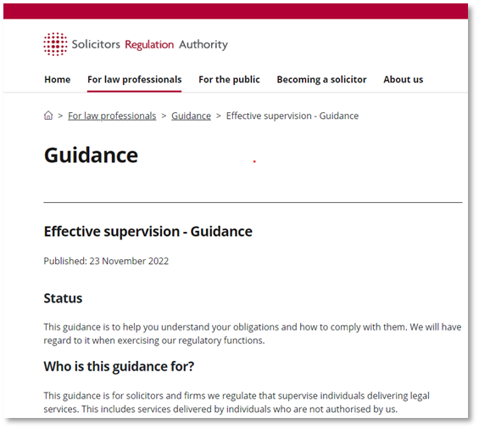
Guidance on effective supervision
Risk-based approach
Direct contact – for clear oversight, support and assurance
Ensuring arrangements are effective
www.sra.org.uk/supervision-guidance

Slide 5

OISC Regulation
Supervision & Regulatory Compliance
January 2023
www.oisc.gov.uk

Slide 6
OISC supervision
  Supervision of trainee advisers and regulated advisers:
  Allows work to be conducted one level above current authorisation
  Must be authorised by the OISC
  - application form including trainee and supervisor details
  supervision plan to be submitted for approval
  Individual supervisor - at least two years’ recent and continuous relevant experience of immigration and asylum casework
Notes:
Trainee advisers - those not yet regulated at all and regulated advisers working up one level
Supervision plan to include:
The arrangements which have been made to ensure that Individual Supervisors are adequately trained or have the necessary experience;
The percentage of their time that they will devote to supervision;
The frequency with which they will meet with their supervisee(s) to discuss their cases and the findings of files reviewed;
To what extent, if at all, supervision will change over time and the intended duration of each particular supervision arrangement; and e) If the Individual Supervisor and the supervisee are not co-located, how the supervision arrangements will accommodate this.
Review of files: Individual Supervisor must review some of each of their supervisee’s client files every month. The OISC recommends that at least three separate file reviews per supervised person are conducted each month

Slide 7
OISC supervision
  Individual Supervisor must be readily accessible to their supervisees
  Requirement to review some of the supervisee’s client files each month
  Requirement to maintain a log book related to supervision, records of feedback given and any action required by the supervisee
  Expectation for supervisee to apply for registration after 12 months
Notes:
Trainee advisers - those not yet regulated at all and regulated advisers working up one level
Supervision plan to include:
The arrangements which have been made to ensure that Individual Supervisors are adequately trained or have the necessary experience;
The percentage of their time that they will devote to supervision;
The frequency with which they will meet with their supervisee(s) to discuss their cases and the findings of files reviewed;
To what extent, if at all, supervision will change over time and the intended duration of each particular supervision arrangement; and e) If the Individual Supervisor and the supervisee are not co-located, how the supervision arrangements will accommodate this.
Review of files: Individual Supervisor must review some of each of their supervisee’s client files every month. The OISC recommends that at least three separate file reviews per supervised person are conducted each month

Slide 8
Regulatory Compliance
  Audit & Complaint Findings
  Areas most commonly identified of concern:
  Diligence in client care
  Poor record keeping
  Competence (failure to keep up to date) linked to underinvestment in CPD
Notes:
For regulated firms the OISC main tools for checking regulatory compliance are audits (premise, remote and thematic) and complaints.
CPD records and action logs are checked at audits and may be requested following a complaint.

Slide 9
Client care
Requirement to issue prospective clients with a client care letter (Code 23) take reasonable steps to ensure the client understands the letter and agrees to it (Code 24) and prescription about contents of this letter (Code 26) - client details, immigration history, current immigration status, immigration instructions, immigration advice, agreed action and confirmation of fees estimated or agreed.

Slide 10
Client care
Most organisations are found to issue a client care letter but areas of weakness include:
Lack of detail about the clients circumstances
Taking insufficient instructions
Lack of clarity on what initial advice is given
Use of templates that do not sufficiently pertain to the individual circumstances
Insufficient discussion of merits
Failure to ensure the client understands the letter

Slide 11
Client care & poor record keeping
Requirement to keep clients informed as their matter progresses (Codes 29- 33) and issue the client with a closing statement (Code 46)
Requirement to have and maintain an adequate record of all interactions with clients and prospective clients (Code 53)
Requirement to issue written receipts for money taken and keep accurate accounts and records of transactions (Code 68)

Slide 12
Client care & poor record keeping
Poor quality attendance notes and/or an ineffective case management system resulting in inability to evidence compliance with Codes 29-33
Closure letters issued without sufficient detail regarding the clients documents or the final financial statement
Financial records are unclear - lack of invoice and receipts

Slide 13
Competence and CPD
Requirement to act competently and maintain competence (Codes 5 & 6). To act only with the level of authorisations (Code 4), not permit themselves to be used in any deception, or abuse UK immigration procedure (Code 14)
Notes:
Failure to consider the most appropriate route given the client circumstances and explain carefully the requirements of this route to the client - pursuing routes that cannot be achieved
Failure to sufficiently address with the client or in representations to the Home Office, deficiencies in the client’s application or documentation - for example missed deadlines
Use of template cover letters that have been poorly applied
Failure to properly navigate the rules in complex areas where there may be exceptions to exceptions (Appendix EU)
Underinvestment in appropriate CPD and identifying areas which need constant review

Slide 14
Competence and CPD
Failure to consider the most appropriate route and explain carefully the requirements of this route to the client
Failure to sufficiently address deficiencies in the client’s application or documentation
Use of template cover letters that have been poorly applied
Failure to properly navigate the rules in complex areas
Under-investment in appropriate CPD
Notes:
Failure to consider the most appropriate route given the client circumstances and explain carefully the requirements of this route to the client - pursuing routes that cannot be achieved
Failure to sufficiently address with the client or in representations to the Home Office, deficiencies in the client’s application or documentation - for example missed deadlines
Use of template cover letters that have been poorly applied
Failure to properly navigate the rules in complex areas where there may be exceptions to exceptions (Appendix EU)
Underinvestment in appropriate CPD and identifying areas which need constant review

Slide 15
SRA Immigration guidance
22 February 2023
Julie Moktadir
Partner, Stone King LLP

Slide 16
Quality of services provided
Client always sent application form, LOR, Home Office correspondence
Workload monitoring to track urgent matters/deadlines
Engagement with ILPA – google groups/Ukraine advice service
Initial consultation to asses strengths and weaknesses. Enforce in writing

Slide 17
Supervision
Sharing responsibility for large complex cases
Regular catch ups/
1-2-1s most effective
Office working
Balancing supervision with personal development - sounding board method

Slide 18
Complaints
Providing a choice of pricing options including, fixed fees
Fee trackers
Feedback forms

