Slide 1
What is AI?

Slide 2
What is Artificial Intelligence?
A fancy name for statistical modelling
We all already use AI every day
There are two types of AI model:
  Pattern spotters (unsupervised learning models)
  ‘Future’ predictors (supervised learning models)

Slide 3
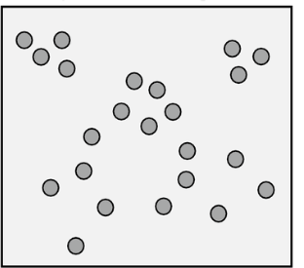
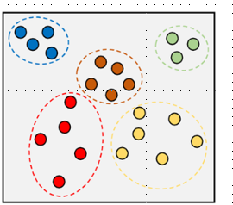
Unsupervised Learning
- Looking for patterns

Slide 4
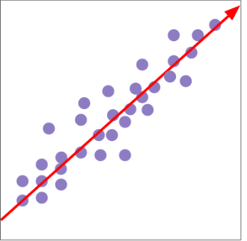
Supervised Learning
- Predicting ‘the future’

Slide 5
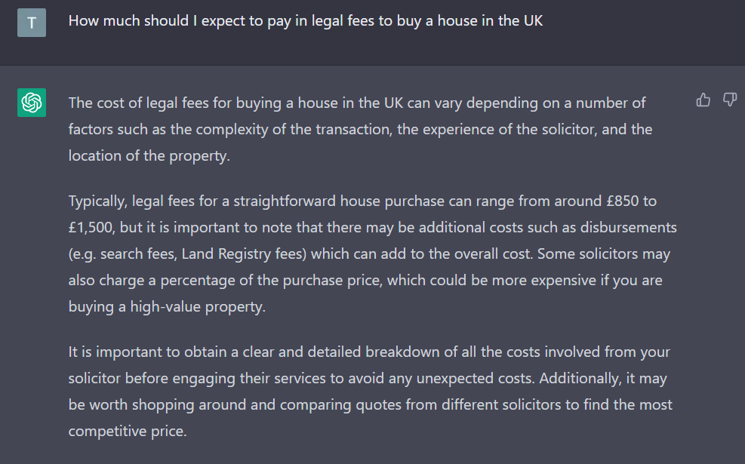
GPT (Other models are available)

Slide 6
GPT (Other models are available)
Combination of lots of different models
  Proprietary so we don’t know exactly
  Most recent iteration is GPT4
Two access routes:
  Web interface (ChatGPT)
  API

Slide 7
The Step Change
Democratisation of AI
  No longer need dedicated expertise and data to build fundamental models
Boom in services based on these models:
  Search engine optimisation
  Client onboarding
  Smart contracts
  Etc…

Slide 8
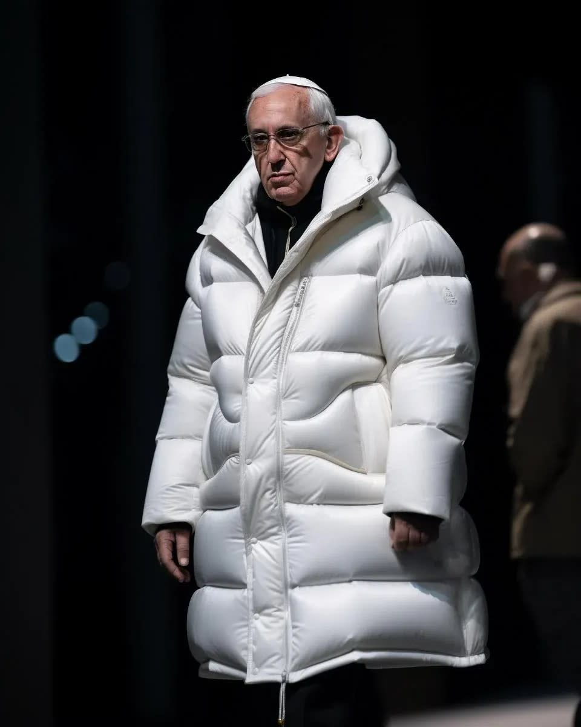


Democratisation of AI
Exaggerates existing opportunities and threats of AI and machine learning
Enables new and innovative solutions/products
Automation
Speed
Accuracy
‘Garbage in Garbage out’
  Bias
  Difficult to interrogate
Poor general understanding
  ‘Computer says no’
No generally accepted ethics or regulation
  Deep fakes
Both incredibly scary and incredibly exciting
Credit: Generated by AI

