Slide 1
Improving retention and progression in law firms

Slide 2


Women make up . . .
Ethnicity in law firms
53%
of lawyers in
law firms
32%
of full-equity
partners in
law firms
20%
of lawyers in
law firms
8%
of full-equity partners
are from a Black, Asian or minority
ethnic background

Slide 3


Mind the Gap: Exploring Progression Rates
KPMG LLP
September 2024

Slide 4

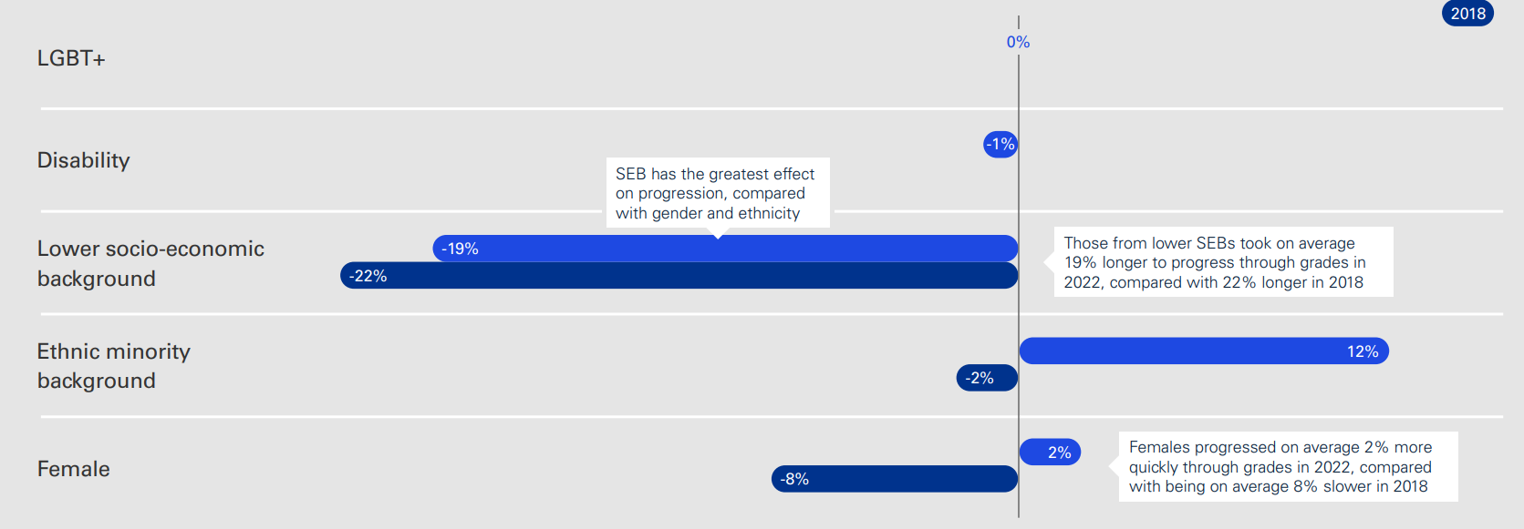
Average progression gaps by characteristics and year of analysis (client facing)

Slide 5
Progression and Retention of Diverse Talent
September 2024

Slide 6

Gender Inclusive Parental Leave
How changes to parental leave have improved retention
FamilyCare was introduced in July 2021
  26 weeks fully paid leave globally irrespective of their gender identity
  No gendered language with a strong focus on gender equality and no distinction between primary/secondary and maternity/paternity
  Inclusion of 5 days paid leave for anyone needing fertility treatments
  Inclusion of surrogacy, foster and kinship care
  Inclusion of pregnancy loss

Slide 7
Development and progression of ethnically diverse talent
An overview of the Amplify Career Impact & Empower Inclusive Leadership Programmes
120 participants
Ethnically diverse talent and their leaders
Empower
Amplify
Equip leaders who have team members who identify as ethnically diverse (Partners and Business Services Leaders)
Career impact programme attended by colleagues who identify as ethnically diverse

