Slide 1
Qualified lawyers:
How to cross qualify as a solicitor
September 2024

Slide 2
How to become a solicitor
A qualified lawyer is someone who holds a professional legal qualification which confers rights to practise in England and Wales or in another jurisdiction.
To become a solicitor, qualified lawyers need to:
  have a degree (does not need to be in law) or an equivalent qualification and/or experience
  pass the SQE1 and SQE2 assessments, unless granted an exemption – for SQE2 exemptions, will also need to demonstrate proficiency in English or Welsh
  meet our suitability requirements

Slide 3
What is the SQE?
  A single, robust examination for all aspiring solicitors
  Consists of two parts:
  SQE1 assesses functioning legal knowledge
  SQE2 assesses practical legal skills
  All candidates must meet the same high standards in a consistent way
  Candidates can choose how to prepare for the assessments

Slide 4





SQE1
Functioning legal knowledge assessment
Two 180-question examinations - 10 hours in total
FLK - test ability to identify legal principles and apply them to client problems
and transactions
Unflagged ethics questions throughout

Slide 5




SQE2
Practical legal skills assessment
+
16 written and oral tests - 14 hours in total
Simulating tasks carried out by
a solicitor in practice
Tests practical legal skills and functioning legal knowledge equally
Unflagged ethics questions throughout

Slide 6
SQE exemptions
  Qualified lawyers are eligible to apply for exemptions from the SQE assessments
  They must demonstrate that they meet the same standards that are assessed in the SQE assessment they wish to be exempted from
  We cannot grant an exemption from an assessment that someone has failed. They would have to must retake it and pass to be eligible to qualify as a solicitor

Slide 7
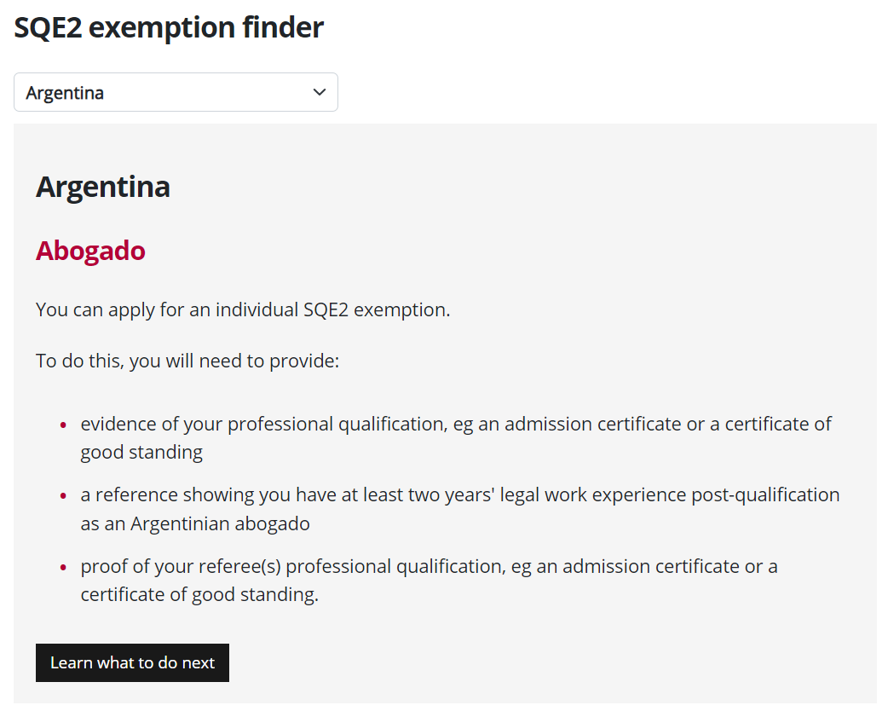
SQE2 exemptions
Use our SQE2 exemption finder to see what evidence you need to provide for your specific qualification
sra.org.uk/sqe-exemptions

Slide 8
Applying for SQE2 exemptions
SQE2 exemptions
Step by step guidance for making an application is on our website
Make sure you have added your jurisdiction in your mySRA profile
Check the SQE2 exemption finder to see if you are applying for an agreed exemption or an individual one

Slide 9
Evidence for an SQE2 exemption
Qualification evidence such as an admission certificate or certificate of good standing (CoGS)
Reference letter from employer
Referees' qualification if they are legally qualified, such as an admission certificate or CoGS
If referee is regulated by us, they only need to provide their SRA number

Slide 10
Practising under your home qualification
  England and Wales is an open jurisdiction for legal practice
  You can practise as a lawyer under your existing home qualification, so long as not carrying on reserved activities
  Legal Services Act 2007 reserves some activities to solicitors and other qualified lawyers of England and Wales
  If you are a lawyer who wants to be a manager or owner of an authorised law firm, you can register with us as a registered foreign lawyer (RFL)

Slide 11
Registered foreign lawyers
  If you are an RFL, you can:
  practise the law of your home state, including legal work reserved to lawyers, provided you can do this within the rules of your current profession
  advise on English and Welsh law
  provide and supervise other unreserved legal services, including acting in first-tier immigration tribunal cases, and preparing documents for immigration tribunal proceedings

Slide 12
More information
SRA information for qualified lawyers: sra.org.uk/qualified-lawyers
SQE assessment exemptions: sra.org.uk/sqe-exemptions
Queries about becoming a solicitor, the SQE route, including exemptions, and registering as an RFL: sra.org.uk/contact-us
SQE assessments information, including dates and venues: sqe.sra.org.uk
Queries about RFL activities/duties: professional.ethics@sra.org.uk

