Slide 1
Yiannis Chrysanthou,
Head of Stakeholder Engagement, Kaplan

Slide 2
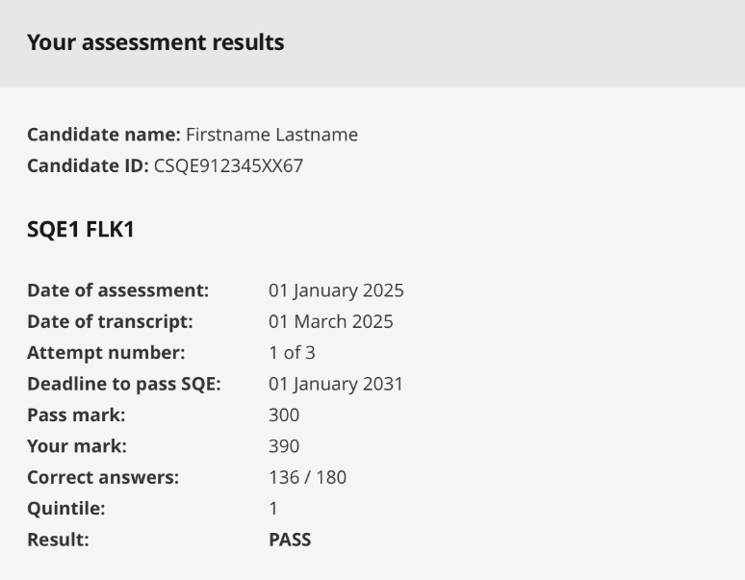
FLK1 results page
Robert/via Flickr: Jemimus

Slide 3
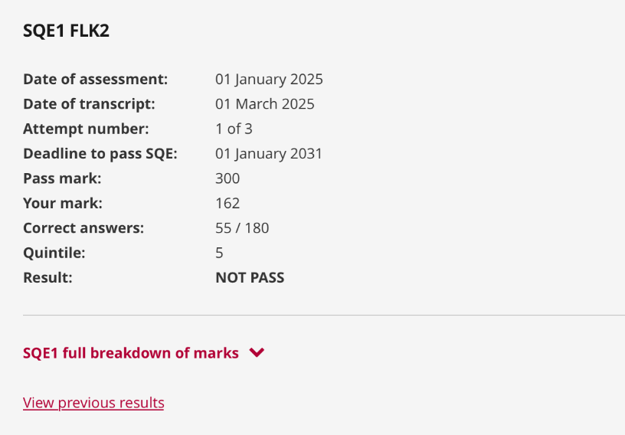
FLK2 results page
Robert/via Flickr: Jemimus

Slide 4
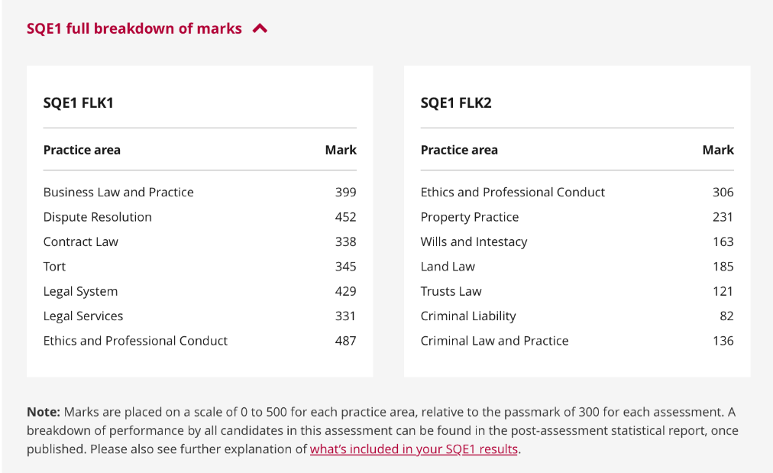
Using the full breakdown
Robert/via Flickr: Jemimus

Slide 5
Feedback for candidates and training providers
Dr Lisa Coombes, Director of Psychometrics &
Assessment Development, Kaplan

Slide 6
Feedback for Candidates
What’s new in 2024
Scaled Scores in SQE1
* No changes to exam process *
Scaled scores for practice areas for candidates for SQE1
Notes:
Spread your text out!

Slide 7
Feedback for candidates
FLK1 (Nov 21, Jul 22)
Performed well – Ethics and Contract Law
Room for improvement – Business Law & Practice, and Dispute Resolution
FLK1 (Jan 23, Jul 23)
Performed well – Ethics, and Contract Law
Room for improvement – Dispute Resolution and Legal Services
BLP was much improved for the Jan test
Tort performed poorly in Jan but scored well in July
Notes:
Spread your text out!

Slide 8
Feedback for candidates
FLK2 (Nov 21, Jul 22)
Performed well – Ethics, and Criminal Liability
Room for improvement – Property Practice, and Wills and Intestacy
FLK2 (Jan 23, Jul 23)
Performed well – Ethics, and Criminal Liability
Room for improvement – Property Practice, Wills and Intestacy and Criminal Law & Practice
Land Law and Trust Law have been consistently above average
Notes:
Spread your text out!

Slide 9
Feedback for candidates
SQE2 (Apr 22)
High scores observed in:
  Legal Research – Dispute Resolution
  Advocacy – Criminal Litigation
  Case and Matter Analysis – Business
Nine scored above 70%, including all four oral stations
Lowest score for Legal Writing – Dispute Resolution
Notes:
Spread your text out!

Slide 10
Feedback for candidates
SQE2 (Oct 22, Apr 23, Jul 23, Oct 23)
The overwhelming majority of stations score above 70%
This includes written and oral stations
Advocacy stations are consistently high scoring
Room for improvement on Legal Writing stations
and Business Organisations, Rules and Procedures stations
Notes:
Spread your text out!

Slide 11
Feedback for training providers
Feedback will be made available to training providers for the first time - starting with Jan 24 SQE1
Will show the proportion of candidates for each provider in each quintile of the assessment, and in each practice area
Summary information only – no identifiable data included
This will provide high level feedback showing strong and weak areas for their candidates
Notes:
Spread your text out!

Slide 12
Apprentice performance
Apprentices do exceptionally well in SQE
FLK1 and FLK2 pass rates are slightly over 70%
SQE2 pass rate is 98.7%
Shows the value of apprenticeships
Validates the role of SQE1
Notes:
Spread your text out!

Slide 13
Further information
For more on scaled scores, a webinar is available on YouTube – youtube.com/@SRAsolicitors
For test results, including performance by practice areas, reports are published after every assessment window –
sqe.sra.org.uk/reports
Notes:
Spread your text out!

Slide 14
SQE1: Sample Questions and Candidate Timing
Tim Maddison, SQE1 Academic Director, Kaplan
Notes:
Frame the session being based on external feedback (candidate or otherwise). The first issue to look at is the SQE1 sample questions.

Slide 15
Purpose of SQE1 sample questions
130 SQE1 sample questions on SQE website - sqe.sra.org.uk/sqe1-sample
Show the kind of questions that appear on the FLK1 and FLK2 assessments
Can help both education providers and candidates with SQE1 training and preparation
Notes:
65 per FLK
Taken from Q bank

Slide 16
Sample questions do not….
Cover all the Functioning Legal Knowledge (FLK)
Replicate sitting the SQE1:
  360 questions sat over two days
  Approximately 1.7 minutes per question
  Closed book
  Pearson VUE system
Notes:
Emphasise that this is not a mock when talking to 2nd bullet.

Slide 17
Feedback and actions
Feedback:
Easier and shorter than the actual assessment
Not enough
Actions:
Amended guidance on website
Amended order of the sample questions
Reviewed candidate timing statistics
Added an ‘anatomy of an SQE1 question’ video
Added 40 new sample questions
Notes:
1st Bullet:
All questions set at Day 1 level
Angoff panel assess question difficulty / pass mark
Angoff scores for sample questions in line with assessment
SRA subject matter expert review
2nd Bullet:
Emphasise that this is not a mock when talking to 2nd bullet.
Re 40 new Qs:
All from bank and all used in SQE1
Q length vs average in bank/previous assessments
Variety of difficulty to reflect SQE1 assessments

Slide 18
SQE1 question length and candidate timing
Notes:
Less feedback but it does come up re timing in survey and focus groups - so we keep a close eye on this and undertaken further analysis and research

Slide 19
Candidate timing
Feedback:
Time pressure in the assessment
Actions:
Reviewed candidate timing data
Reviewed word count of assessment
Notes:
1st Bullet: this is not a major piece of feedback In terms of volumes but has been raised in feedback survey and equally in focus groups. We had looked at this last year but wanted to revisit this.

Slide 20
Candidate SQE1 timing data
Average of 1% of questions taking less than 20 secs to respond
Proportion of candidates not answering all items in an assessment is low
Assessment | % of questions taking less than 20 seconds
Nov 21 | 1.1
July 22 | 1.0
Jan 23 | 0.9
July 23 | 1.0
Notes:
Overall, candidates mange time well……………
1st Bullet: taking less than 20 secs would suggest a guessed answer and so this v low % is encouraging
2nd: proportions being higher for FLK1 than for FLK2 in each window suggesting candidates learn to manage time better as they gain experience with the assessment

Slide 21
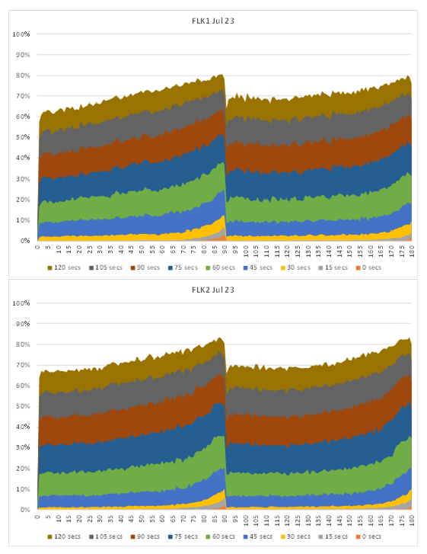
Candidate timing data
Very few candidates spend a low amount of time on a question
When they are, it is at the end
Candidates are spending longer on earlier questions
Quickening their pace towards the end
Notes:
Timing is an issue for some candidates
Timing is invariably an issue in any exam for some candidates
The proportion of candidates reporting the issue is low
Candidates appear to manage their time well in the assessments
Candidates do not appear to be rushing to finish
The data is not definitive as many candidates will be trained to manage their time (i.e. spend X seconds and move on…)

Slide 22
Word count and reading speed
Analysis on reading speeds and text complexity
Impact of age and English as a second language
Notes:
Do we want more detail per presentation? Prob not
Reading speeds modelled with text complexity
Candidates have [enough][suitable amount][use % time to read and comprehend and % of “other” time]
Keep it under observation

Slide 23
SQE2: Sample Questions and Performance Indicators
Kate Cooper, SQE2 Academic Director, Kaplan

Slide 24
SQE2 samples
Client Interviewing and Attendance Note/Legal Analysis – Wills and Intestacy, Probate Administration and Practice
Advocacy – Criminal Litigation
Case and Matter Analysis – Business Organisations, Rules and Procedures
Legal Research – Criminal Litigation
Legal Writing – Property Practice
Legal Drafting – Dispute Resolution
sqe.sra.org.uk/sqe2-sample

Slide 25
SQE2 Performance Indicators
Client Interviewing
Attendance Note/Legal Analysis
Advocacy
Case and Matter Analysis
Legal Research
Legal Writing
Legal Drafting

