Slide 1
An ethical practice framework for in-house solicitors
Jim Baxter
SRA in-house conference 12.3.25

Slide 2
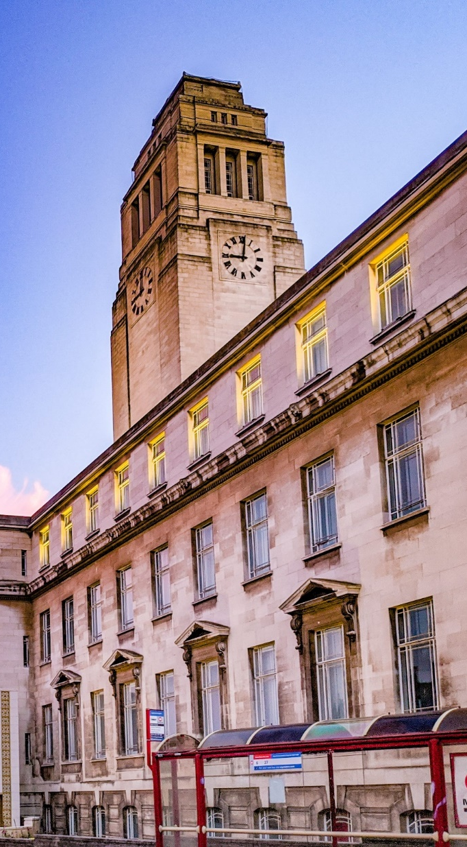
Who am I?
Dr Jim Baxter
Professional Ethics Consultant
IDEA, The Ethics Centre
University of Leeds
Commissioned by the Law Society to produce an Ethical Practice Framework for In-House Solicitors

Slide 3

Why in-house ethics?
Part of the Law Society’s professional ethics programme: Changing Ethical Landscapes.
An important (more than 20% of solicitors in England and Wales) and relatively under-examined segment of the profession.
Potentially exposed, vulnerable.
In-house ethics is complex.

Slide 4

What did we do?
Three rounds of research:
  Survey
  Expert interviews
  Further interviews and focus groups
Scoping and development phases.

Slide 5
What is the ethical practice framework?
Not regulation. Complementary to the SRA’s guidance for in-house solicitors.
Supporting in-house solicitors in meeting their ethical challenges.
Helping them balance influence and independence.
Three levels of support:
  Individual understanding and skills.
  Strengthening the position of in-house solicitors in organisations.
  Professional support and solidarity.

Slide 6

What next?
Launching soon in beta/consultation phase (date tbc).
Feedback from The Law Society members to be reflected in final version.

Slide 7
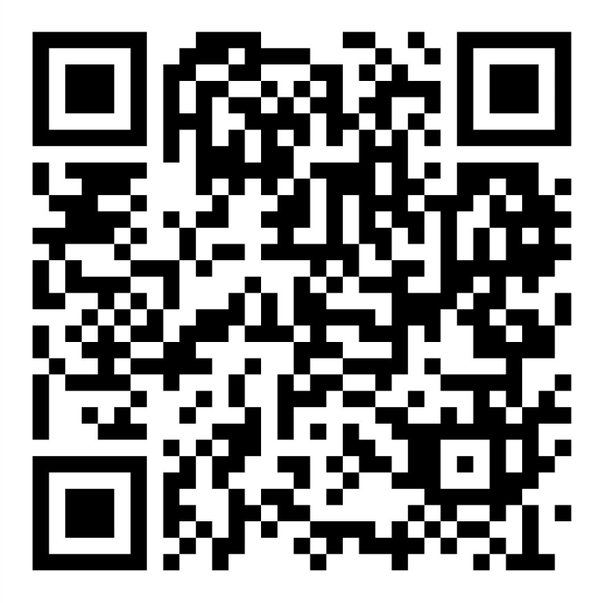
Use the QR code to register to be kept informed: https://act.lawsociety.org.uk/page/158053/subscribe/1
And/or get in touch at j.d.baxter@leeds.ac.uk

