Slide 1
Cybercrime – protecting your firm
Chair: Robert Loughlin, Executive Director, SRA
James van den Bergh, Security Awareness Specialist, DLA Piper
Rachel Clements, Regulatory Manager, SRA
Paul Hastings, Head of Thematic Team, SRA
Michelle Rosen, Partner and Compliance Officer, Brightstone Law

Slide 2
What are we going to cover?
Quick cybercrime quiz
Developing situation
Preview of our thematic project findings
Firm experiences
Future developments
Quiz answers
Top tips
Notes:
ROBERT –
Welcome to the cybercrime session.
We hope that the session will provide some interesting insights into the risk of cybercrime with an emphasis on providing some practical (real life) information and advice.
We’re going to start with a quick quiz that you will need to access via the conference App so hopefully you will have already downloaded that.
The rest of the session will cover:
Some information on how cybercrime is continuing to develop
A sneak preview of some of the key points from our thematic review of cybercrime.
Some examples of the impact of cybercrime and the steps that can be taken to reduce the risk both from out thematic visits to firms but also our guests:
Michelle Rosen from Brightstone Law?
James Van Den Bergh Security Awareness Specialist from DLA Piper
An update on some future developments with regard to cybercrime
We will then reveal the quiz answers and see how you all got on!
And finally we will show you 5 top tips for you to consider

Slide 3
The developing situation
What has changed
What is coming
The latest advice
Notes:
ROBERT -
The threat of cybercrime to law firms is a constantly developing situation. I’m going to give you a sketch of the battlefield here to show you what’s changed since last year’s talk, what we see coming down the road, and what we are doing to help firms respond.

Slide 4
What has changed – the crimes
Half of all reports are email modification frauds – a decline
Residential conveyancing main target – but not the only one
Cybercrime is getting more sophisticated and can be hard to prevent
Notes:
ROBERT –
The basic picture of cybercrime has actually not changed all that much. As solicitors, you hold money and sensitive information for your clients. Criminals want to steal that. That isn’t really going to change. But we are seeing some trends in how they are going about their attacks.
We know cybercrime is becoming more sophisticated. It has never been more important to have secure systems around money transfers and to verify where it is supposed to go. But it is not always easy to recognise every phishing attempt or modified email.
To see how difficult this can be, there has been at least one publicly reported case of criminals using AI to mimic the voice and vocal tics of a senior staff member to induce a more junior staff member to move money. This is going to become more common as this type of technology is more available.
Email modification fraud is still the type of cyberattack reported to us the most. Around half of all cybercrimes reported to us use this method – at the start of 2018 it was 80%. Most of the rest are various phishing scams and identity thefts.
Residential conveyancing is still the most frequent target, but other types of work are targeted too, from immigration to insolvency, from investment business to personal injury. Bluntly, if you handle client money, assume you could be targeted. If you don’t already, you should have a system for securely handling client’s personal account details. Some firms telephone the client to verify requests, on a previously known number. We know some firms set out from the outset that they will treat any emailed request to change bank details as false. There’s a range of methods in between as well.

Slide 5
What has changed – the consequences
Losses are not just financial for victims
Costs to firms £4k+ per attack,
£22k+ for larger
Average loss of £60,000 client money for successful attacks
Notes:
What happens when the criminals get through? Well, attacks reported to us involve thefts of around £60,000 client money on average, but one single attack in January saw over £1.5m stolen. And the cost isn’t just financial. Here’s an example.
A 70 year old was selling her house. She did use email, but she didn’t use online banking or use the internet much. She had tried to stay safe, giving the solicitors a handwritten note with her bank details. On the day of completion, the solicitors received an email supposedly from her, asking them to divide the funds between two accounts, with details of the new one. The email address was different from hers by just one letter, a hard thing to spot. Even so, the solicitors phoned the client to confirm that the email was genuine. She was busy packing, distracted, didn’t catch on that they’d mentioned an email she hadn’t sent. She couldn’t remember her bank details off hand – how many people could while trying to juggle all the last moving day jobs? The bank details sounded right, so the solicitors went ahead. The criminal got £613,000, and had already dispersed it by the time the police were involved. The solicitors had to reimburse all but £150,000.
Knowing she had been scammed out of her money left the client, in her own words, “traumatised to the point of being suicidal”. While the loss was covered by the solicitor, and ultimately by insurance, this wasn’t a victimless crime. The consequences were deeply personal.
And this was a client who had taken pains to use a safe method to get her details to the solicitors. A firm that had confirmed those details with the client by phone. And the criminals had just faked an email from a similar address with a difference that could have been spotted. There have been similar attempts using different alphabets – for instance a capital B replaced with a V in the Russian alphabet, which looks exactly the same. That’s harder to spot. Frequently the criminals actually hack one of the email accounts involved, so the email comes from the real address.
As well as the impact on clients, this affects firms too. Businesses including law firms are paying the price of cybercrime. The average business in 2019 hit by cybercrime lost £4,180 rising to £22,700 for larger firms. That’s for routine scams. Some companies have faced costs in the hundreds of millions to recover from major ransomware strikes. And that’s just the direct financial costs.
Around a third of businesses with a breach in 2019 lost staff time dealing with it, a fifth had staff stopped from doing their daily work. In law firms, that would mean completions and contractual deadlines not happening. To show you the potential, the world’s largest container shipping company was hit hard by ransomware in 2017. It had 10 days without any IT at all. It only recovered by physically replacing 45,000 PCs and all 4000 of its servers – its entire infrastructure. We don’t see these sorts of attack in reports that come to us, because there’s no leak of client information, no theft of client money. But it can cause a lot of disruption to your operations and your clients’ cases.

Slide 6
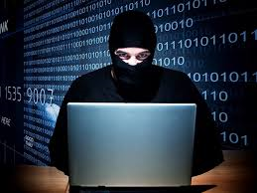
Thematic visits
Visited 40 firms to understand the impact of a cybercrime attack.
Notes:
PAUL HASTINGS
We are keen to understand how firms are actually being impacted by cybercrime and the steps they are taking to mitigate that risk.
So we visited 40 firms that had been subjected to a cybercrime attack
Today, I’m just going to talk about just some of the headline findings from that review.

Slide 7
Attacks
Visits results - cyber attacks
During visits firms identified more cyber attacks and confirmed they did not adequately record them
2 firms had more than 100 cyber attacks every year
31 firms were successfully targeted by fraudsters between 2016 and 2019
Notes:
PAUL HASTINGS
The first point to highlight is that the volume of attempted cybercrime attacks is high – far higher than the c150 per year that are reported to us.
2 firms had been attacked over 600 times during the last 3 years.
Obviously many attacks are NOT successful but …This is NOT just a hypothetical issue – 77% of the firms we visited had been successfully targeted by Fraudsters.

Slide 8
Visits results - financial impact
Firms
Stolen client money amounted to £4m+ in 23 firms
£3.67m paid out by insurers on behalf of 16 firms
Almost £400k paid by 18 firms
Notes:
The amounts of client money stolen is also significant.
Just over £4m had been stolen from 23 firms
ie c£173k per firm – firms are under an obligation to replace client funds – so how would you immediately find the money to do that?
The vast majority of losses were eventually covered by Insurance but at cost to the firms still had to pay an excess and presumably higher premiums next year.
AND, as you will know better than me, there’s probably a cost to the whole legal sector with all of you also having to potentially pay higher premiums due to these successful attacks.
BUT cybercrime is not just about money - DATA theft is also a huge risk – for you and your clients.
Also NOT just financial cost – there is also the time and effort, reputational damage and considerable emotional impact on everyone in the firm.

Slide 9
Visit results - people and policies
People
Firms told us people were their main vulnerability when it comes to cyber security
11 firms had inadequate policies
10 firms had inadequate controls
Notes:
Easy to regard Cybercrime as just a ‘technology’ based issue – it creates the image of high tech IT scams being perpetrated by IT boffins or organised crime groups.
Whilst those elements may feature, the common weak link remains people. Most cybercrime attacks rely on the involvement of people.
It will be a person in your firm that will click on the email link or will send information to the wrong person or transfer funds to the wrong bank account.
Our visits to firms showed the importance of having both good policies AND controls in place.
Your Policies – will tell people what you want them to do
BUT it’s the Controls which will MAKE people do it and allow you to check people have done
You are obviously interested in cybercrime – that’s why you’re here – so who is managing the risk back in the office right now?

Slide 10
Mitigation
How many of you know what the Cyber Essentials Plus Certification is?
How many of you have the certification?
Notes:
Hands Up & Keep your hands up

Slide 11
Mitigation
5 firms had Cyber Essentials Plus Certification
All these firms were judged to have good written processes and controls
All were judged to have a good approach to cyber security
Notes:
This is just one of the steps you can take to mitigate the risk of cyber attacks
It’s a scheme is provided by the National Cyber Security Centre (part of GCHQ)
If you don’t know – go and have a look
There’s some free support and options to have your cyber security independently verified.
It’s one of the ways you can prove to clients that you are taking cyber security seriously and are looking after both their money and data!
I’ll now hand over to my colleague Rachel who will be telling you about the impact successful cybercrime attacks had on 2 firms.

Slide 12
Thematic visits
40 firms reported a cyber incident
What was the impact?
Had they mitigated the risk?
Notes:
RACHEL CLEMENTS
This year the Thematic team went to visit 40 firms who had reported a cyber attack between 2016 and 2019.
We wanted to know what their experiences were and importantly whether they had taken steps to reduce the chances of it happening again.
The following are examples of two of those firm’s experiences.
As Paul mentioned a key risk factor for these firms too was human error. However, it’s important to note that we recognise that empowered staff who feel confident to report concerns is also a key line of defence. No cyber defence is infallible but these examples demonstrate the huge impact cyber crime can have on firms.

Slide 13
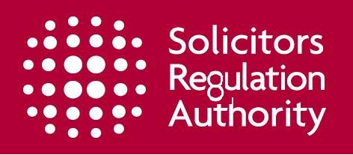
Case study 1
Entity: Small Firm
Type of attack: Email Modification Fraud
Funds transferred: £400k
Firm losses: £5k Excess, £900 compensation
Notes:
RACHEL CLEMENTS
Our first case study involves a small firm that told us that they had been acting in a high value property sale for a client when they received an email on the day of exchange purporting to be from the client.
The email address in fact was difficult to spot, having only one letter difference in it but was badly written and said:
‘After Due consideration, I want Half of the proceeds paid into my account you have on file and the other half directly into my fixed savings account details below… Please reply me now so I know you have received this instruction.”
The real client’s bank account was with the same bank but of course with a different a/c number.
The firm’s policy was to contact clients for a verbal confirmation if they changed a/c details. An employee contacted the client, however she was busy packing and didn’t have her a/c details to hand. She told the firm to ‘get on with it’.
The perhaps slightly flustered employee made the payment and never did get confirmation about the change of bank details.
The flustered employee made the payment. The bank in this case was suspicious and stopped the payment but was only able to recover 150K.
Now ask yourself – Could this happen to someone at your firm? Would your staff feel pressurised in this situation or empowered to make sure the details were confirmed?
And you? - Would you spot a slight change in the name or address of someone you know well…. or would you be complacent about their identity?
*DID YOU spot the slight change to something familiar? Look again! (Next Slide)

Slide 14
Impact and mitigation
Time and effort dealing with an investigation
Cash flow issues
Complaint, compensation and bad publicity
New payment procedures
Notes:
RACHEL CLEMENTS
If you didn’t spot the change to our logo - would you trust your firm to be able to spot any slight variations in an email from someone you know and trust?
The truth is that it can be easy to miss. We wanted to understand the impact of cybercrime on firms and how successfully they managed to mitigate them
In this case the firm repaid the client straight away by replacing the funds out of the office account.
However, in the interim the firm’s cash flow was affected, there was a police investigation and the insurance claim took some time to be resolved.
The client was also very distressed about the incident and complained to the LeO. The LeO agreed that their had been poor service and upheld the complaint and ordered the firm to pay compensation of 900. On top of all of this the story reached the press, damaging the firm’s reputation.
Think about how your firm would manage if you had to replace a 400k shortage today and deal with embarrassing publicity about this mistake in the press?
This event definitely had a significant impact on the firm but how did they mitigate the risk?
In this case the firm did have a good policy but didn’t follow it. However, rather than leaving it at that - they decided to strengthen their policy.
The firm now ask any client who wishes to change their details to provide a signed authorisation. They acknowledge that this may take longer but provides the security the firm feels it needs.

Slide 15
Case study 2
Entity: A Large Firm (Turnover:>£5m)
Type of Attack: Ransomware
Cost of Overall Mitigation: £50-60k
Notes:
Our second case study involves a large firm who deal with high volumes of conveyancing.
They discovered one Monday morning that they were unable to access their systems.
An employee had clicked on a link in an email over the weekend that contained malicious software. This was ransomware a malicious code that bypassed their firewall encrypted their operating systems making them inaccessible.
The ransom request was interestingly only $500 meaning it was likely to have been an opportunistic attack
What would you do in this situation? Would you pay the ransom?
This is a dangerous option – if you did you could be funding criminality and there is no guarantee that you would recover the data or that fraudsters would not inflict further attacks or request a higher ransom. Any data breach may need to be reported to the ICO
In this case the firm did not pay and indeed said that the damage to their systems was such that they were unable to access the demand anyway and so couldn’t pay!
So what did the firm do and what was the impact?

Slide 16
Impact and mitigation
Firm Closure for 2 weeks
Up to £150k in lost revenue
Emotional toll on staff
Improved systems and training procedures
Notes:
RACHEL CLEMENTS
The attack had a massive impact. The firm tried to isolate what was left - but lost nearly everything
The firm had to shut down for two weeks and key staff were working nearly 20-hour days to restore the data over the festive period.
* How would you feel deal about having to deal with IT providers and make decisions about servers when everyone else is enjoying themselves and spending quality time with friends and family?
Overall, revenue losses were calculated to be up to approximately 150K. However, the biggest impact appeared to be the emotional toll on staff.
This stressful experience was brought to life by a member of staff who recalled that the continual sound of the emergency ‘Whatsapp’ group notification left him with an overwhelming feeling of dread with every call!
However, while there is no doubt that this was an unfortunate mistake by an employee and it had a significant impact the firm what really impressed us was their positive response to the risk.
The firm invested heavily in new secure systems and storage facilities, storage however most significantly they also recognised that a key risk is people. They felt that their most important investment was in training and awareness, and for them face to face training to emphasise how every employee has responsibility for their own cyber security. Their advice to firms was that you should not wait to have an event before you begin to educate your staff.
*And finally I would like to leave you with one last thought– no cybersecurity is infallible and people are therefore both a risk and a key line of defence – has your firm got the balance right?
Thank you – I would now like you to welcome our next speaker Michelle Rosen from Brightstone Law…..

Slide 17
Michelle Rosen
Partner and Compliance Officer, Brightstone Law

Slide 18
DLA Piper International

Slide 19
Security Awareness Roadmap
1: No Awareness
2. Compliance focused
3: Promotes Awareness & Change
4: Long-term sustainment
5. Metrics Framework
(Criminals don't care about checkboxes)

Slide 21
Layers of defence
Physical
Technology
Processes
Policies
People

Slide 22
human firewall

Slide 24
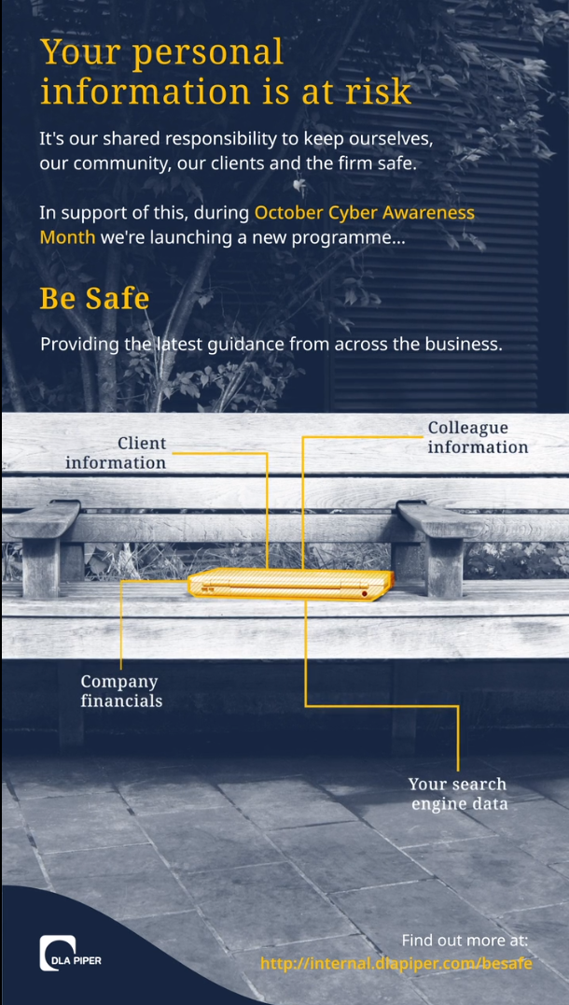

Slide 25
Takeaways
People are your first and last line of defence
Talk to them in a language they can relate to
Show your staff how to take responsibility

Slide 26
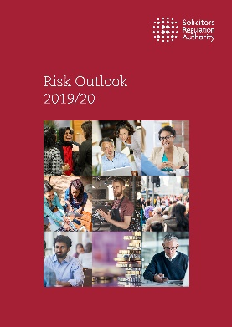
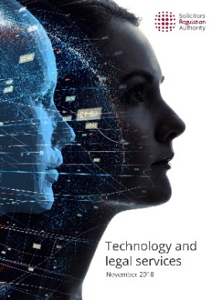
Responding to the threat
Using our Risk Outlook to get the best advice to you
Our published papers
Cybercrime
thematic report
Enforcement Strategy – taking a proportionate approach
Notes:
ROBERT –
We are developing our response to cybercrime to help firms protect themselves and their clients
Our new enforcement strategy is available on the website. We know firms hit by cybercrime are victims too. So we take a proportionate approach. We’ll look at whether firm’s systems were robust, with reasonable protections in place.
Our Risk Outlook 2019, which launched on 28 October, includes an information and cyber security section as usual. We’ve worked with the National Cybersecurity Centre to make sure it gives the latest advice on how to protect yourself and your clients. We also signpost you to a range of papers that the NCSC have produced, which give you more specific guidance.
Our published papers on information security and on technology and legal services are still valid, and on our website.
We have just completed our thematic project looking at cybercrime and will be looking to publish the results later this year

Slide 27
What is coming
New Accounts Rules – easier to use third-party managed accounts
Confirmation of payee scheme from March 2020
Notes:
ROBERT
So what’s coming down the road in the world of cybercrime?
Well, in March 2020, we should see the Confirmation of Payee scheme in place. That will verify bank transfer requests against the name of the account holder. It will make email modification fraud much harder to commit, since they won’t be able to just give a different account number any more. Yes, the criminals will try to move to new systems, other forms of phishing. But email modification has been their main method of stealing client money in conveyancing transactions, the most common form of cybercrime reported to us, and the one with the highest losses. Making that harder should make a good dent in the risk of cybercrime to clients.
Our reform of the Accounts Rules ,coming into force on 25 November, will make it easier to use third party managed accounts. It will make it easier for you to reduce the exposure that holding client money brings to you. You won’t need to get our permission to use one – but you will have to tell us about it. You can learn more on our website.

Slide 28
Five things to consider
Do you have a no blame culture? A swift response to a cybercrime attack could be crucial
People are the key – support your staff
Monitor attacks – record, analyse, respond
Look at the Cyber Essentials website - cyberessentialsonline.co.uk
Continue to review and adapt your policies and procedures
Notes:
ROBERT
No blame culture – would everyone in your organisation acknowledge an issue or mistake? A swift response to a cyber attack could be crucial.
People are key – most cyber attacks prey on human weaknesses not systems. How are you supporting staff and clients to reduce their vulnerability?
Monitor attacks – record, analyse, respond.
Basic steps – review the National Cyber Security Centre’s Cyber Essentials website and make sure you understand the basics.
Review and adapt – cyber attacks are constantly evolving and emerging, so should your processes, controls and procedures.
IF YOU HAVE ANY QUESTIONS OR WANT TO CHAT ABOUT THIS MORE – COME SPEAK TO ANY OF US OR COME ALONG TO THE THEMATIC STAND.

