Slide 1
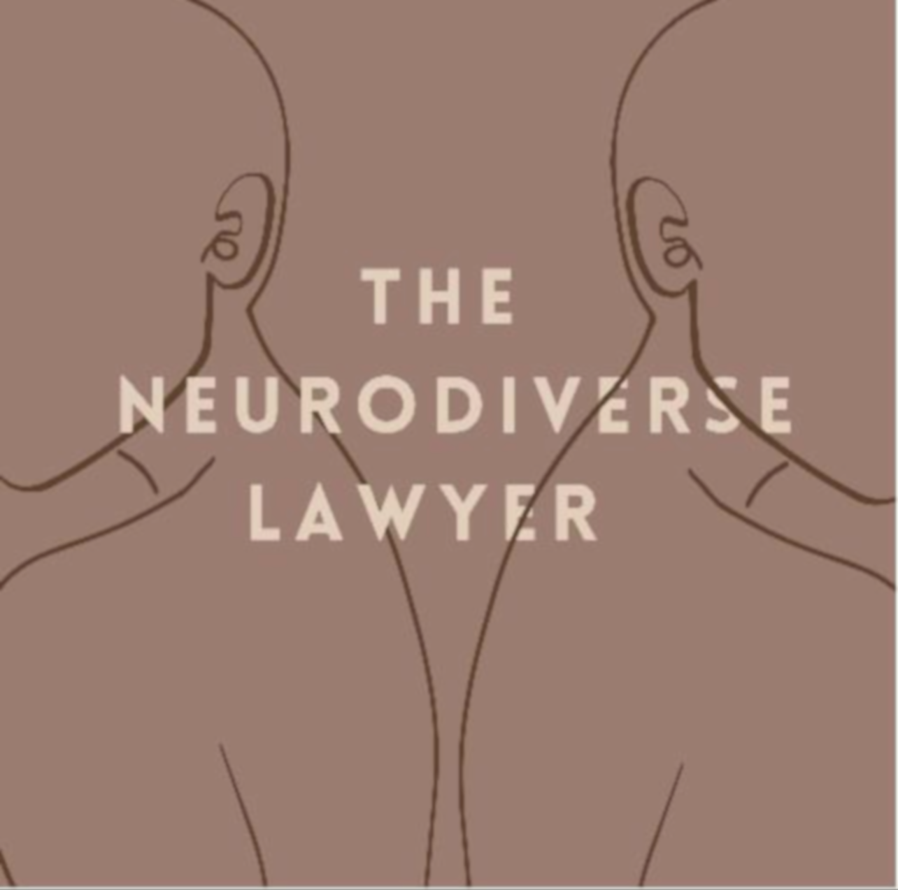
Inclusive workplaces for neurodivergent lawyers
By The Neurodiverse Lawyer Project (SOON TO BE ND LAWYER PROJECT)
Presented by Amelia Platton

Slide 2
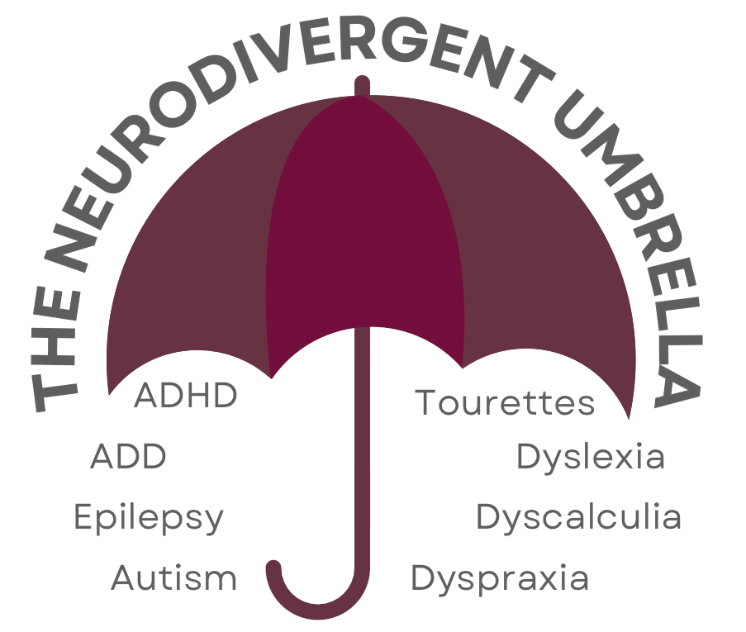
WHAT IS ‘NEURODIVERSITY’?
Neuro/typical/divergent
Neurodivergent umbrella
Diversity in neurodiversity
1 in 7

Slide 3
LANGUAGE AND WHY IT CAN MATTER
”I’M A LITTLE NEURODIVERGENT TOO”
FUNCTIONING LABELS
SUPERPOWERS
WITH AUTISM/AUTISTIC

Slide 4
BARRIERS TO INCLUSION
Issues:
No focus on ND
Varied skills profiles
Discrimination
“This is how its always been done”
Diagnosis
Why was NDLP set up?
A snapshot of my experience

Slide 5
INCLUSIVE WORKPLACES
Performance and targets
Get educated
Open conversations
Reviewing and feedback
Provide clarity
Be proactive
Flexibility
Sensory-friendly
Remember to tailor to the individual!

Slide 6

Find us:
Instagram @neurodiverselawyer – help for aspiring and current ND lawyers and more info on how employers can be inclusive
Website – https://neurodiverselawyer.co.uk
Free resources for ND lawyers in recruitment, blog posts
Podcast – The Neurodiverse Lawyer Podcast
Advice and tips for ND Lawyers and their employers, hear the stories of real ND people
Buddies scheme – Can be found on our website
For the support of aspiring and current lawyers, NOT mentoring.

