Slide 1
Anti-money laundering - what you need to know
Colette Best, Director of Anti-money Laundering

Slide 2

Why does preventing money laundering matter?
Not a victimless crime
Organised crime has a massive impact on the prosperity of the UK
Reputational risk to the legal sector

Slide 3
How do we supervise?
We are supervised by OPBAS
Four part approach to AML supervision:
  Sharing information
  Providing guidance
  Proactive supervision
  Investigations

Slide 4
What are we seeing?
Compliance is improving
Still issues with firm-wide risk assessments
Most conduct files because something went wrong with customer due diligence
Firms struggling with independent audit and screening staff
Listen to our session on Wednesday for more practical hints and tips!

Slide 5
Anti-money laundering - what you need to know
Mark Boyle, Anti-Money Laundering
Policy Manager

Slide 6
Legal framework
The Anti- Money Laundering regulations 2017
The Proceeds of Crime Act 2002
The Terrorism Act 2000
Many sectors in scope – eg estate agents, banks, gambling companies
Importantly also independent legal professionals, trust and company service providers and tax advisers

Slide 7
The building blocks of compliance
Firm-Wide Risk Assessment (R18)
Customer Due Diligence, or Enhanced Due Diligence and Ongoing Monitoring
Policies Controls and Procedures (R19)
Client/Matter Risk Assessments
Identification and Verification of Clients and Beneficial Owners
Source of Funds and/or Wealth
Money Laundering Reporting Officer
Reports Suspicious Activity to the NCA
Training
Audit
MLCO
Screening
Notes:
These are some what you would call the big ticket items of AML compliance, and as you can see some of the requirements are highly interraleted.
I’ve drawn out some of the other major pieces to the bottom right, but they are no less important. Training is mandatory in all in cases but the other three controls are not mandatory in all cases, but we would view them as strong protections when applied correctly and all firms should be using them and if not, considering carefully why they are not.

Slide 8
Legal sector guidance
New version imminent
Using technology
Sources of funds/wealth
Risk assessments
Discrepancy reporting to Companies House
Covid-19 Guidance
Notes:
All the legal sector supervisors together write the official guidance and HMT signs off. New version imminent
Tech – It’s not mandatory to use EID&V but do not necessarily need to go off and buy these things, but for sure they can be helpful.
Screening – will talk more about this later, but self declarations are useful but not enough (EID&V)
SoF – SoW – UK bank account myth, more clearly setting out expectations
Risk Assessments more details on both firm-wide and client/matter level assessments.
We also provide guidance on newer elements of the requirements eg discrepancy reporting.

Slide 9

Tax Advisers
We now supervise this activity
Have undertaken a thematic review and our findings will be embedded in a guidance piece
If your firm has not been approved for AML, but you meet the definition – you have until 10 January 2021
Notes:
Old
a firm or sole practitioner who by way of business provides [advice about the tax affairs of other persons]
Current
material aid, or assistance or advice, in connection with the tax affairs of other persons, whether provided directly or through a third party

Slide 10
Tax Advisers
Anything with a tax element, or tax consequence runs the risk of bringing to into scope
The more tailored the information is, the more likely it is to be advice. Material aid and assistance are also triggers
The choice is yours, but there’s no such thing a little bit of tax adviser work as far as AML is concerned

Slide 11

Trust & Company Service Providers (TCSP)
The approval process is different
Even if it’s small in scale or ancillary –
if it meets the definition, it’s in scope.
The risks are different – TCSP risk
increases alongside other services
Notes:
The Approval Process
Technically speaking, we do not approve TCSPs, recommend their approval to HMRC and it is they who make the call. In coming to a decision, the regs allow us significant leeway and freedom to have regard to information we may have when coming to a conclusion. By contrast, when it comes to Independent Legal Professionals as they are termed in the regs, we can only have regard to whether an individual has relevant convictions or not so arguably the TCSP test is a higher bar, and as I say ultimately it’s HMRC’s decision to take.
The next point, is a repetition of one from tax advisers, but I’d like to reiterate it here. There’s such thing as TCSP work that’s not enough to be considered in scope. If it meets the definition, then it’s in scope, regardless of how small or ancillary it may be. This sounds facile, I realise that but because these regulations have not necessarily been designed with legal services in mind it’s fair to say, they do not always readily overlap on the existing ways of working that firms have. What does that mean? Well you may have departments, or practice units etc. which divide up your work on what are I’m sure perfectly reasonable lines. AML may not respect these divisions. Probate work as an example, nominally out of scope but it can be quite common that when dealing with a probate matter to look to create a trust for some of an inheritance to be paid into a trust. Well in this way, as you can see in doing probate work, in this example the professional is drifting into providing an in-scope service.
Last point is that TCSP risk is compounded when provided with other services. To take an example - just setting up a company, creates a risk, but creating and then managing a company creates more risk. Now those services may be being provided by other entities, so it is not foolproof, but if your firm is a one-stop shop then a criminal or facilitator may be able to get all the services they need in order to effectively launder their money, which would be very attractive. I’d also flag here that where we are talking about trust or company creation, there is a risk that you don’t know what the trust or company will ultimately will be used for. That’s really challenging, and in and of itself that should be a cause to take a risk averse approach as your ability to track how your services may ultimately be used may be inherently limited.

Slide 12

Sectoral Risk Assessment
2018 first issued - 2020 reviewed
Resourcing for AML compliance
Over reliance on external help
Not understanding PEP risk
Inaccessibility of due diligence info
Notes:
Resourcing for AML compliance (Covid 19/Economic Disruption)
Over reliance on external help – generally help is good but you need to engage and embed
Not understanding PEP risk
Inaccessibility of due diligence info

Slide 13
What does the future look like?
Economic Crime Plan (and accompanying levy)
New legislation – early 2022?
We are reviewing how we rate the risks of firms – aiming to collect and use more information going forward

Slide 14



SRA Compliance Officers conference
Money Laundering in Context

Slide 15
CFCS Mission Statement
“
The CFCS is dedicated to addressing the challenges of financial crime and threat finance to the UK and international security and the important role finance can play in identifying and disrupting a range of globally-recognised threats.
“

Slide 16



Laundering money? Doesn’t do any harm does it?

Slide 17
Why AML Compliance Matters
“For it is absolutely clear that criminals organise their activities in the interstices of the legitimate society and will exploit – if they have the necessary skills and connections – any opportunities they are given. The trick of regulation is to minimise the illegitimate exploitation without wrecking the economic dynamism”
Michael Levi – Professor of Criminology (Cardiff University)

Slide 18
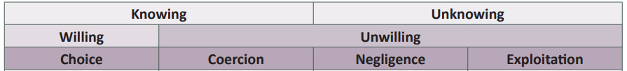
Why Due Diligence Matters
Source: Katie Benson, The Facilitation of Money Laundering by Legal and Financial Professionals (University of Manchester, PhD thesis, 2016)

Slide 19
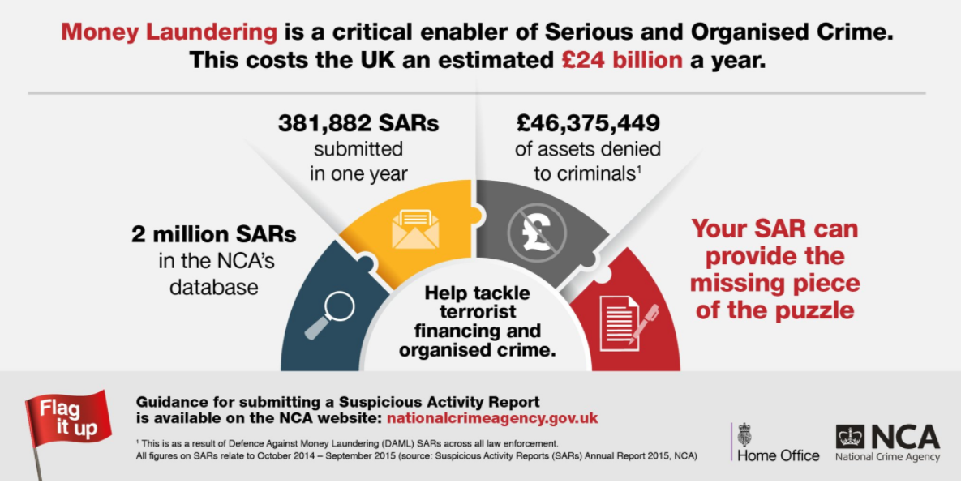
Suspicious Minds?

Slide 20


Contact
Helena Wood
HelenaW@rusi.org
Follow the CFCS on Twitter:
@CFCS_RUSI
Listen to our podcast:
The Suspicious Transaction Report

Slide 21


Making good quality SARs
Tony Fitzpatrick & Yunis Martin-Hussain
United Kingdom Financial Intelligence Unit

Slide 22

Presentation Outline
What makes a good Quality SAR
Why quality matters
Overview of Legal and Accountancy sectors contributions
Bad Quality DAMLs case studies & Regulator referrals
Benefits of good quality SARs
Signposting the available guidance for making good quality SARs and DAMLs
What is on the horizon - SAR Guidance & knowledge building
Notes:
Tony

Slide 23

Notes:
Tony

Slide 24
Why Quality Information matters
Law Enforcement data-matching against SARS
Matching Known Persons
Matching Known Profiles
Matching External Datasets
Depends Upon
Basic Quality Standards
Suspected criminal behaviour
e.g.
Glossary code(s)
Clear description for reason for suspicion
Required information for NCA to make DAML decision
e.g.
Clear description of reason for suspicion &
Criminal property with value & Prohibited Act
Subject identifiers
e.g.
Full Name
Date of Birth
Address
Account Numbers
Occupation
Notes:
Tony

Slide 25
NCA DAML letters
Letter C = Closure for not meeting standards criteria
Letter D = Request for more information or to clarify required information (48hrs time limit)
Letter E = Closure no response in specified time frame/ unsatisfactory answer in response to letter D
Notes:
Tony

Slide 26

Solicitor SARs Overview
April 2019 – March 2020 | Volumes
Solicitors | 1552
April 2019 – March 2020 | Volumes
Solicitors | 1546
Total DAML Letters Issued = 799
April 2019 – March 2020
Letter C | 127
Letter D | 648
Letter E | 232
Notes:
Yunis

Slide 27
Solicitor SARs Overview
April 2018 – March 2019 | Volumes
Solicitors | 1535
April 2018 – March 2019 | Volumes
Solicitors | 1531
Total DAML Letters Issued = 694
April 2018 – March 2019
Letter C | 139
Letter D | 519
Letter E | 237
Notes:
Yunis

Slide 28
Bad Quality DAML
We are suspicious of the source of the monies because the buyer, ijaz jawed, has instructed his own solicitors in the transaction and the purpose of sending the monies to our account direct maybe to avoid anti- money laundering procedures required by his own solicitors, if the buyer was unable to provide legitimate source of funds evidence if the monies are derived from benefit fraud or tax evasion.
We do not have an address for the buyer as this has not been disclosed to us at this stage of the transaction. the monies remain in our client account.
We seek a defence to the prohibited acts of transferring, retaining and possessing criminal property under sections 327-329 poca 2002. ……
Notes:
Yunis

Slide 29
Bad Quality DAML
We are instructed in the purchase of Plot 007 St Georges Way Nice town for the clients.
£270,000 is coming form the purported sale of Mr Johnson business in China. the money is held in his wife’s bank account - standard chartered in US Dollars in Hong Kong.
We have no means of verifying the legitimacy of these monies as they are held outside of the UK.
We require consent to proceed with the transaction.
Notes:
Yunis

Slide 30
Bad Quality DAML
Mr Khan is buying a house with the aid of a mortgage (the mortgage offer has not yet been received) and a deposit of £20000 from Miss R Ali and Miss S Ali (who he has in one email described as cousins and in another as friends). £10,000 each has been gifted to him by both Miss R and Miss S Ali, neither of whom have been able to produce a good paper trail for the funds they transferred to Mr Khan and which money they only received in to their own accounts a few days before they transferred the sum to Mr Khan.
Notes:
Yunis

Slide 31

SARS – May be the vital piece of the puzzle
Notes:
Tony

Slide 32




SARs help to combat all crime types
Cash seizure & Confiscation investigations
Gang & Knife Crime
SARs help solve local problems
Help protect Vulnerable people
Notes:
Tony

Slide 33
Getting SAR Quality right the benefits
GOOD QUALITY SAR -
Helps Data Matching & criminal network analysis
Helps Prevent and detect money laundering & other serious crimes
Getting it right first time saves time & resource
Helps prioritise exploitation of information
Helps analysis to feedback typologies, patterns and trends
Helps UKFIU Decision making thus enhancing response to reporters and End users
Helps analysis to find red flag indicators for due diligence and risk profiles
Notes:
Tony

Slide 34
NCA Guidance Documents
Suspicious Activity Reports (SARs) guidance notes can be found on the NCA website www.nationalcrimeagency.gov.uk
ALSO
UK Financial Intelligence Unit (UKFIU) Guidance Signpost 2020
Shows all the available guidance relating to SARs and DAMLs
Notes:
Tony

Slide 35
UKFIU Guidance links
SAR Guidance - https://nationalcrimeagency.gov.uk/what-we-do/crime-threats/money-laundering-and-illicit-finance/suspicious-activity-reports
DAML FAQ - https://nationalcrimeagency.gov.uk/who-we-are/publications/167-defence-against-money-laundering-daml-faq-may-2018
Law Society Scotland SAR Video - https://www.lawscot.org.uk/members/business-support/financial-compliance/anti-money-laundering/suspiciousactivityreports/
Notes:
Tony

Slide 36

What’s coming over the horizon?
Notes:
Yunis

Slide 37


UKFIU communications
@NCA_UKFIU
Notes:
Yunis

Slide 38
UKFIU WEBINAR
Suggestions for Guidance products or ideas for UKFIU magazine, workshops or webinars can be forwarded by email to
UKFIUengagement@nca.gov.uk
Notes:
Yunis

Slide 39

Questions?

