Slide 1
Cybercrime – Covid-19, homeworking and changing risks
Robert Loughlin, Executive Director, Operations and Performance,

Slide 2
What we will be covering
The developing situation
Cybercrime thematic review
National Cyber Security Centre (NCSC) update
Q&A
What might be coming
Top tips
Notes:
Chair’s opening remarks:
Welcome everyone to this session where we will be discussing Cybercrime and in particular the impact Covid19 and Homeworking may have on the risks you face.
The session is being recorded and will be available after the broadcast.
If any of you have any questions during the session then please use the link in the comments box and we will try to answer some of them towards the end, time permitting.
The areas we intend to cover during the session are:
The developing situation
Cybercrime thematic review
National Cyber Security Centre (NCSC) update
Q&A
What might be coming
Top tips

Slide 3
The developing situation
What we are seeing
The impact on law firms

Slide 4



Cybercrime – the trends
Cybercriminals are developing & boosting their attacks at an alarming rate
Jurgen Stock,
INTERPOL
Ransomware is a growing threat
- globally cases doubled in 2020
Cybersecurity researchers
300% increase in phishing emails during first two months of lockdown
NCSC
Notes:
ROBERT – So what’s going on now?
New ways of working
Law firms adapted fast and well to the move to remote working during the Covid-19 pandemic. With more reliance on IT , cybercrime risks have increased not in scale but also complexity
QUOTE – if needed could have on a separate slide
“Cybercriminals are developing and boosting their attacks at an alarming pace, exploiting the fear and uncertainty caused by the unstable social and economic situation created by COVID-19.” Jürgen Stock, INTERPOL Secretary General
INTERPOL, INTERPOL report shows alarming rate of cyberattacks during COVID-19, 2020
Increased exposure and vulnerabilities
We have seen already that cybercrime is becoming more sophisticated.
EXAMPLE- we received a report recently about a solicitor in a firm who had noticed that their email system was acting a little oddly. Emails were arriving out of sequence, and with a bit of a delay. No more than that. They contacted the firm’s IT department, and probably thought the system was just acting up. The firm’s IT provider found the problem – a number of unauthorised rules had been set up by someone on the solicitor’s email account. They were forwarding every email that included words like “purchase” to a couple of external addresses not controlled by the firm.
The firm did the right thing – changed passwords, cancelled the email rules, and notified clients about the risk of email modification fraud. They reported it to us, the ICO and the police.
Phishing emails – REMAIN the biggest source of risk.
These are still the biggest threat. The NCSC reported that there was a 337 per cent rise in phishing scams in the first two months of the lockdown.
We see a range of types of cybercrime, from email modification fraud through to impersonation of a senior staff member. But the biggest thing they have in common is that they almost all rely on using email for phishing.
Email modification fraud is still common as well. Conveyancing funds are normally the target. But we have seen reports involving probate and commercial transactions as well.
Ransomware
One of the most potentially serious rising threats is ransomware. Globally cases of this reportedly doubled in 2020.
What is ransomware?
Basically a programme scrambles your data and you have to pay money to get it back.
There is evidence that the technologies cybercriminals are using is getting more powerful. Now they not only scramble your data they steal it and threaten to release it unless you pay large sums of money to get it back.
We’ve had reports from firms that have been hit by these, and the threat to client confidentiality is increasing.
EXAMPLE - One US law firm found that out, when this year criminals used a ransomware variety called R.Evil to steal data for famous client including Elton John, Robert de Niro and Mariah Carey and share it across the web.

Slide 5



The consequences
Losses are not just financial for victims
High costs for affected firms too
£2.5m stolen in the first six months of this year
Notes:
Money lost
£2.5m client money stolen in the first six months of this year. Attacks reported to us involve thefts of around £135,000 client money on average, but more than one report this year has involved sums over £500,000.
Client Impact
Wider consequences
And we know the cost isn’t just financial. Additional costs of cyberattacks to firms include:
higher insurance premiums
lost time
damage to client relationships
lost jobs
stress and pressure on staff.
As well as the impact on clients, this affects firms directly. Businesses including law firms are paying the price of cybercrime.
EXAMPLE - One insurer’s surveys found that cyberattacks cost financial services companies £137,404 on average to deal with, and over £280,000 for the largest businesses. One case we know of saw a solicitor’s firm lose £150,000 worth of billable hours dealing with the aftermath of an attack.

Slide 6
How we are responding
Enforcement Strategy – taking a proportionate approach
Risk Outlook has the latest NCSC guidance
Help and guidance on our website –our latest thematic review
Notes:
ROBERT –
What we are doing -Helping firms and solicitors
When we receive reports about cybercrimes, we take a proportionate view. We know that mistakes can happen. In deciding how to handle a reported breach, we will look at whether the firm had reasonable protective measures in place. We will take into account whether the matter was self-reported to us promptly and whether they took reasonable steps to remedy the situation.
EXAMPLE The firm I mentioned earlier that had malware forwarding confidential emails - We took no further action against them, and were able to point them towards some further steps they could take to be sure their systems were secure.
Our Risk Outlook 2020, which launches this week/today (date TBC) includes the latest advice and information on how to stay safe in our information and cyber priority risk.
In March this year, we put out guidance on avoiding cybercrime in the age of Covid-19, which you can find on our website. It gives advice on subjects from risks from homeworking through to the safe use of remote meeting systems.
In September 2020 , we published our Cyber thematic review which gives you lots of helpful resources on how you can stay safe as well and we are also launching a supporting toolkit on (TODAY –TBC!)
I’ll now hand over to Rachel, who’ll be talking to you about our thematic review of cybercrime.

Slide 7
Cybercrime thematic review
Rachel Clements
Notes:
Thank you, my name is Rachel Clements, and I am a Regulatory Manager in our Thematic Risk team and I’m going cover some of the key findings from our t review of cybercrime as well as some practical advice from our new cyber security toolkit being published hot off the press today
Our review looked at the experiences of 40 firms who had been the victim of cybercrime between 2016 and 2019. However, it has never been more important to protect your clients as our working lives have moved online and so we will also look at how you can prepare for the current challenges and keep your clients safe.
Let's look at some of the key risks for firms we identified.

Slide 8

How risks looked in our review
£4m stolen from 23 firms
£400k paid by firms
Data security & governance
Email modification fraud
Phishing and vishing
Ransomware
Notes:
Ah the good old days! An office - I remember it well! While our working environments might be different - the risks remain largely the same. In 2019 we were already working in an increasingly digital world and of course transferring client money.
Significant sums had passed into the hands of criminals using cybercrime techniques. 4m pounds was stolen from just 23 of the firms and while most was covered by insurance firms still paid 400k from their own funds.
The impact of a loss of data is more difficult to calculate, but we found substantial indirect costs in terms of time and money.
Additionally- we identified governance concerns with servers, data sticks and outdated systems.
In terms of common threats – we saw a range of attacks targeting both firms and clients most involved modified emails and phishing and most targeted conveyancing transactions. Now we are seeing a rise in covid 19 phishing attacks and of course despite lockdown - the property market has remained buoyant and is still a key target.
Some attacks were sophisticated for example in a vishing attack social engineering techniques were used to persuade the victim to transfer over 1.3 m pounds to several accounts.
Four firms were subject to a ransomware attacks and affected to various degrees.
Its important to say that overall we were satisfied with the way most firms managed these attacks, however we remain concerned that not all would be resilient now in the current climate - particularly because of gaps in training and awareness.

Slide 9



Key risks: training and support
60% of firms viewed their staff
as the
greatest risk
88% of fee earners could not explain the term ‘ransomware’
20% of firms had not provided any cyber training
Notes:
So let's look at this risk in some more detail and reflect on the implications for remote working.
We wanted to know how well-prepared firms were to defend against attacks and their awareness of the risks.
Most firms told us that their staff were their key weakness but as the slide shows --
20% of firms had not provided any training at all to staff . Of those that did more than half did not keep training records and so were not able to confirm to us who had actually received training.
Untrained staff are inevitably at a higher risk in a cyber attack and it only takes one attack to potentially target your clients.
To put this in context - we tested firms’ knowledge about a range of common cyberattacks and asked the same question to both managers and fee earners.
We identified that overall managers had a good level of knowledge (although many relied on their IT support!) however concerningly levels of knowledge noticeably dropped when we asked their staff the same questions.
As you can see 88% of fee earners, we spoke to were unable to explain what ransomware was. But only 15% of managers got this question wrong.
Why is this important? Well ransomware attacks continue to increase in 2020 and it is more than likely that a member of staff might click on an attachment that exposes them. However, more than that - all staff need to be aware of risks to know how to avoid them and of course when to report them.
This starts with regular training and having an effective and supportive cyber culture – driven from the top down with good oversight and clear reporting lines.

Slide 10
Test your knowledge
You have received a ransomware demand. What is the first thing you should do?
Determine if it is legitimate. If so, inform the SRA and follow the instructions carefully to get your data back
Ignore the demand and back up your data, you do not need to inform the SRA
Do not pay the ransom. You may need to inform the SRA, ICO and the police
Notes:
So as you know we tested our firm's knowledge about cyber attacks and found varying results.
How do you think you would fare if we came to your firm and carried out a similar test? You now have your chance to test your response.
The question is …..READ.
Think about how you would respond, and we will come back to the answer shortly.

Slide 11

Policies, controls and technology
32% no disaster recovery plan
57% had not tested processes
20% no policy on USBs
20% no incident records
37% using Windows 7
55% using external USBs
Evidence of IT support over-reliance
Notes:
So what can our 2019 review tell us about current risks now that so most of us are working remotely?
Firstly cyber security is not just about technology – its about your whole business, and we expect you to have robust policies to mitigate against risks.
However, we found gaps that could have an impact on how well firms are managing remote working risks now when good governance is needed more than ever.
These risks are listed here and while I wont cover everything on this slide its important to note that poor governance overall was a significant issue - whether that be from soon to be outdated systems that will no longer have security updates this year or indeed systems that hadn’t been updated since 2014 - to risks around policies on USBs.
Importantly over half of firms had not tested their processes and some firms were significantly over reliant on their IT support that could mean that they are not fully prepared for an attack.
This was particularly highlighted by a firm who discovered that their IT provider had failed to prevent multiple password attempts on their systems.
Of course this was only discovered after they had been hacked.
IT provide valuable expertise, but remember you remain responsible for oversight of your own security
So with this in mind how can you make sure you are prepared to meet the current risks facing us now?

Slide 12

Remote working risks
Notes:
Well firstly you could be forgiven for feeling complacent about the transition to remote working – we already carried out so much of our work online and digitally . However we know that attacks have increased this year as criminals exploit lower levels of security and our increased dependence on technology - perhaps best evidenced by the fact that more than 2.5m in client money has been stolen this year alone.
What could that look like?
Well let's imagine someone you know working at home right now. They are logged on to the firm network using their own device and perhaps working at the kitchen table because they don’t have their own office space. They might be feeling isolated from their colleagues, anxious or under pressure.
Suddenly an email arrives. Its from a client but something just doesn’t feel right.
How would they deal with it? Ignore it – perhaps its nothing to be concerned about after all?
Delete it and say nothing? Report it or respond to it?
What other risks to confidential data could also make them vulnerable in this scenario?
We are all vulnerable to cyber attacks, and this vulnerability increases as cybercriminals take advantage of any initial weaknesses in our transition to working from home and colleagues may be feeling more isolated or under pressure than usual.
That is why it has never been more crucial to support and train your staff and even educate your clients in order to protect them from risks.
So what steps can you take to manage client risks?

Slide 13

Managing client risks
Warn you would not email bank a/c changes
Scrutinise 'out of place’ emails
Look at alternatives to holding client money
Confirmation strategies for transfers
Monitor firm email accounts
Notes:
Our new toolkit provides some practical steps to help you manage the client risks we identified in firms.
While there is no such thing as a one-size-fits-all model focusing on your policies and procedures particularly in financial transactions is a really good place to start!
The first point to stress is that most firms in our review implemented appropriate measures following attacks. Inevitably, this cost time and money but as we point out in our report for most firms, this cost far less than the sums lost from the initial attack.
So where should you start?
tell your clients that you would never change your bank details by email.
Use software to monitor your email account for example for email forwarders
Train staff to regularly scrutinise emails; and check for any variations to addresses and unusual spelling or grammatical errors. For example by hovering your mouse over the sender’s address.
Think about strategies to confirm fund transfers - such as requiring a password, written confirmation or even test payments with a £1 pathfinder – transfer £1 and call to check it has been received.
If appropriate - look at alternatives to holding client money such as third-party managed accounts
Finally let's go back to out cyber question

Slide 14
Test your knowledge
You have received a ransomware demand. What is the first thing you should do?
Correct answer
Do not pay the ransom. You may need to inform the SRA, ICO and the police
Notes:
So the answer was c - do not pay the ransom and consider your reporting obligations. Did you get it right?
Paying ransoms involves giving money to criminals. It encourages and funds the development of more ransomware. COLPs should consider their duties which might include informing us about an attack even if it is unsuccessful or you have back ups. This is because it may help us to warn others about risks.
We saw 4 ransomware attacks in our review and in one case this had a significantly disruptive effect that lasted more than 2 weeks. The firm reported the incident to the ICO and to the police. The attack was likely to have originated from a malicious email attachment. Fortunately, the firm had a secure backups, stored separately. The only loss was the significant time spent reinstalling files and the costs of repairing the damage.
When we receive reports about cybercrimes, we take a proportionate view. We know that human and system errors are unavoidable, particularly in these difficult circumstances.
Having robust systems, prompt reporting a taking reasonable protective measures and remedying any breaches will always be considered carefully by us by reviewing our report and guidance materials will help you make sure to meet your obligations.

Slide 15


Help and support
Cybercrime thematic review
sra.org.uk/cyber-security-review
Cybersecurity tips and advice
https://www.sra.org.uk/solicitors/resources/cybercrime/
Notes:
If you would like to learn more about our findings, please read our thematic report on our website and our new toolkit published today.
For further help and support If you would like to learn more about our findings, please read our thematic report on our website and our new toolkit which is being launched today.
The toolkit highlights real-life cyber incidents at the firms we met and what we learned so that you can check how prepared you would be when faced with a similar attack and some tips to help you recover.
But for now thank you for listening and I will pass you over to my colleague Karen from the NCSC

Slide 16

26th November 2020
Karen J, NCSC
Notes:
My name is Karen and I work in the NCSC Economy & Society engagement team. Our role is to reach a range of previously underrepresented UK's businesses, large and small; charities, universities and schools – to improve their levels of cyber security resilience and develop their maturity – and thus raise the UK's cyber security as a whole.
Today I will give you:
A brief overview of who the NCSC is
A briefing on the cyber threat to the legal sector, how things have changed with coronavirus and then I’ll move onto giving you some information on how you can protect yourselves against cyber criminals.

Slide 17
46% of all UK businesses identified at least one breach or attack in the last year
* *The Department for Digital, Culture, Media and Sport's 'Cyber Security Breaches Survey 2020' reported that almost half (46%) of all businesses have identified at least one cyber security breach or attack in the last 12 months (and 43% have among micro and small firms)
Notes:
I mentioned earlier that making the UK the safest place to live and do business online was no small challenge. According to the DCMS cyber security breaches survey 2020 46% of all UK businesses identified at least one breach or attack in the last year.
This figure was 32% last year.
Cyber attacks are getting much more sophisticated and in some situations harder to spot

Slide 18
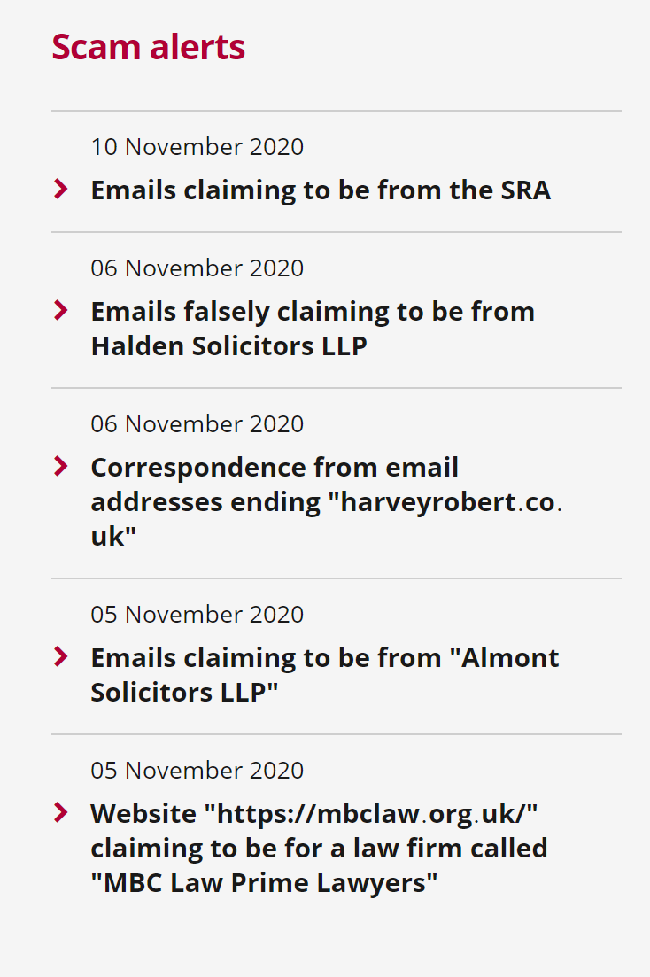

Slide 19

2019 Incident trends
1. Cloud Services
2. Ransomware ✓
3. Phishing ✓
4. Vulnerability scanning
5. Supply chain attacks ✓
https://www.ncsc.gov.uk/report/incident-trends-report
Notes:
The latest trends that we are seeing also include cloud services and vulnerability scanning.

Slide 20


Cloud Services
Notes:
Cloud services, and Office 365 in particular, an increasingly common target for a range of threat actors.
In some cases, these services are only protected by a username and password.
There has been significant use of tools and scripts to try and guess users’ passwords. Password spraying and credential stuffing
Online security is important, but it should be considered in the context of your overall business needs.
Start by considering whether the measures you take to deal with the COVID-19 lockdown will become more permanent ways of working.
For example, will you allow homeworking to continue, will you look to expand your online business? If so, you will need systems in place which are sustainable and can scale as your business adapts and grows.
Cloud services have been designed to meet this need, allowing you to grow or shrink your IT requirements in response to market conditions, without massive investment in hardware or personnel.
They have many advantages in terms of security, but you as an end user will still be ultimately responsible for your data, how this is accessed and by whom.

Slide 21
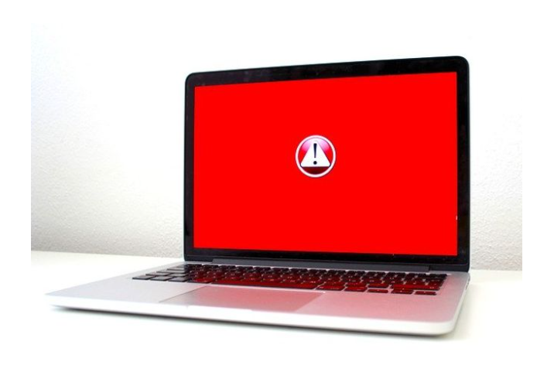
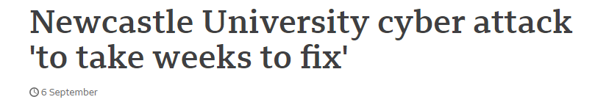
Ransomware
Notes:
What is ransomware?
Ransomware is a type of malware that prevents you from accessing your computer (or the data that is stored on it). The computer itself may become locked, or the data on it might be stolen, deleted or encrypted. Some ransomware will also try to spread to other machines on the network, such as the Wannacry malware that impacted the NHS in May 2017.
The NCSC dealt with several ransomware attacks against education establishments in August, which caused varying levels of disruption, depending on the level of security establishments had in place.
The NCSC issued an alert to the sector containing a number of steps they can take to keep cyber criminals out of their networks, following a recent spike in ransomware attacks.
However, even if you pay the ransom, there is no guarantee that you will get access to your computer, or your files. Occasionally malware is presented as ransomware, but after the ransom is paid the files are not decrypted.. For these reasons, it's essential that you always have a recent offline backup of your most important files and data.
The line between ransomware attacks and data breaches continues to blur in early 2020, with a number of prolific ransomware operators creating their own websites where they publish the stolen data of non-paying victims

Slide 22


Phishing and Vulnerability scanning
Phishing has been the most prevalent attack delivery method seen over the last few years. Common tactics include:
targeting Office 365 credentials
sending emails from real, but compromised, email accounts
fake login pages
Vulnerability scanning remains a common reconnaissance method to identify unpatched, legacy or vulnerable software.
Notes:
Phishing continues to be the most prevalent attack see on the last few years. Becoming much more sophisticated now and not just coming through by email but by text, phone call and social media.
How many have you have been phoned by Microsoft telling you that you have a virus and to give them remote access to your laptop
Vulnerability scanning. Looking for vulnerabilities in software. Vendors find a weakness in software and patch it. Cyber criminals try to take advantage of this before people update their devices.

Slide 23

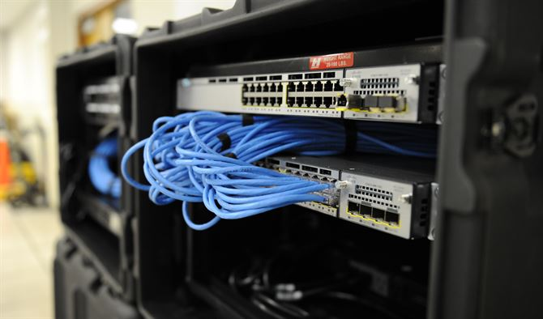


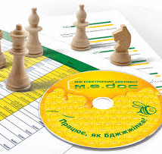
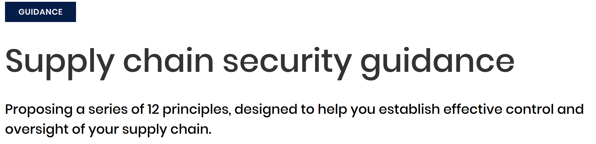
Supply chain
Notes:
We know that the financial institutions that you deal with are enforcing stricter audit requests on law forms to understand who they’re and your customers are. How safe is their data as it flows through the supply chain.

Slide 24

WHAT CAN WE DO TO PROTECT OURSELVES
Notes:
I’ve given you a lot of information today.
My top takeaways
1. Passwords– use THREE RANDOM WORDS for example toffee, aeroplane, bottle and two factor authentication wherever possible.
SOFTWARE UPDATES – make sure you update your software as soon as possible
Backups – keep an upto date off line back up of your critical information
STAFF TRAINING – use the time to do some staff training TOP TIPS FOR STAFF package on our website. Takes about 30 minutes to do.
And PRACTISE!! Have a look at EXERCISE IN A BOX available from our website. Exercise in a Box aims to exercise and improve the resilience and preparedness of our nation’s organisations in effectively responding to cyber incidents in a safe and private environment

Slide 25
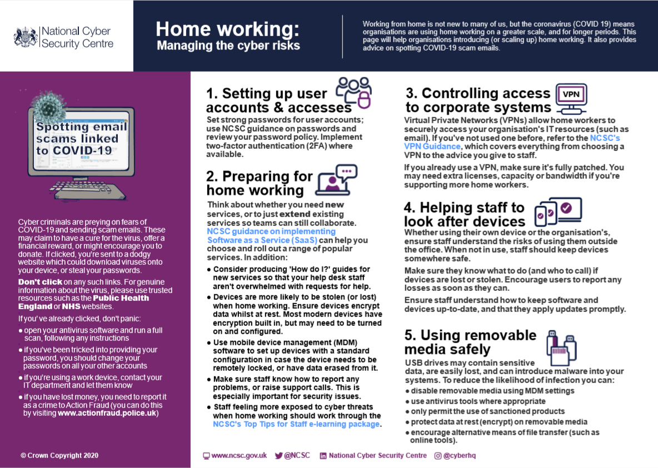
Notes:
Whilst working from home will not be new to many organisations and employees, the coronavirus is forcing organisations to consider home working on a greater scale, and for a longer period of time. You may have more people working from home than usual, and some of these may not have done it before.
This guidance helps talk you through the use of
Virtual Private networks (VPNS’)
USB drives
Staff Access
And passwords
Remote users may need to use different software (or use familiar applications in a different way) compared to what they do when in the office.
Make sure staff know how to report any problems. This is especially important for security issues
Your staff might feel more exposed to cyber threats when working outside the office environment, so now is a great time for them to work through the NCSC's Top Tips for Staff e-learning package.

Slide 26
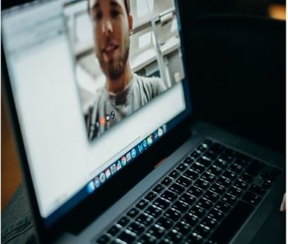
Video conferencing services: security guidance for organisations
Notes:
With more staff now working remotely, video conferencing has an obvious role to play. The NCSC has produced some guidance that helps organisations to select, configure and securely implement video conferencing services.
When choosing a service, you will want to ensure that the video calls themselves and any other data (such as messages, shared files, voice transcriptions and any recordings) are protected. Your first step is to find out if a video conferencing service is included in your existing business software implementation. If you've performed some due-diligence or security risk assessment of video conferencing services, you should re-examine these.
If considering a new service, you should perform a security risk assessment across a shortlist of providers. You can do this by following the NCSC’s SaaS security guidance, and/or requesting copies of any independent assessments or audits. The results of this assessment, combined with the provider’s terms and conditions (and privacy statement), will give you an understanding of:
how the provider implements basic security controls
where your data is held
what they can do with it
If you need video conferencing for more sensitive meetings, you should follow the NCSC’s Cloud Security Principles to determine whether a service meets your security needs. We recommend this approach for government use (such as handling OFFICIAL data), regulated industry sectors, and organisations that handle personal data. The principles cover a greater level of detail to help you understand how the service is built and managed by the provider. Some cloud providers publish a response to the principles so you can understand exactly how their service meets the security goals.
Many video conferencing services include paid options that provide additional features or levels of service. This can include enhanced security, configuration and privacy features.
Some services implement end-to-end encryption so that all data is encrypted in transit and can only be decrypted by the meeting participants. Other services specifically encrypt data between user devices and the service - so allowing them to provide richer functionality that can only be implemented server-side. Whichever model your chosen provider implements, you still have to be able to trust them to have designed and implemented this well, and that the apps and service actually work in the way that they describe.

Slide 27
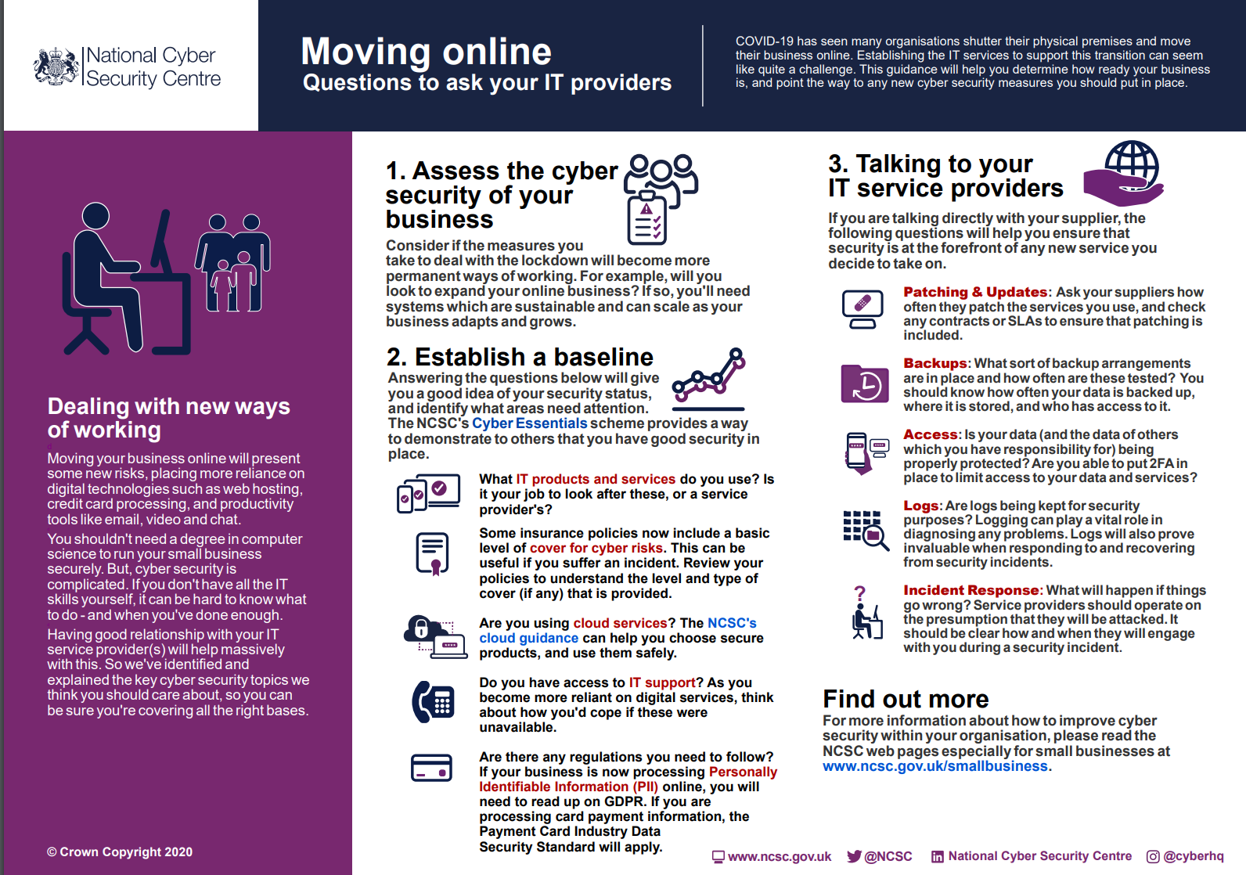
Notes:
Moving your business from the physical to the digital securely will not only help your business grow confidently and sustainably, but it will also help to uphold your reputation with customers.
Your security measures and those of your suppliers should be regularly reviewed. It's important to keep the dialogue open with your IT service providers, building a positive relationship and developing a better understanding of each others' responsibilities.

Slide 28
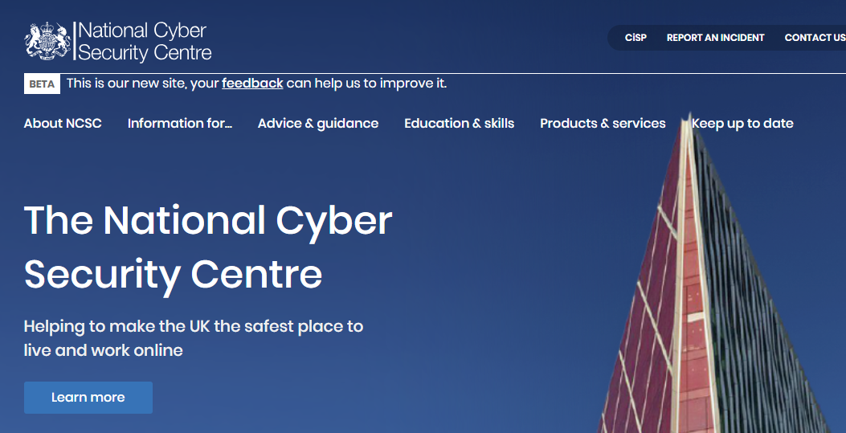
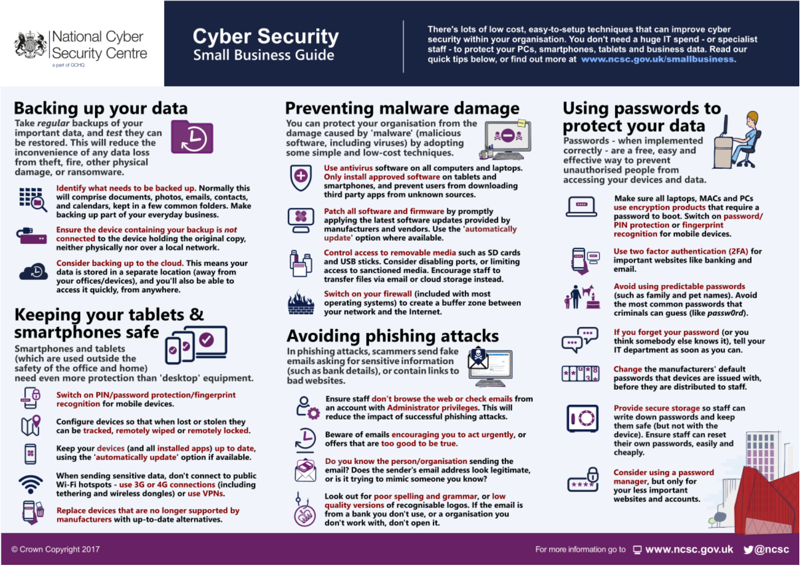
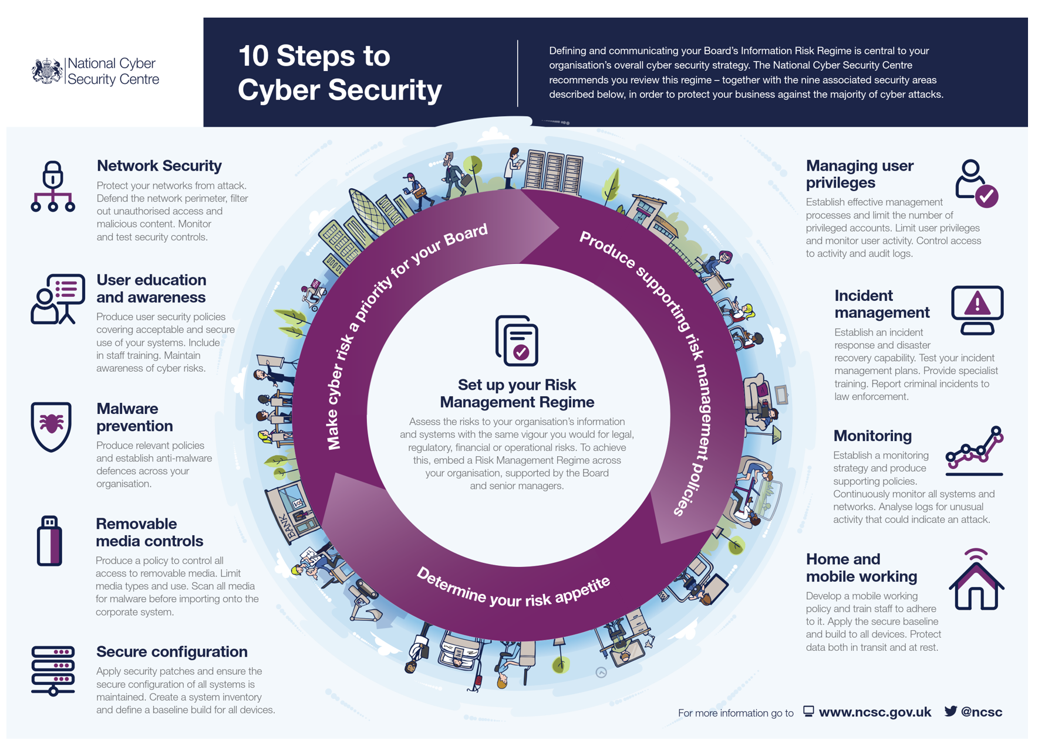
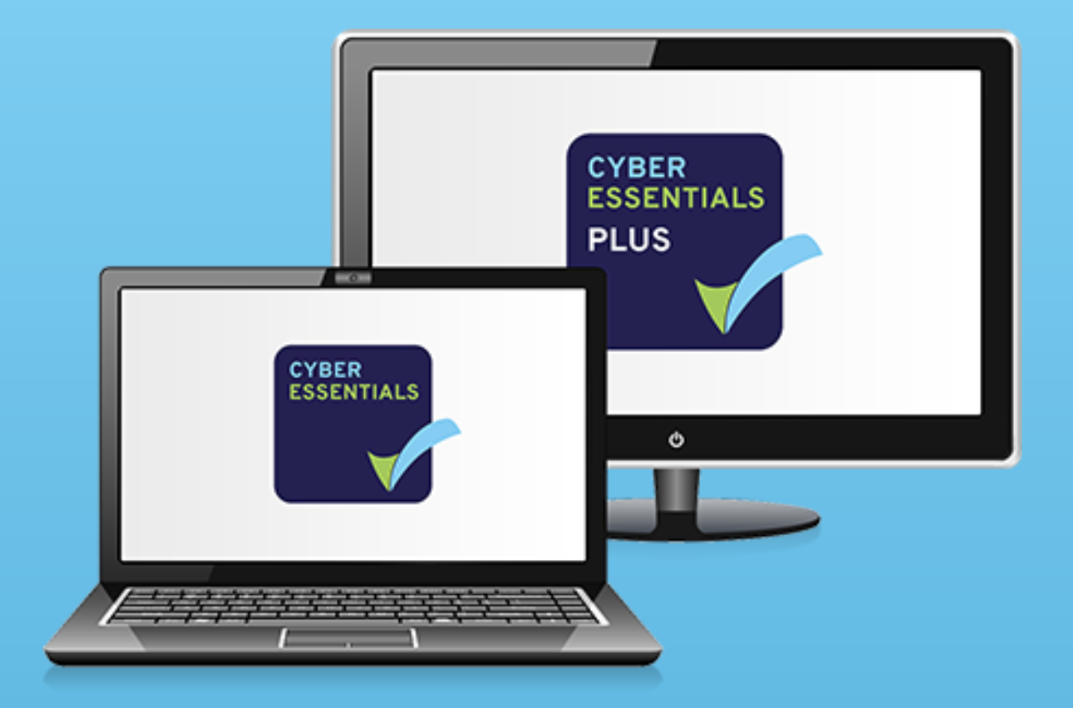
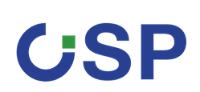
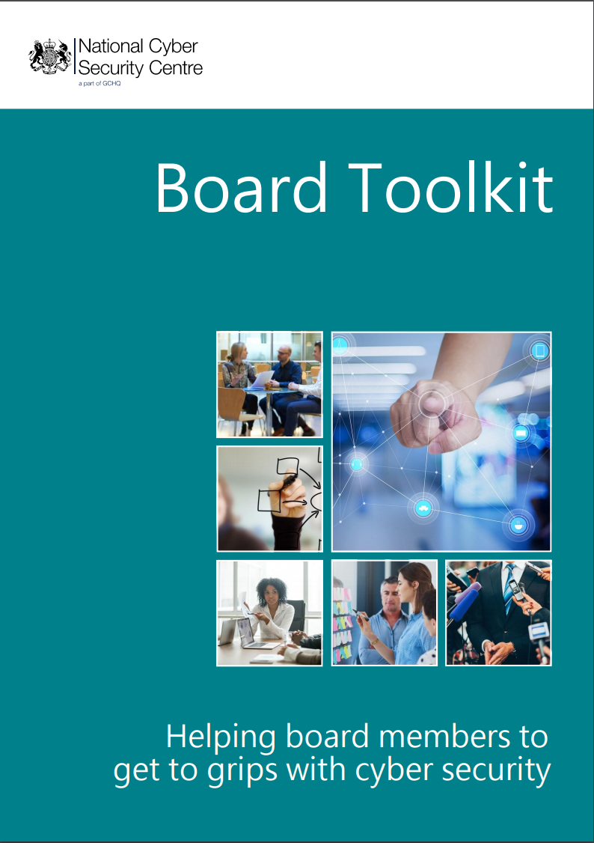
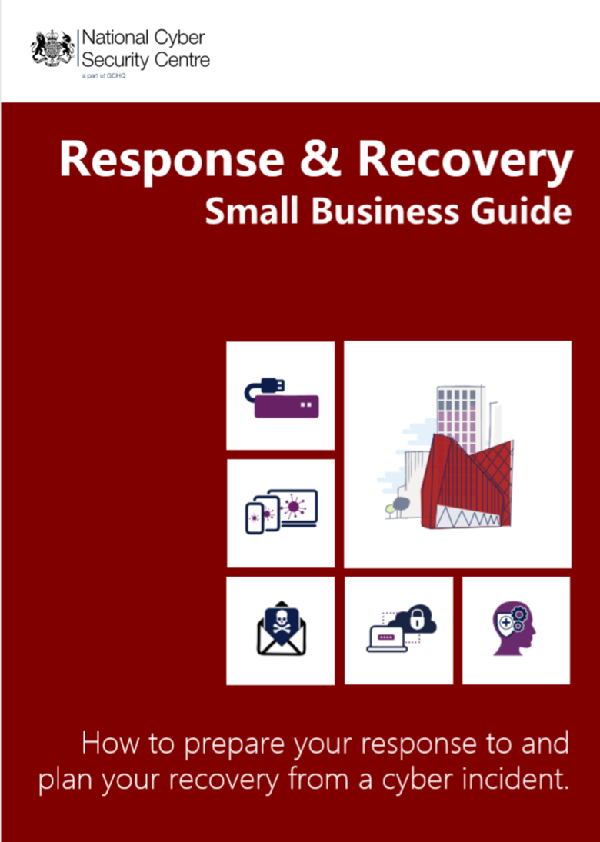
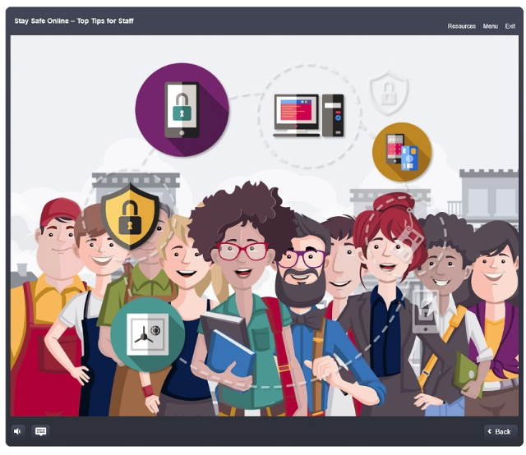
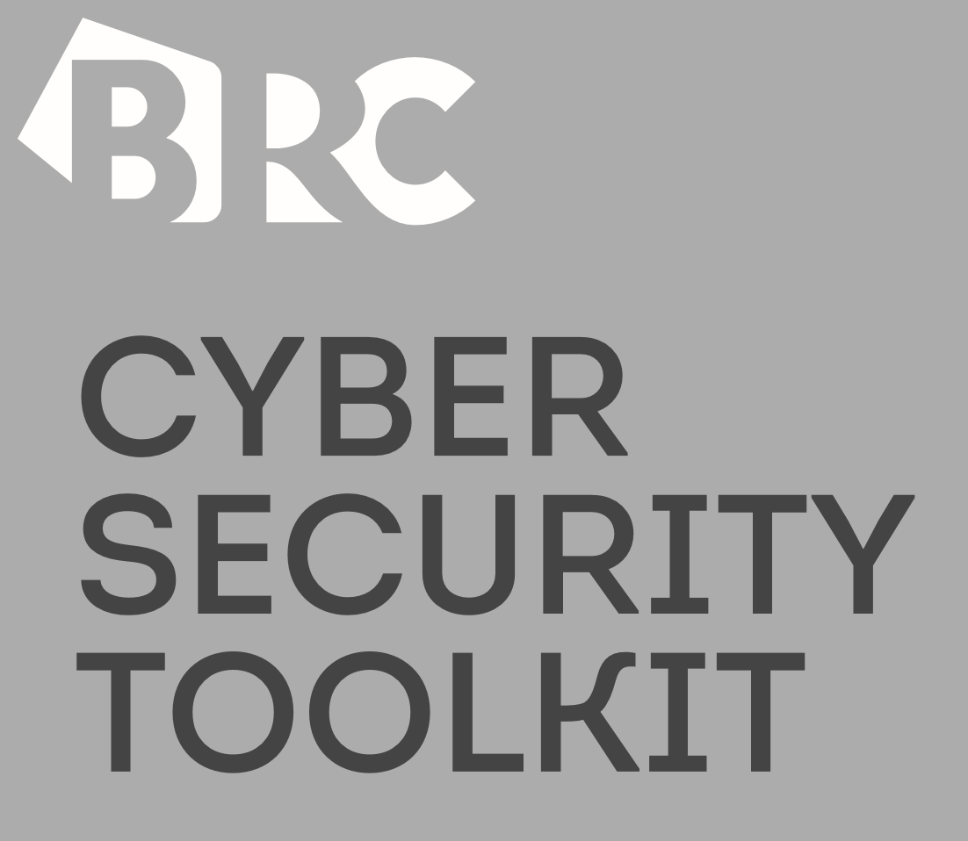



Products & Services
NCSC Website
Small Business Guide
10 Steps
Cyber Essentials (Plus)
Trust Groups
Sector Specific Toolkit
Top Tips for Staff
Board Toolkit
Response & Recovery Small Business Guide
Sector Specific Assessment
Notes:
There is a lot of cyber security advice out there – our role as the National Technical Authority is to provide the lead on practical guidance and advice for the sectors we serve. How we do this:
WEBSITE full of practical advice and guidance:
advice on mitigations for current threats
threat reporting, e.g. weekly summary
links to key products and services, e.g. 10 steps, small business guide
enquiries area where you can get in touch with a question
SMALL BUSINESS GUIDE
Focus on 5 key areas where small businesses can improve resilience. Quick, easy, inexpensive measures.
(SBG: How to Back up your data, Protect your organisation from malware, Keep smartphones and tablets safe, Avoid phishing attacks, Password best practice)
Cyber Essentials
Cyber Hygiene certificate/assurance scheme addresses 5 key controls that, when implemented correctly, can prevent approx. 80% of the most common cyber attacks and shows your clients that you take CS and protection of their information seriously.
Two levels – CE (self assessment, reviewed by an external certifying body) and CE PLUS (same requirements to satisfy but assessment/testing is carried out by external certifying body)
(CE: firewalls, secure configuration, user access control, malware protection and patch management)
10 Steps to CYBER SECURITY
Many principles similar to those outlined in SBG but aimed at larger companies.
Now used by a majority of the FTSE350.
The guidance is designed to help organisations protect themselves in cyberspace. It breaks down the task of defending your networks, systems and information into its essential components and providing advice on how to achieve the best possible security
(10 Steps: Risk Management Regime, Secure configuration, Network security, Managing user privileges, User education and awareness, Incident management, Malware prevention, Monitoring, Removable media controls, Home and mobile working)
CiSP
A safe environment that provides an opportunity for a community of people to engage, share and collaborate on cyber security matters
BOARD TOOLKIT
The NCSC Board Toolkit has been designed to help Board members get to grips with Cyber Security
More on that to follow
Sector specific threat assessment
NCSC produce general and sector-specific assessments on CS threats – weekly threat report
EXERCISE IN A BOX
online tool produced by the NCSC which helps organisations test and practise their response to a cyber attack. It is completely free and you don’t have to be an expert to use it. I’ll show you a few screenshots of the tool next.

Slide 29

Themes & Scenarios
Themes::
Scenarios:
Preventing malware damage
Phishing leading to ransomware
Backing up your data
Mobile phone theft and response
Avoiding phishing attacks
Insider threat Leading to a Data Breach
Using passwords to protect your data
Third party software compromise
Keeping your smartphones and tablets safe.
BYOD
Threatened leak of sensitive data
Unknown Wi-Fi attack
Supply Chain Risks
Home & Remote Working
Technical Scenario
This information is exempt under the freedom of Information Act 2000(FOIA) and may be exempt under other UK information legislation. Refer any FOIA queries to ncscinfoleg@ncsc.gov.uk. All material is UK Crown copyright ©.
Notes:
Here is a list of the current themes and scenarios that are covered in exercise in a box. We have linked the scenarios to NCSC products and guidance and, as this is a live tool that will be continually updated, it means you will always have the latest advice and support. ​
​
​
The attack scenarios we have provided for you are also the most common attacks mentioned in our user research. ​
​
We have expanded EinaB scenarios recently to include Micro exercises – small ‘bite sized’ exercises designed to be mix of learning styles but still aimed at the sector needs.

Slide 30

Is Cyber insurance right for you?
Notes:
At the NCSC, we often get asked about cyber insurance, and how it fits within an organisation’s overall approach to cyber risk.
While we can’t tell you what your exact insurance needs are, we have looked at useful cyber security considerations, and come up with some questions that can help you work out what - if anything - is right for your organisation.
Some of these questions may help you think about what cyber security defences you already have in place, and what you want to protect the most. Most importantly, buying cyber insurance doesn’t mean you no longer have to worry about cyber attacks.

Slide 31
The NCSC’s Early Warning system provides an organisation notifications of threat events against their networks. This may be alerting that a client on the network has joined a botnet, sharing that there is a vulnerable application on an IP address or that an IP address has been seen conducting abusive activities, such as participating in a DDOS.
Notes:
And finally to let you know about a product that NCSC are launching shortly called Early warning scheme. By providing details of the IP addresses and Domain Names that an organisation owns, the NCSC will collate this against many threat intelligence feeds and notify based on the outcome. Early Warning should complement your existing security controls and should not be used in isolation. Keep your eye on the web page for more details.

Slide 32
Q&A
Question during the session
Questions previously summited:
  Our IT system was hacked via email and our IT providers are working on protecting the system. They have told us not to tell anyone, is this correct?
  Our cloud based case management system was attacked. We don’t think the clients are affected, do we need to tell them?
  I know about phishing and ransomware, what new risks are there?
Notes:
Robert to ‘chair’ and read out questions.
Question 1 - Our IT system was hacked via email and our IT providers are working on protecting the system. They have told us not to tell anyone, is this correct?
Answer -Rachel Clements to answer:
No, that is not correct, as we have already mentioned it is important that you inform us and also the ICO and police. It is good that the IT providers are working on preparing the system against future attacks. However, at this point the firm are not aware what level of information the hackers have obtained in terms of client details and bank account details. The firm will also need to make their insurer aware of the attack.
Question 2 -Our cloud based case management system was attacked. We don’t think the clients are affected, do we need to tell them?
David Bish to answer
Similar to the previous answer, we would recommend that you immediately contact the ICO to seek their guidance. Even though the firm ‘thinks’ the clients aren’t affected they can not be certain and therefore need to make them aware their information may be at risk so they can take any necessary precautions. You should ensure that your IT team or provider undertake a full review to establish the level of the attack and the information that may have been compromised. This should them be used to keep your clients (and us) fully informed.
Question 3 – I know about phishing and ransomware, what new risks are there?
Lead into David Bish’s slides

Slide 33


What might be coming?
Deepfakes may become a significant threat
Criminals will find new ways to attack
Notes:
DAVID – draft to be reviewed.
So where do we see cybercrime going in the near future? Once we get past the current Covid-19 situation and the economy begins to recover, cybercrime will start rising along with the markets. But how?
One obvious point is that conveyancing funds in particular will likely always be a major attraction for criminals. It’s the largest financial transaction in most people’s lives, the most common legal service, and only probate comes close in having so much money passing between ordinary people.
While Confirmation of Payee and greater awareness will make email modification fraud harder to commit, criminals will keep trying. We expect we will see new scams targeting legal services, probably still in ways that involve impersonating the parties.
One potential big threat is deepfakes. That’s where people use AI to impersonate someone’s voice, speech patterns, appearance. You see this used where people insert celebrities or historical figures into scenes they were never in – it’s how for example Lucasarts could have a posthumous Peter Cushing appearing in Rogue One. Sadly, it finds criminal uses too. We’ve already seen a case of CEO fraud where one staffer got a call from a partner, apparently from their phone and recognisably with their voice, asking to move money. It was a phishing call, using deepfake technology.
This could go beyond CEO fraud. Any form of phishing will be more effective if criminals can mimic someone’s voice convincingly enough to fool people on a call. If they can mimic their appearance and mannerisms, then this will work on a video call. But think beyond phishing – virtual court hearings have kept the justice system going through the pandemic lockdowns, and will remain a feature even when the lockdowns are long gone. Jury intimidation is already a thing, and likely more dangerous when jurors aren’t physically there. What will happen if criminals can use deepfake technology to replace jurors, and acquit themselves? Or if they can impersonate parties, experts, witnesses? Looking further ahead, it’s worth asking how far this could go. Could we one day find people victimised by fake litigation, in a Kafka-esque labyrinth where everything from the other side to their own lawyer to the judge is a deepfake run by fraudsters?
We may be only seeing the beginning of a new threat.
But at the same time, we’re also seeing awareness spreading. As Robert mentioned, reports we’ve seen have shown firms clearly doing the right thing. People are getting wiser to some of the tricks criminals were using in the past, helping to stop them. As the crimes get more sophisticated, our defences can too. It’s always going to be an arms race, as long as solicitors have money and valuable information for their clients and as long as our computer systems cannot infallibly identify who is who. We’ll keep doing what we can to help you all protect yourselves, your firms and your clients.

Slide 34
Principles for a Cyber Secure Environment
Prepare
Your strategy for future threats
Protect
Your devices with strong passwords and encryption
Patch
Systems regularly to avoid exposing vulnerabilities
Promote
A supportive cyber culture with regular training
Notes:
ROBERT:
Finally If you are at the beginning of your cyber security journey and wondering where you should start …here are four simple principles – or the 4 P’s to focus on :
Prepare - Evaluate your risk areas with a risk assessment and check for any vulnerabilities. First steps include planning for future threats with an incident or contingency plan and maintaining an inventory of systems
Protect –your systems and network by changing passwords regularly and automatically. Restrict error attempts and ensure passwords are complex and cannot be re-used.
Patch systems - update your operating systems, browsers and devices regularly – it is vital to install updates as soon as they are released and always use the latest version.
Promote a no blame cyber culture so that when things go wrong – your colleagues feel confident and motivated to report any concerns to you. Support colleagues with regular training and don’t forget to educate your clients about cyber risks too.
Planning and testing your response to a disaster could help your firm limit the impact of an attack and recover more quickly.
I would like to conclude by thanking all our speakers today and just remind you that if you would like to learn more about our findings, please have a look at our thematic report and the new toolkit published today. Use the checklist and ask yourself how prepared you are to respond to a catastrophic loss of data and how quickly you would be able recover and resume your business after disruption?
You can also get further information on how to protect your firm by reading the NCSC’s guidance.
We hope you have enjoyed the session and would appreciate it if you can provide feedback by clicking on the link in the comments box.
Our final session in our Compliance week will be 13.30 tomorrow on ‘Better information’ when you can find out what our one-year review of our transparency rules has found.
Thank you and goodbye

