Slide 1
The SQE: what it means for law firms
Julie Brannan,
Director of Education and Training

Slide 2
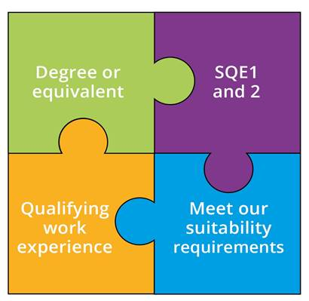
The SQE – a reminder
A single, robust, examination all aspiring solicitors will have to take
To be introduced on 1 September 2021; details of the transition to SQE are on our website
Everyone will meet the same high standards in a consistent way
We will no longer specify routes to admission as a solicitor
Notes:
SQE 2 only after passing SQE 1

Slide 3
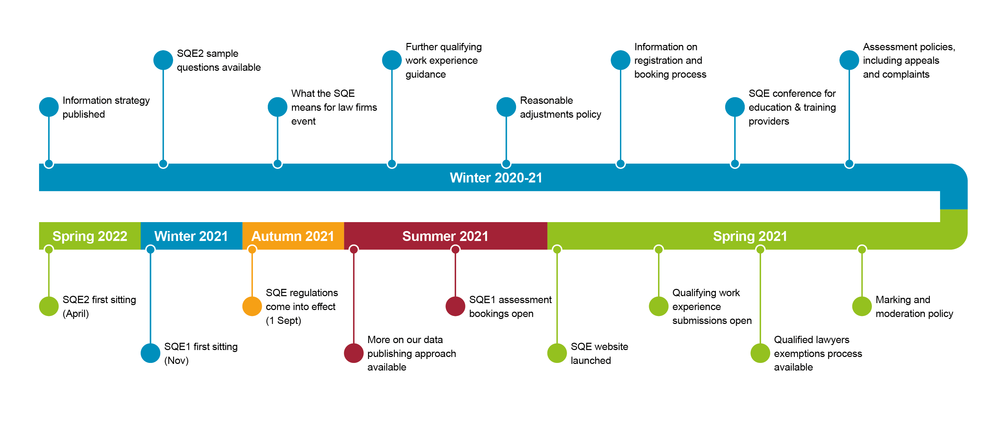
What’s next?

Slide 4



Action for us all
Joint responsibility to take action to realise SQE benefits:
    ‘Increasing diversity in the profession is dependent critically on the actions of employers and training providers, with actions by the SRA likely to achieve only modest gains without corresponding action from stakeholders in the sector.’
    Bridge Group
    Employers who currently employ trainees can now recruit from different talent pools and qualification routes
    Employers who don’t currently employ trainees might want to think about whether they can offer qualifying work experience
  We want to collaborate with firms and training providers. Tell us what support you would find helpful: sqe@sra.org.uk

Slide 5



What’s already happening?
Variety and choice in solicitor training:
  Traditional delivery, or online courses, or integration between classroom and work-based learning
  Short focused courses or additional learning
  The trainee or apprenticeship or paralegal models
Closer collaboration between traditional universities and providers of professional legal education and/or law firms
New entrants to the market
Price competition

