Slide 1
Performance by practice area
Lisa Coombes, Director of Psychometrics and
Assessment Development, Kaplan

Slide 2
Performance by practice area
Each assessment has common areas
Based on the assessment blueprint
Outline the range and scope of the assessment
These are grouped and analysed together
We publish information on performance after each assessment, for both SQE1 and SQE2

Slide 3
SQE1 – FLK1
High scores observed in Ethics
(69% and 73.4%)
And in Contract Law
(65.5% and 70%)
Low scores observed for Business Law & Practice
(49.6% and 58.5%)
And in Dispute Resolution
(52.6% and 55.8%)

Slide 4
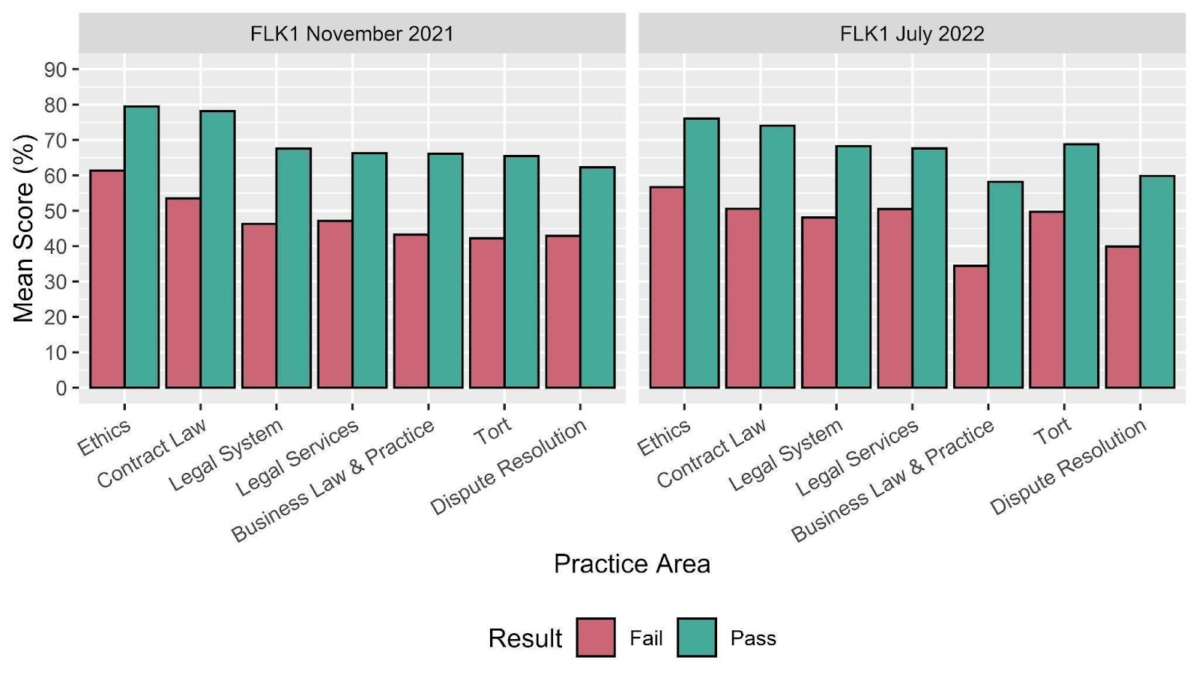
SQE1 – FLK1

Slide 5
SQE1 – FLK2
High scores observed in Ethics
(65.1% and 74.8%)
And in Criminal Liability
(58.8% and 71.8%)
Low scores observed for Property Practice
(46.4% and 48.3%)
And in Wills & Intestacy
(50.7% and 55.6%)

Slide 6
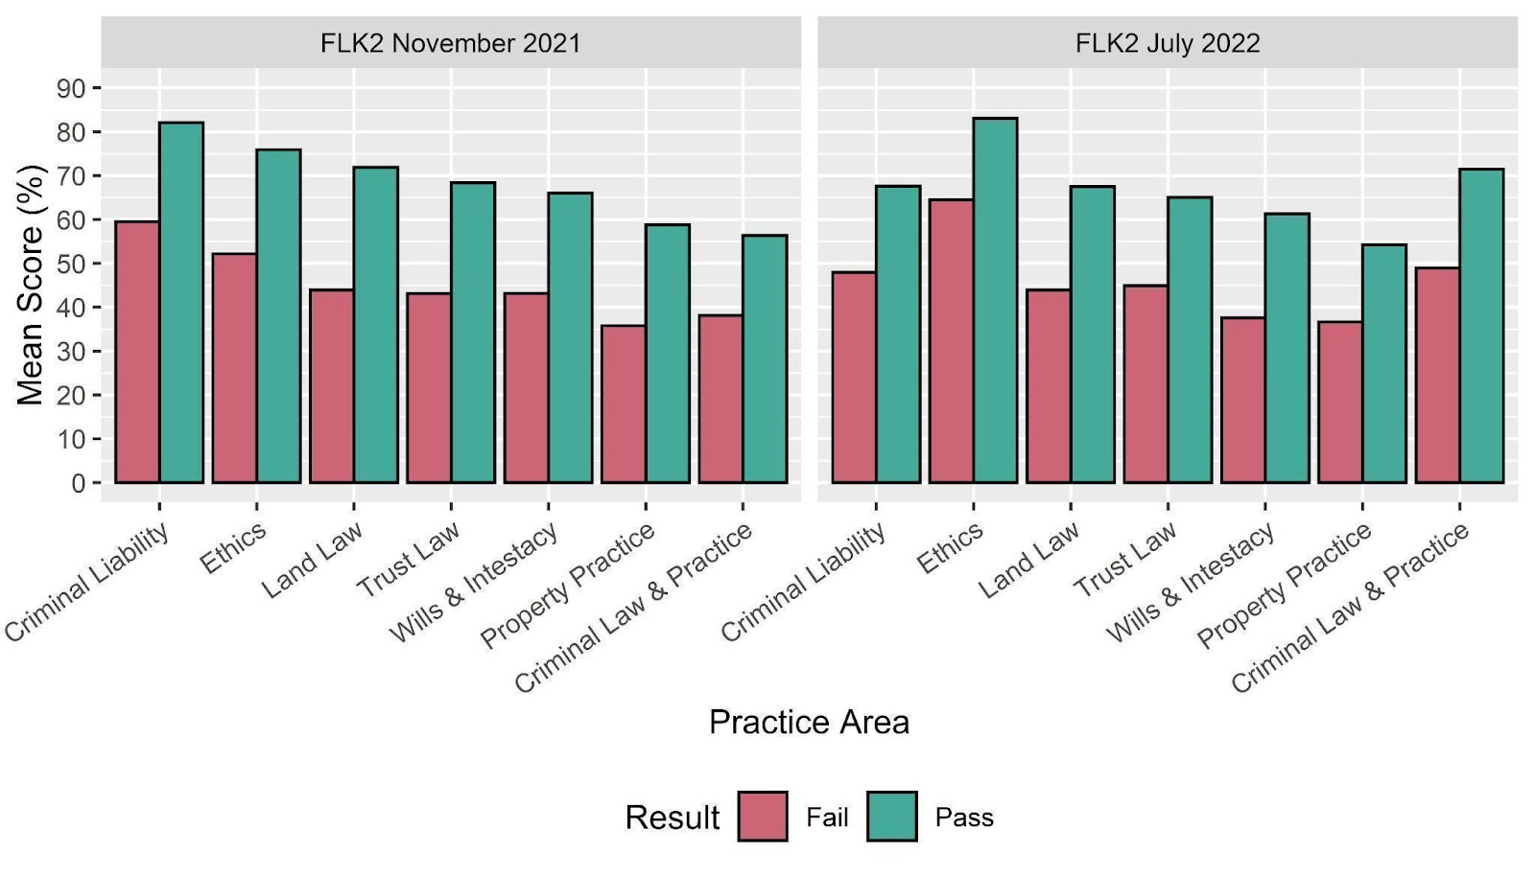
SQE1 – FLK2

Slide 7
SQE1 – Quintile Plots (Jul 22)

Slide 8
SQE2
High scores observed in:
Legal Research - Dispute Resolution (85.0%)
Advocacy - Criminal Litigation (78.5%)
Case and Matter Analysis - Business (78.3%)
9 scored above 70% incl all four oral stns
Lowest mean score Legal Writing - Dispute Resolution (57.0%) which was the only mean score below 60%

Slide 9
SQE2 – April22 written stns

Slide 10
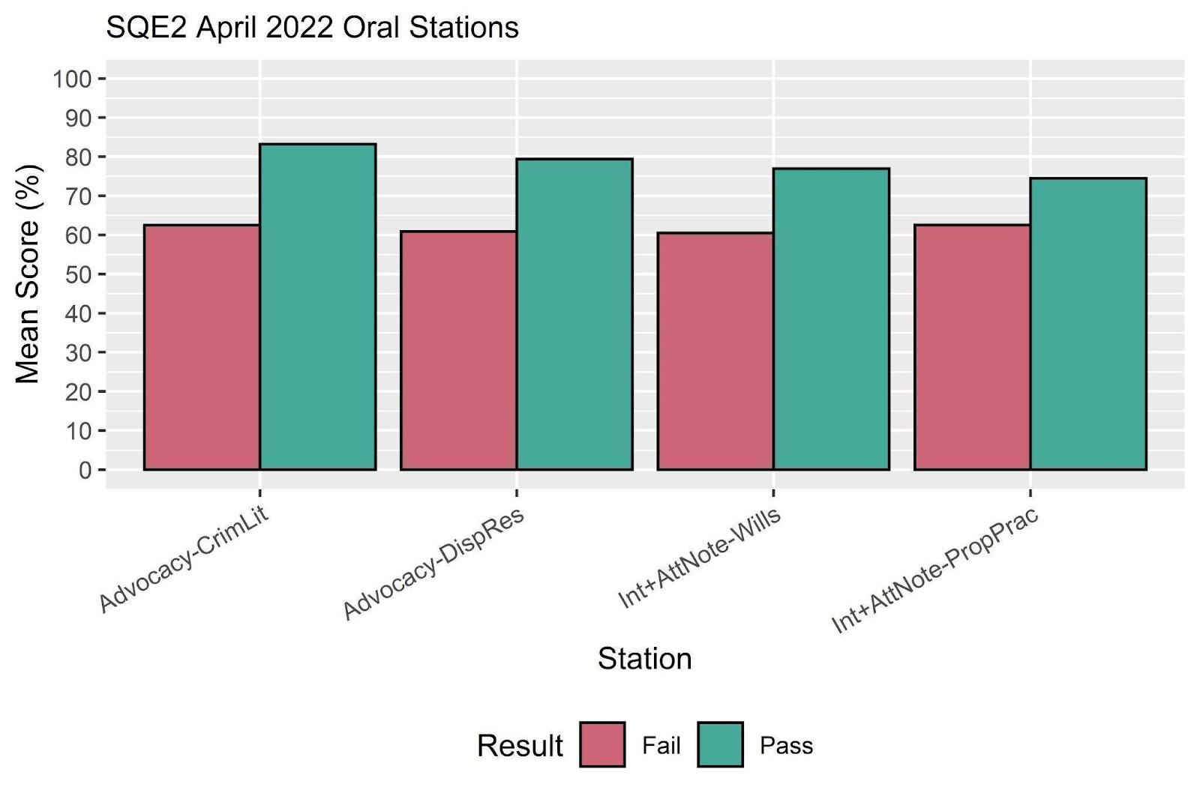
SQE2 – April22 oral stns

Slide 11
SQE2
Within each of the five practice areas there is a range of mean scores
Failing mean scores follow different pattern to the passing candidates

Slide 12
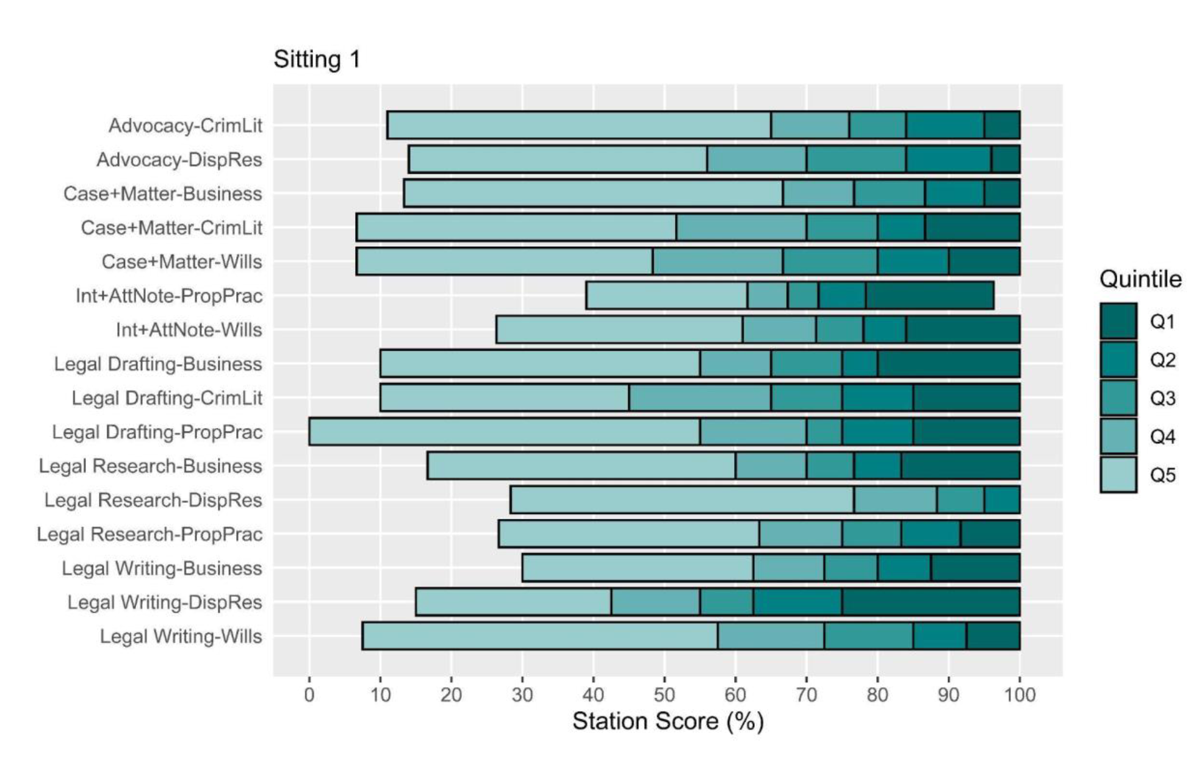
SQE2 – Quintile Plots (Sitting 1)

Slide 13
Conclusions
Detailed analysis made available post-test
Provides insight into which areas are performing well and which are not
This can help guide revision practice and show effectiveness of interventions
More tests = more data = stronger interpretations

