Slide 1
The SQE:
Qualified lawyers and overseas students
Julie Brannan, Director of Education and Training
Ben Fisher, Head of External Communications

Slide 2
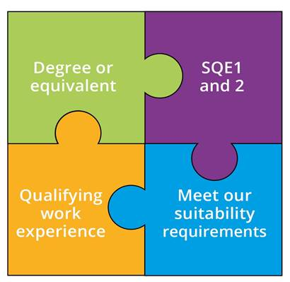
The SQE
Notes:
SQE 2 only after passing SQE 1

Slide 3


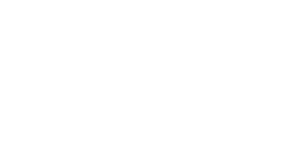
Current QLTS candidates
If you have passed QLTS part one (multiple choice) before 1 September 2021 you can choose:
  Pass QLTS part two (OSCE) + apply for admission by 31 August 2022; or
  Pass SQE2 + apply for admission by 31 August 2023
If you have not passed QLTS part one before 1 September 2021, or are fully exempt – you are not in the QLTS transitional cohort
SQE

Slide 4

Foreign qualified lawyers in future
Qualified lawyer – someone with a professional legal
qualification and practice rights
To qualify in England and Wales, you must:
  Pass SQE1 and 2
  Meet our character and suitability requirements
No work experience requirement
Can apply for exemptions
Possible language test for candidates with SQE exemptions

Slide 5

Overseas students and trainees
Overseas degree will usually count – we will check
You can get QWE overseas – needs to be signed off by a COLP or other solicitor of England and Wales
SQE1 available to sit internationally, availability will evolve with demand
SQE2 written assessments available internationally
SQE2 oral assessments only available in England and
Wales

Slide 6
CILEx members
You could still qualify through the current LPC route if you have
accepted an offer to start an LPC or QLD, before 1 September 2021 – see exact details on our website
To qualify through the SQE you will need:
  Degree or CILEx level 6 qualification
  CILEx work experience will likely count
  Pass SQE1 and 2
  Character and suitability
SQE

Slide 7


Barristers
For qualified lawyers route, need to have completed pupillage
and have practice rights
Already have a degree
Experience at the bar likely to count
You will also need:
  Pass SQE1 and 2 – unless you have exemptions
  Character and suitability
SQE

Slide 8


Exemptions
Qualified lawyers can apply from exemptions
Must demonstrate that qualifications and/or experience are equivalent
in content and standard to the SQE
Exemptions can only be granted for the whole of:
  SQE1 paper one
  SQE1 paper two
  SQE2
SQE

Slide 9



Keep in touch
Send your
queries to sqe@sra.org.uk
SQE resources
sra.org.uk/
becomingasolicitor
Subscribe to our monthly
SQE Update

