Slide 1
The SQE2 assessment
Julie Brannan, SRA
Eileen Fry, Kaplan

Slide 2
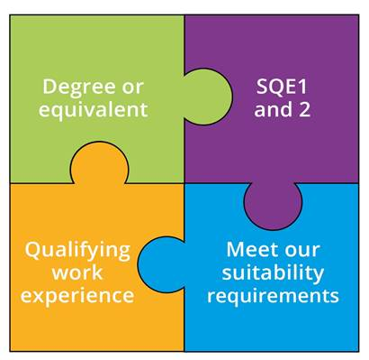
What is the SQE?
Two parts to SQE:
SQE1 – Test of functioning legal knowledge
SQE2 – Practical legal skills assessments
You must pass SQE1 before you can attempt SQE2

Slide 3







SQE2
Practical legal skills assessments
+
16 written and oral tests - 14 hours in total
Simulating tasks carried out by
a day one solicitor in practice
Tests practical legal skills and application of law equally
Unflagged ethics questions throughout

Slide 4


SQE2
Practical legal skills assessments
Six skills assessed
    Client interviewing and attendance note
    Advocacy
    Case and matter analysis
    Legal research
    Legal writing
    Legal drafting
Across five contexts
Criminal Litigation
Dispute Resolution
Property Practice
Wills and Intestacy, Probate
Administration and Practice
Business organisation rules and procedures

Slide 5
SQE2 Oral
Four assessment tasks over two half-days:
Day 1 | Day 2
Advocacy (Dispute Resolution) | Advocacy (Criminal Litigation)
Interview and attendance note/legal analysis (Property Practice) | Interview and attendance note/legal analysis (Wills and Intestacy, Probate Administration and Practice)

Slide 6
SQE2 Written
12 assessment tasks over three half-days
Day 1 | Day 2 | Day 3
Case and matter analysis x1 | Case and matter analysis x1 | Case and matter analysis x1
Legal drafting x1 | Legal drafting x1 | Legal drafting x1
Legal research x1 | Legal research x1 | Legal research x1
Legal writing x1 | Legal writing x1 | Legal writing x1
Two of these exercises will be in the context of Dispute Resolution and two will be in the context of Criminal Litigation | Two of these exercises will be in the context of Property Practice and two will be in the context of Wills and Intestacy, Probate Administration and Practice | Candidates will sit all assessments in the context of Business Organisations, Rules and Procedures

Slide 7
How is SQE2 marked
For each assessment task candidates are marked according to the assessment criteria for that task
Marks for each station are added together to get the candidate’s total mark
In order to pass candidates must obtain the overall pass mark for SQE2
The overall pass mark is set at the level of a just competent day one newly qualified solicitor

Slide 8
SQE2 sample questions
Visit sra.org.uk/sqe2-sample-questions
Read in conjunction with the assessment specification
Contain:
  Question and additional candidate papers
  Discussion of answer
Give an indication of the type of tasks. Do not represent all the material that will be covered. Future questions may not take exactly the same format.

Slide 9
Preparing for SQE2
We don’t specify particular preparation. But work experience, training or a combination of the two can help.
Qualifying work experience can be obtained in any legal sector or practice area: important to focus on the skills you are developing. Check against the Statement of Solicitor Competence
If you work in an area not assessed in SQE2, you may wish to take top up training to refresh your legal knowledge or understand how the skills apply in those contexts

Slide 10
Where is the detail?
SQE2 Assessment Specification
SQE2 sample questions
Visit sra.org.uk/sqe2-assessment
Watch sra.org.uk/sqe-conference-2020

Slide 11




Sitting SQE2
First sitting April 2022. Two sittings per year – will grow to meet demand
Written tests – available in England and Wales, wider UK and internationally at Pearson VUE centres
Oral skills – available in London, Manchester and Cardiff; expanding to five centres over time
Assessment fee - £2,422

Slide 12




Keep in touch
Send your queries to sqe@sra.org.uk
Join our SQE LinkedIn group
Monthly SQE
Update bulletin sra.org.uk/sqeupdate
SQE resources sra.org.uk/sqe

