Slide 1
Transitional arrangements for students, graduates and trainees
Julie Brannan, Director Education and Training
Benedict Fisher, Head of External Communications

Slide 2
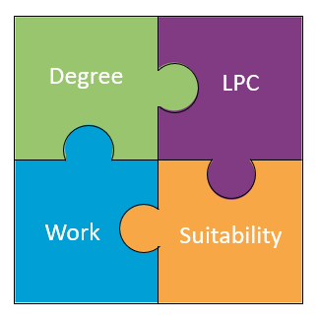
How people qualify now
Degree/ conversion

Slide 3
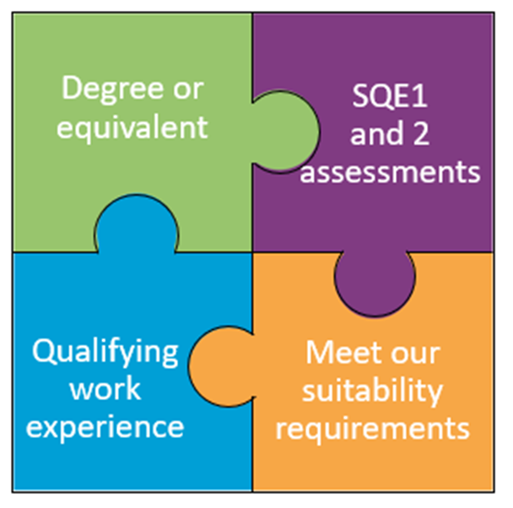
The SQE

Slide 4
Who can carry on the current route?
Must have completed, started or accepted an offer to start by the following dates:
1 September
Law conversion (CPE/GDL)
LPC
Period of recognised training (training contract)
21 September
Law degree
Notes:
Sign off to confirm completion of QWE, not to assess that standard has been met
Focus on developing the competences in the Statement of Solicitor Competence

Slide 5
Law degree and law conversion
If accepted an offer, must start the course by 31 December 2021
More flexibility if deferred entry (or for a law conversion, if you have an offer of a training
contract) – have until 31 August 2022 to start
Notes:
Sign off to confirm completion of QWE, not to assess that standard has been met
Focus on developing the competences in the Statement of Solicitor Competence

Slide 6
Legal Practice Course (LPC)
If have - or accepted an offer to start - an LPC before1 September 2021, you have a choice
Can’t get a training contract? If you have 2 years’ qualifying work experience, can just take SQE2
SQE
Notes:
Sign off to confirm completion of QWE, not to assess that standard has been met
Focus on developing the competences in the Statement of Solicitor Competence

Slide 7
Trainees
Already a trainee or due to start a training contract before 1 September 2021?
Then you can qualify as a solicitor through the current route up until 31 December 2032

Slide 8
Keep in touch
Send your
queries to sqe@sra.org.uk
SQE resources
sra.org.uk/
becomingasolicitor
Subscribe to our monthly SQE Update

